Slide 1
STEAR: Robust Step Counting
from Earables
Jay Prakash,
Zhijian Yang, Yu-Lin Wei and Romit Roy Choudhury
University of Illinois at Urbana Champaign
Notes:
Today I will be sharing our recent finding from one of the works exploring emmerging opportunities from introduction of Earables. This work particualry focuses on precise step cputing and jump anakysis through earables, STEPS through Earables hence STEPEAR: STEAR I am Jay a visting research student at UIUC.

Slide 2
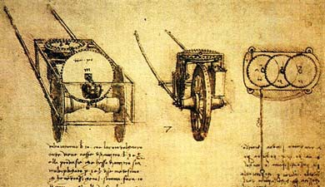
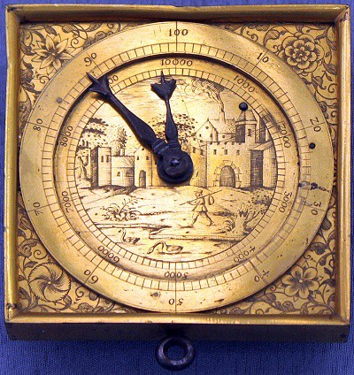
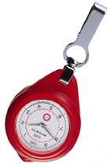
Step Counter (History)
Counts the number of steps a human has walked
A valuable human-sensing primitive
15th century: Leonardo Da Vinci, Roman soldier’s walking distance.
1780: Swiss watchmaker
1985: Y. Hatano → 10,000 steps is important, first commercial pedometer
Notes:
Step counting has been a valuable human sensing primitive for years. The history goes back, not so surprisingly, to Leonardo da vinci for conceptualising. Furhter modified by swiss match maker. But commericalisation and association with health benefit goes to ajapanese researchers. 10000 steps as a good benchmark for healthy life style, caloric intake and energy burnout

Slide 3
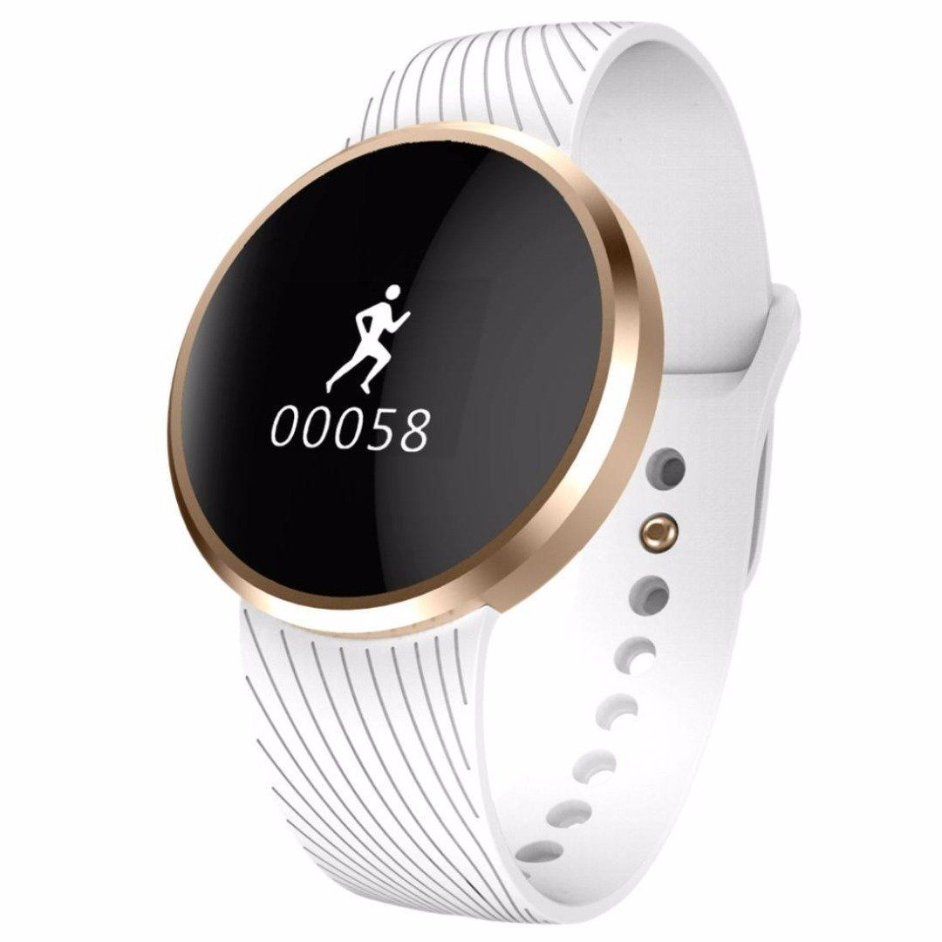
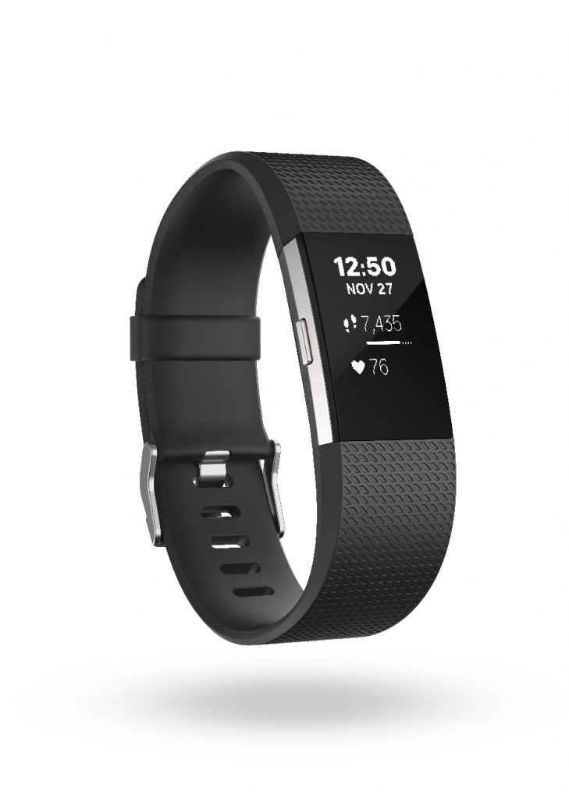
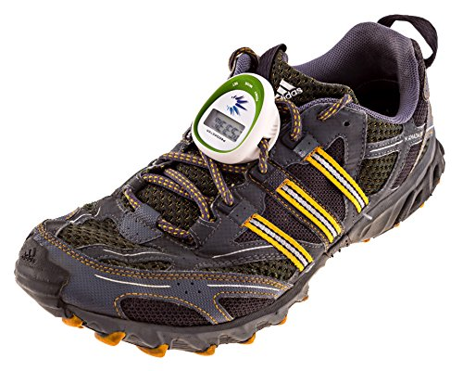
Step Counter (Today)
Smartphones, smart-watch, Fitbit, dedicated wearables
Notes:
Step counting has been a valuable human sesniting primitive for years

Slide 4
Step Counter (Today)
Smartphones, smart-watch, Fitbit, dedicated wearables
Many Applications
Health and well-being: Calorie, injury, rehabilitation
Navigation: Indoor localization, augmented reality
Activity profiling: Sports analytics
Notes:
Step counting has been a valuable human sesniting primitive for years

Slide 5
Step Counter Today: How?
Walking motion sensed by IMU (mainly accelerometer)
Walking causes up/down bounce
Bounce causes sinusoidal motion in IMU

Slide 6
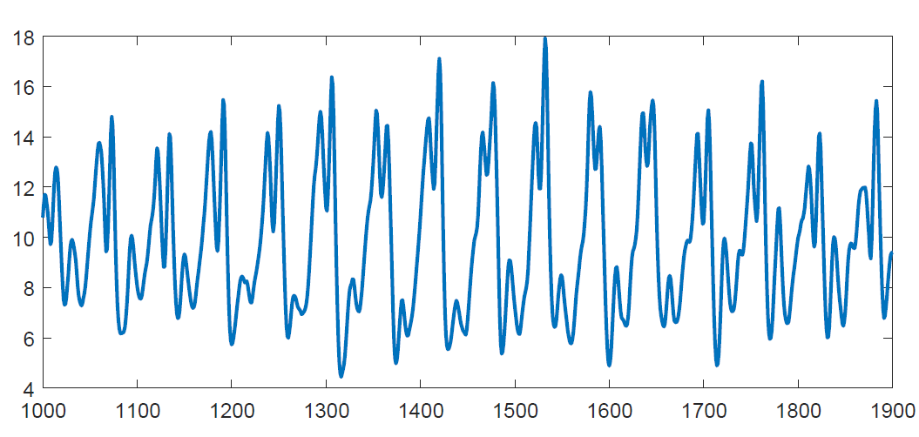
Step Counter Today: How?
Walking motion sensed by IMU (mainly accelerometer)
Walking causes up/down bounce
Bounce causes sinusoidal motion in IMU
IMU Accelerometer Data
Acceleration
Time (samples)

Slide 7
So what is the problem today?
IMU Accelerometer Data
Acceleration
Time (samples)

Slide 8
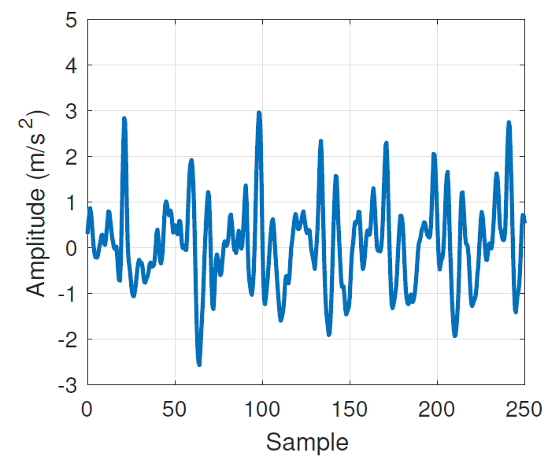
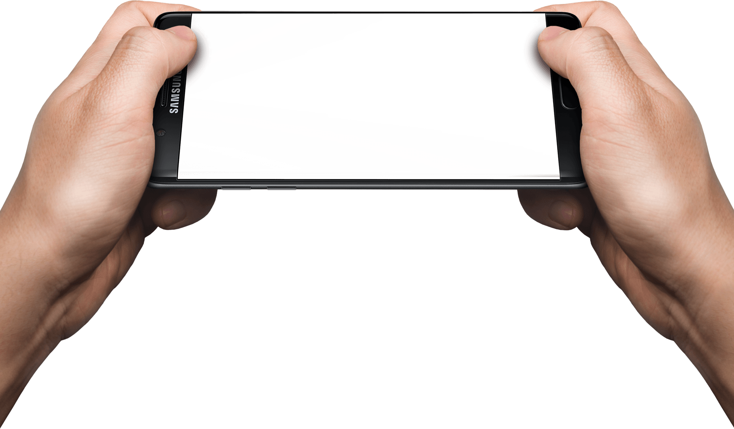
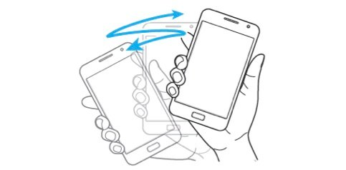
So what is the problem today?
Phone/watch IMU senses the sum of walking signal + gesture interference
Acceleration
Time (samples)

Slide 9
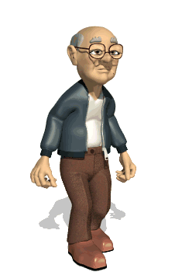
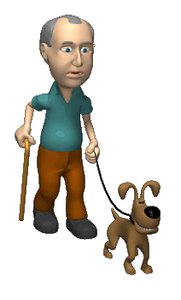
So what is the problem today?
Phone/watch IMU senses the sum of walking signal + gesture interference
Problem is worse when user walks slow

Slide 10
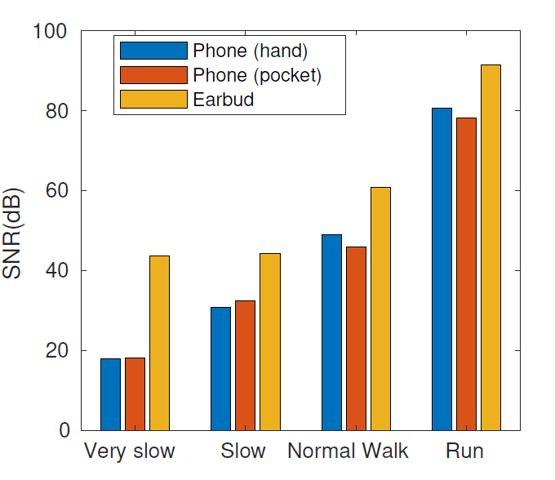
So what is the problem today?
Phone/watch IMU senses the sum of walking signal + gesture interference
SNR decreases for slow
and soft steps
SNR (dB)

Slide 11
Net Result across Users, Scenarios …
Error in ideal walk = 3%
Step Count error
goes up to 90%
Step Accuracy (%)

Slide 12
Slow walk step count is essential
Analysis of slow walk is critical for
old adults and
medical recoveries from joint impairments/fractures…
Notes:
Give a demo here

Slide 13
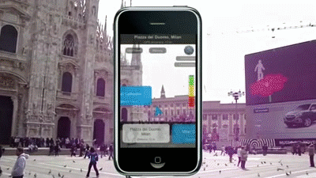
Slow walk step count is essential
A very precise count of small step is crucial for augmented reality applications

Slide 14
Can we improve step count?

Slide 15
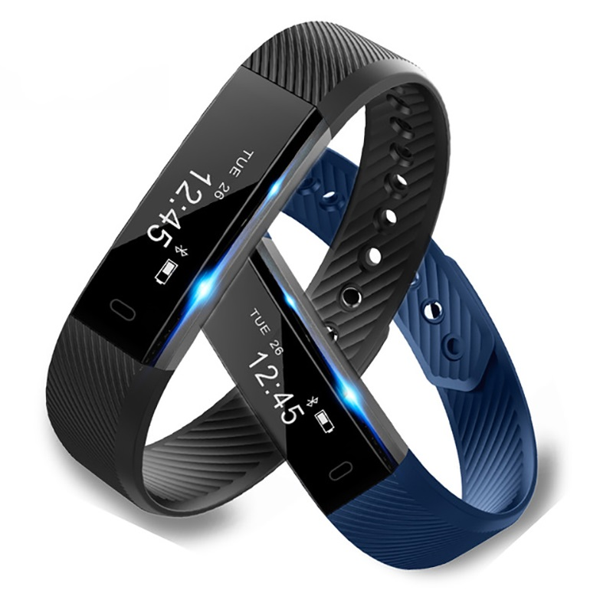
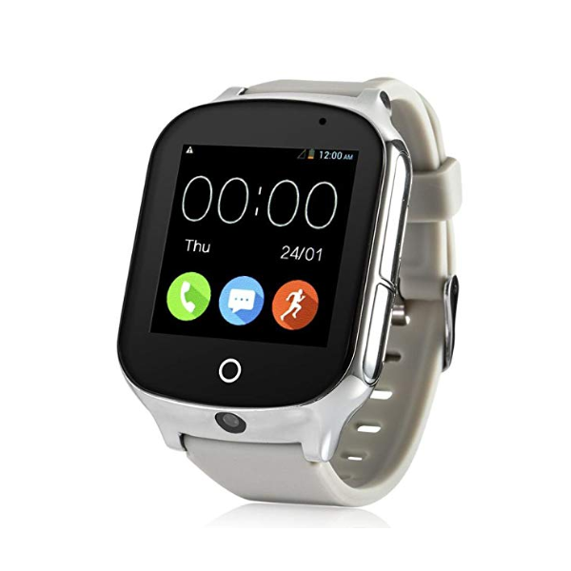
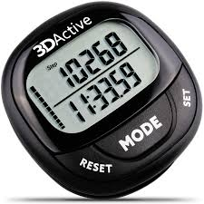
Observation …
Lower body

Slide 16
Observation …
Introduction of earbuds with sensing and computing capabilities, like Esense.
Lower body

Slide 17
Can we leverage IMU in earables?
Lower body

Slide 18
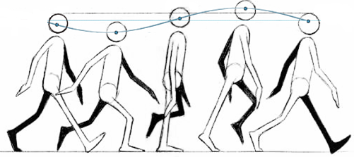
Key Opportunity: Body is a “Filter”

Slide 19
Key Opportunity: Body is a “Filter”
Interference from arms, legs, device filtered by the time signal propagates up to the ear …

Slide 20
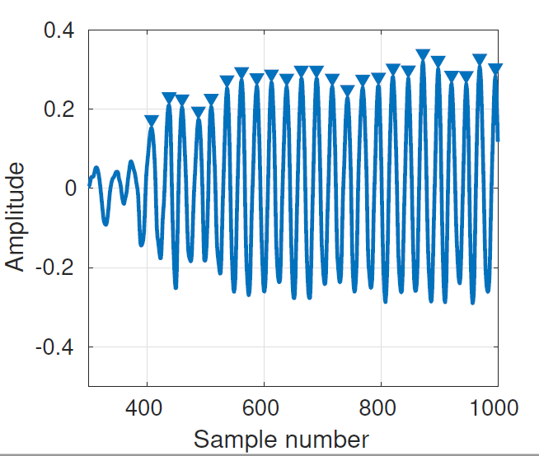
Key Opportunity: Body is a “Filter”
Interference from arms, legs, device filtered by the time signal propagates up to the ear …

Slide 21
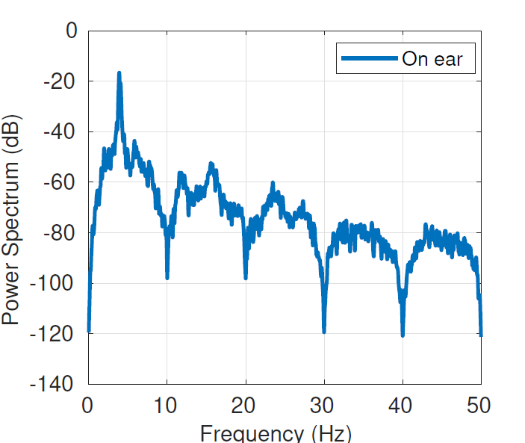
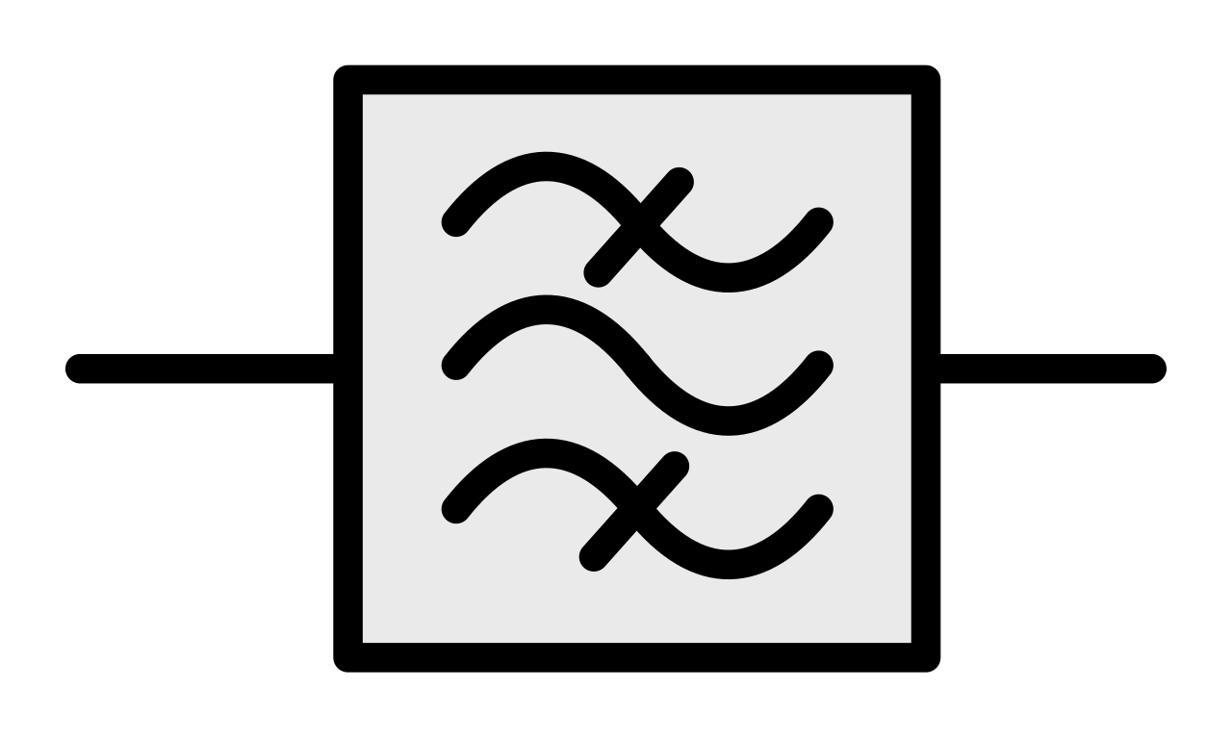
Key Opportunity: Body is a “Filter”
Sinusoidal, up and down motion of head, dominates the observed spectrum of IMU acceleration

Slide 22
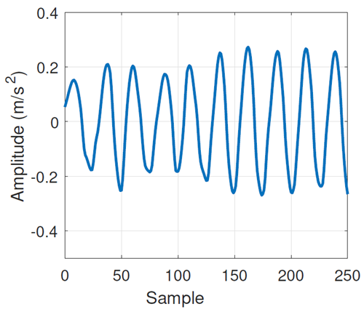
Validation
For same activity, a slow walk, IMUs on ear give much cleaner signal
Smartphone
Earbud on ear: Esense

Slide 23
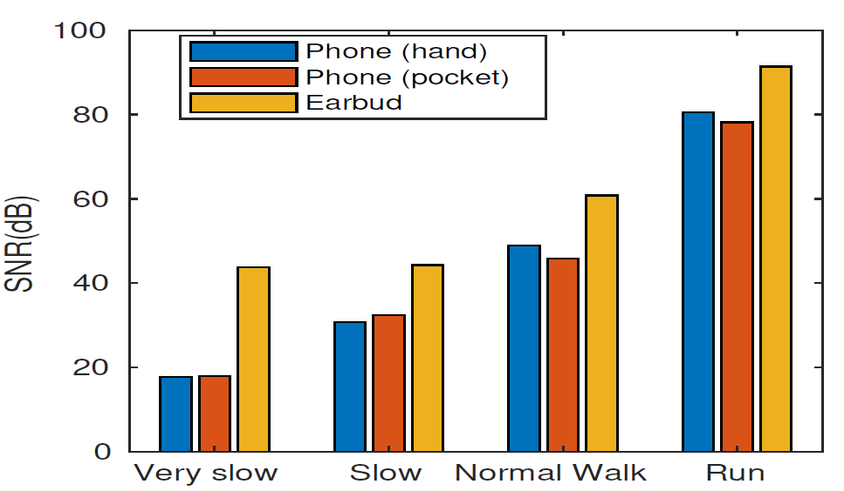
Validation
IMUs on ear give better SNR for slower walks

Slide 24
Challenges?
Head motions might corrupt IMUs reading of earbud
Variations in human gait: Cultural, demographic, physical abilities

Slide 25
STEAR
Precise Step Count
Jump Analysis
Accommodate different modes of steps/walking
Jump height estimation
Notes:
tree

Slide 26
Why did PGP fail?
STEAR Design
IMU data
Step
count
Pre-Processing
Global Projection
Filtering
Step segmentation
DTW matching
Anomaly filter & Counter
Jump height
Pre-processing
Sensor calibration
Gyroscope bias cancellation
Notes:
Slide #13 - #17 look really good.

Slide 27
Why did PGP fail?
STEAR Design
IMU data
Step
count
Pre-Processing
Global Projection
Filtering
Step segmentation
DTW matching
Anomaly filter & Counter
Jump height
Global Projection and Filtering
Projecting IMU reading to global frame
Z: Outward
Y: Front
3D Orient.
IMU (Global)
IMU (Local)
[Local]
$$∆_{R}$$
X: Right
$$\left[R\right]\left[\begin{matrix}a_{x} \\ a_{y} \\ a_{z}\end{matrix}\right]=\left[\begin{matrix}0 \\ 0 \\ −g\end{matrix}\right]$$
Notes:
Slide #13 - #17 look really good.

Slide 28
Why did PGP fail?
STEAR Design
IMU data
Step
count
Pre-Processing
Global Projection
Filtering
Activity segmentation
DTW matching
Anomaly filter & Counter
Jump height
Segmentation
Why? Peak-detection are erroneous:
unrelated movements
diversity in positions of phones
diversity on gaits
Notes:
Slide #13 - #17 look really good.

Slide 29
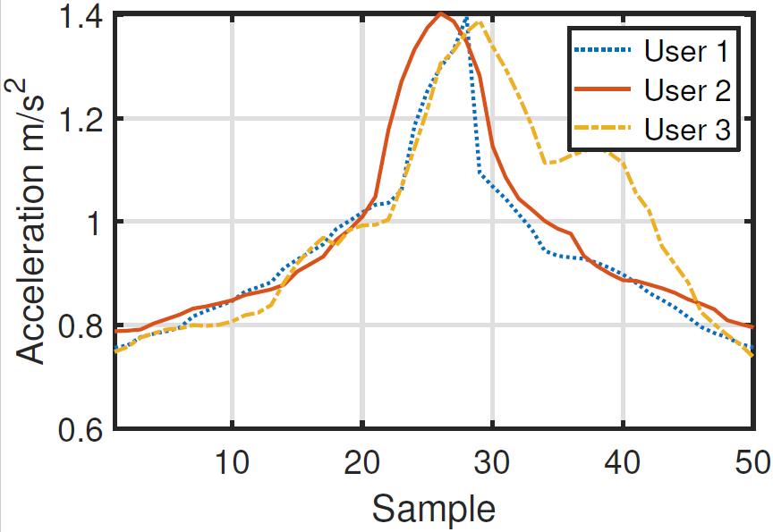
Why did PGP fail?
STEAR Design
IMU data
Step
count
Pre-Processing
Global Projection
Filtering
Activity segmentation
DTW matching
Anomaly filter & Counter
Jump height
Segmentation
Earbud’s IMUs: Consistent activity templates
Notes:
Test abd train

Slide 30
Why did PGP fail?
STEAR Design
IMU data
Step
count
Pre-Processing
Global Projection
Filtering
Step segmentation
DTW matching
Anomaly filter & Counter
Jump height
Dynamic time warping (DTW) matching
Matching segments with activity templates
Notes:
Slide #13 - #17 look really good.

Slide 31
Why did PGP fail?
STEAR Design
IMU data
Step
count
Pre-Processing
Global Projection
Filtering
Step segmentation
DTW matching
Anomaly filter & Counter
Jump height
Dynamic time warping (DTW) matching
Matching segments with activity templates
Benefits:
Gait and person-to-person variations: template compression or expansion
Robust again spurious peaks and noisy false positives
Notes:
Slide #13 - #17 look really good.

Slide 32
Why did PGP fail?
STEAR Design
IMU data
Step
count
Pre-Processing
Global Projection
Filtering
Step segmentation
DTW matching
Anomaly filter & Counter
Anomaly filter and step-counter
DTW score + threshold: Activity classification
Notes:
Slide #13 - #17 look really good.

Slide 33
Why did PGP fail?
STEAR Design
IMU data
Step
count
Pre-Processing
Global Projection
Filtering
Step segmentation
DTW matching
Anomaly filter & Counter
Jump height
Anomaly filter and step-counter
DTW score threshold: Activity classification
Threshold : $2σ/3$
Notes:
Slide #13 - #17 look really good.

Slide 34
Lets see how Step Count performs?

Slide 35
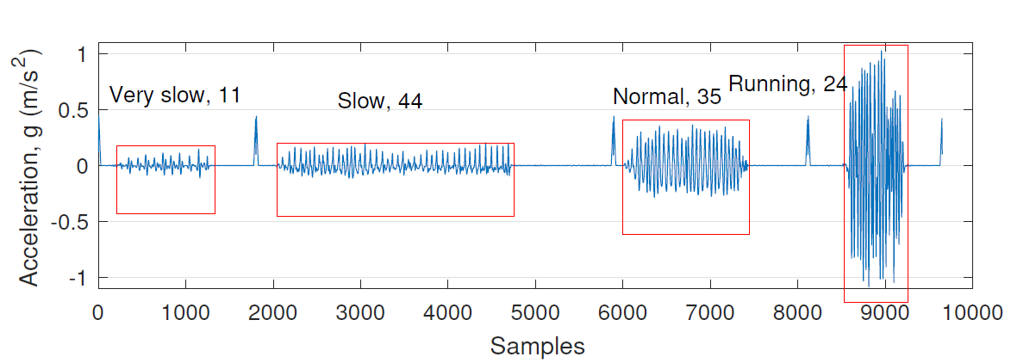
Why did PGP fail?
Step Count Evaluation
Vivid difference between different modes of walking

Slide 36
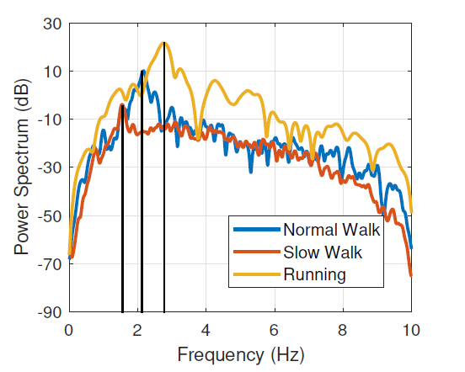
Why did PGP fail?
Step Count Evaluation
Opportunity of walking mode and activity profiling

Slide 37
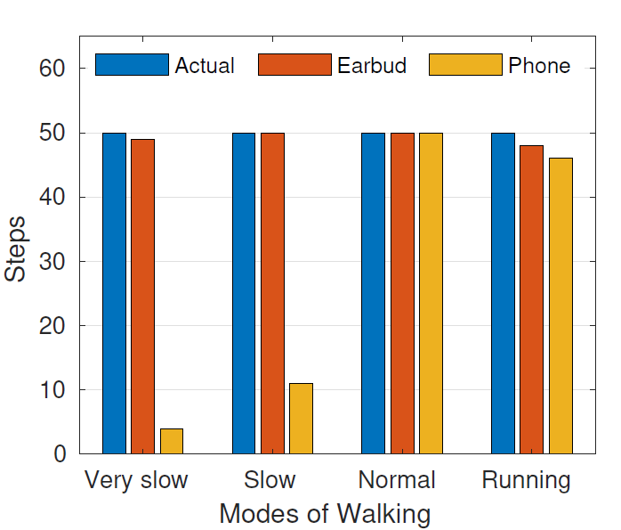
Why did PGP fail?
Step Count Evaluation
Outperforms smartphone for slower modes of walking
Error in walk < 5%
Very slow > 95%
Slow > 98%

Slide 38
How do we calculate Jump height?

Slide 39
How do we calculate Jump height?
IMU data
Pre-Processing
Global Projection
Filtering
Step segmentation
DTW matching
Height estimation
Jump height
$$h$$

Slide 40
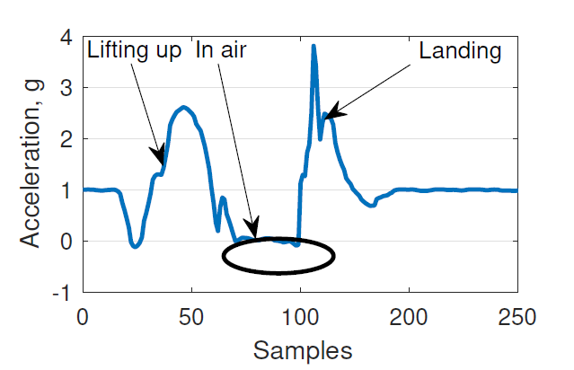
Why did PGP fail?
Jumping Observation
Opportunity: mid-air $α→0$
Notes:
Maybe have a bland slide before this slide … With only one line: “Jump Tracking”.
Why? We have context switch here, so it’s important to “empty” readers’ mind with a simple slide
Any simple graph that shows a evaluation for this one? If not that’s fine.
We should definitely put a last slide which shows the vision. Including IMU for precise step length (dead reckoning), IMU for decoding speech, etc.

Slide 41
Why did PGP fail?
Jump Height
Jump height estimation
Using kinematics
$$h=\frac{gt_{air}^{2}}{8}$$
$$t_{air}$$
Notes:
Maybe have a bland slide before this slide … With only one line: “Jump Tracking”.
Why? We have context switch here, so it’s important to “empty” readers’ mind with a simple slide
Any simple graph that shows a evaluation for this one? If not that’s fine.
We should definitely put a last slide which shows the vision. Including IMU for precise step length (dead reckoning), IMU for decoding speech, etc.

Slide 42
Why did PGP fail?
Jump Height
Jump height estimation
$h, n$eeded to compensated for shoe lift, $h_{lift}$
$$h_{lift}$$
Notes:
Maybe have a bland slide before this slide … With only one line: “Jump Tracking”.
Why? We have context switch here, so it’s important to “empty” readers’ mind with a simple slide
Any simple graph that shows a evaluation for this one? If not that’s fine.
We should definitely put a last slide which shows the vision. Including IMU for precise step length (dead reckoning), IMU for decoding speech, etc.

Slide 43
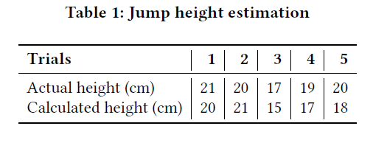
Why did PGP fail?
Jump Height Evaluation
Accurate jump height across 5 users

Slide 44
Why did PGP fail?
Improvements and Study
Extensive study and analysis
Template matching, for DTW, across multiple persons
Different head movements, demographically and culturally, to be studied
Hybridization with smartphones
Usability and long time adoption of earables

Slide 45
Why did PGP fail?
Conclusion
Explored a good natural filtering opportunity of the human body
Proposed:
A simple, yet robust and precise step counting
Accurate jump analysis

Slide 46
Buffer

Slide 47
Why did PGP fail?
Related works

Slide 48
What’s the unique opportunity?
Growing research community and user’s adoption of Earables
Earbuds with sensing and computing capabilities: Esense
Notes:
This slide is “unexpected” … and it breaks the flow.
Why not push it towards the “Implementation” slide?

Slide 49
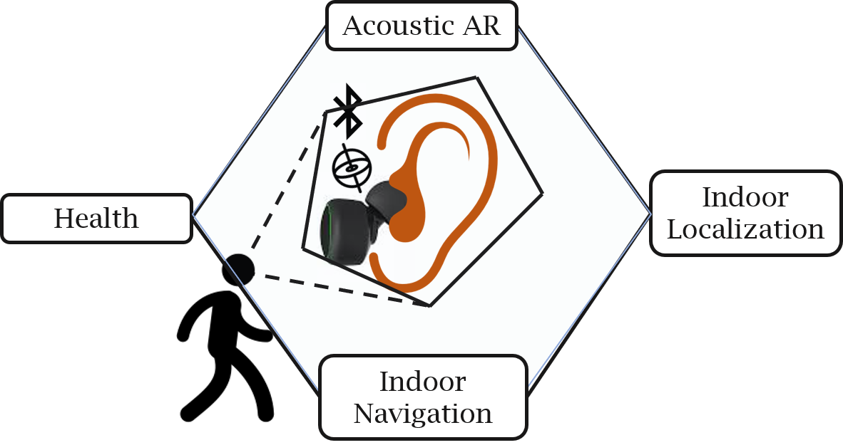
What’s the Goal?
Meet needs of applications requiring precise step counting
Very precise and diverse step counting for different modes of walking
Applications of precise step count

Slide 50
What’s the Goal?
Meet needs of applications requiring precise step counting
Very precise and diverse step counting for different modes of walking
Applications of precise step count

Slide 51
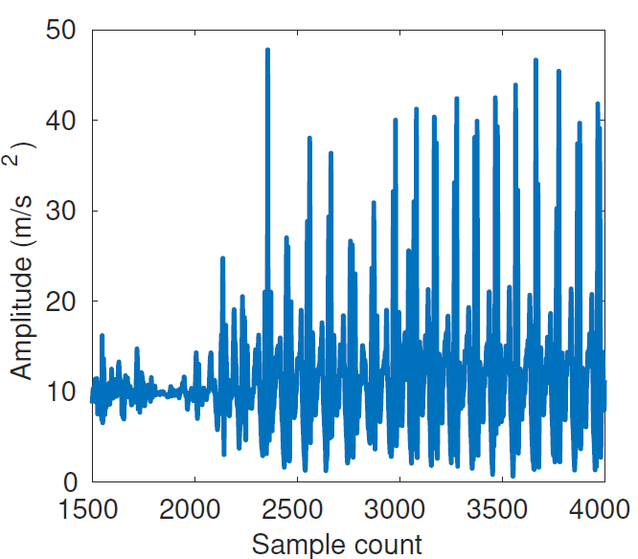
What’s the Problem?
Robust and precise step count is still hard!
IMU of smartphones, watches etc are subjected to unwanted, unintended, motions
Hence, observations are noisy

Slide 52
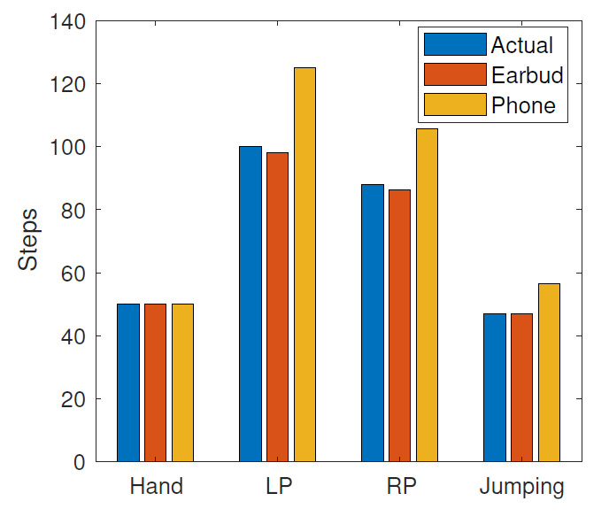
Why did PGP fail?
STEAR Analysis
Outperforms smartphone for slower modes of walking
Very slow: 95%
Slow: 98%

Slide 53
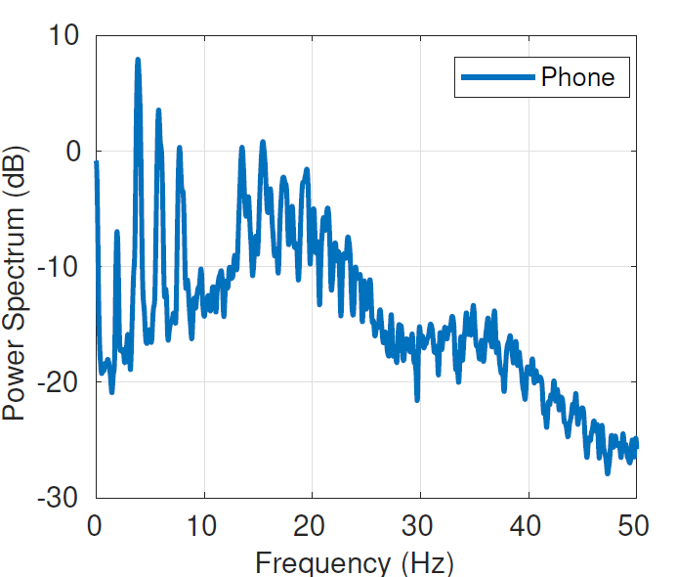
What’s the Problem?
Robust and precise step count is still hard!
IMU of smartphones, watches and Fitbit are subjected to unwanted, unintended, motions due to wrist movements, in-pocket movements…..

Slide 54
Do we need to design yet another counter??
Notes:
This raises a question: do we need to need to design yet another counter?

Slide 55
Can we do something promising with Earbud?

Slide 56
What’s the key opportunity?
Unique location and associated kinematics in and around ear
IMU near ear should be more stable, less noisy
Notes:
The unique location brings oppritnities with

Slide 57
What’s the key opportunity?
Head follows a near sinusoidal pattern during walk
Human torso/body acts as a natural-filter for lower body movements
Notes:
This slide is “unexpected” … and it breaks the flow.
Why not push it towards the “Implementation” slide?

Slide 58
STEAR: 1. Step Count
Meet needs of applications requiring precise step counting
Accommodate different modes of steps/walking
Goals

