Slide 1
AutoLabel: Matching Physical Sites with Web Sites for Semantic Localization
Rufeng Meng, Sheng Shen, Srihari Nelakuditi, Romit Roy Chouhury

Slide 2
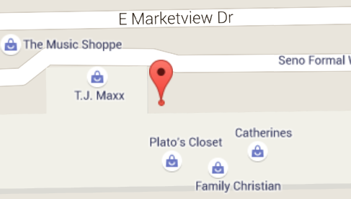
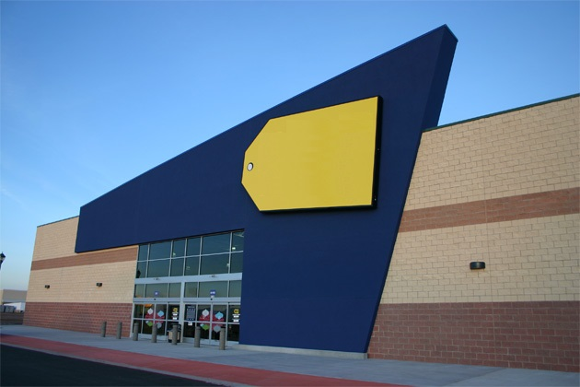
Semantic Localization
Physical Location
40.137675, -88.241373
?
Semantic Location
Best Buy
?

Slide 3
Wi-Fi Based Semantic Localization

Slide 4
Wi-Fi Based Semantic Localization

Slide 5
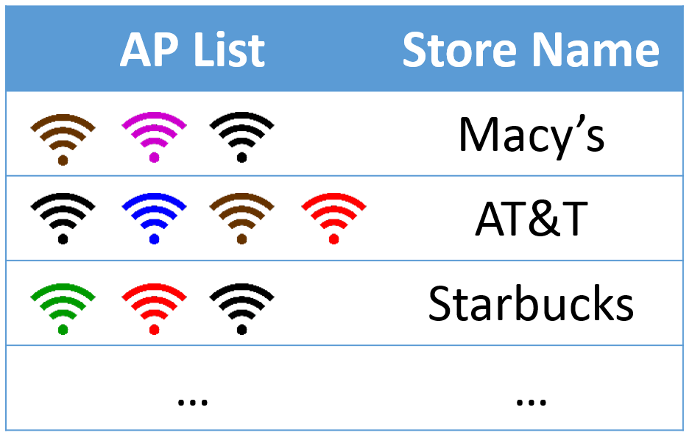
Core Problem
?

Slide 6
Intuition: Manual Labeling
AP List | Store Name
 | Macy’s
 | AT&T
 | Starbucks
… | …
Manual Labeling

Slide 7
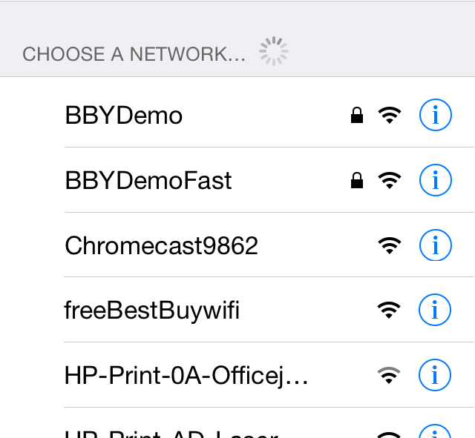
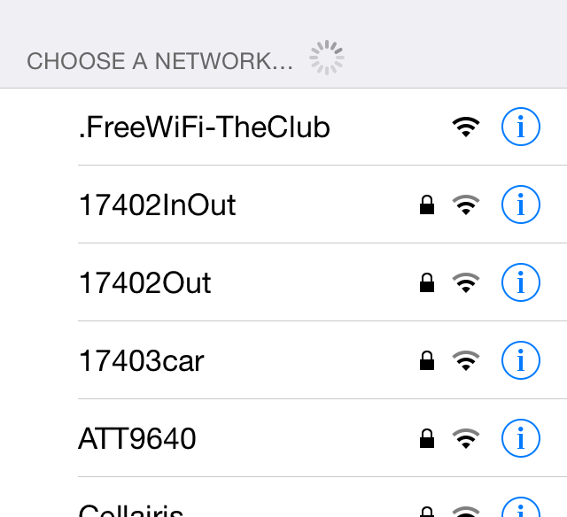
Intuition: AP Name Mining
AP List | Store Name
 | Macy’s
 | AT&T
 | Starbucks
… | …
AP Name Mining
Best Buy on Street
Macy’s in Mall

Slide 8
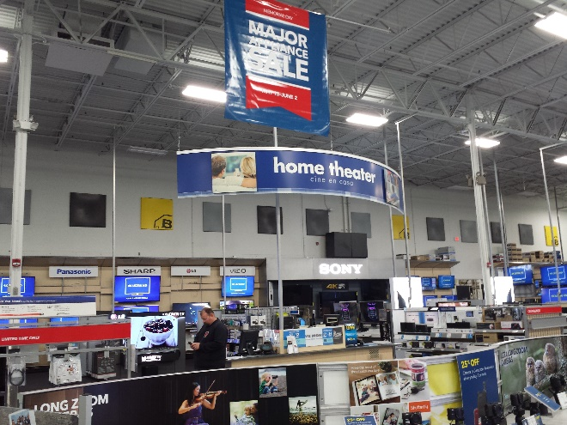
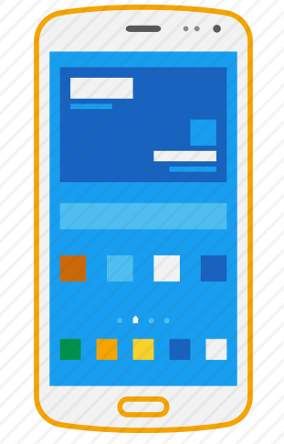
Opportunity

Slide 9
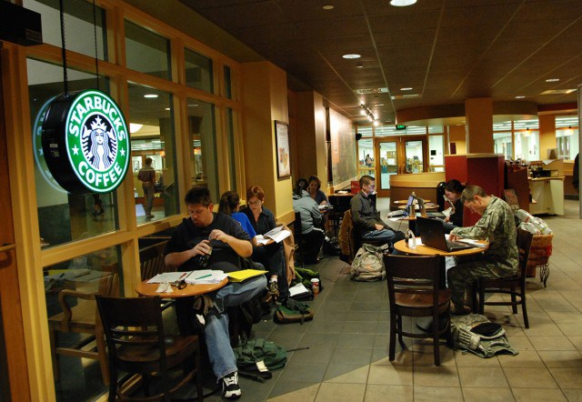
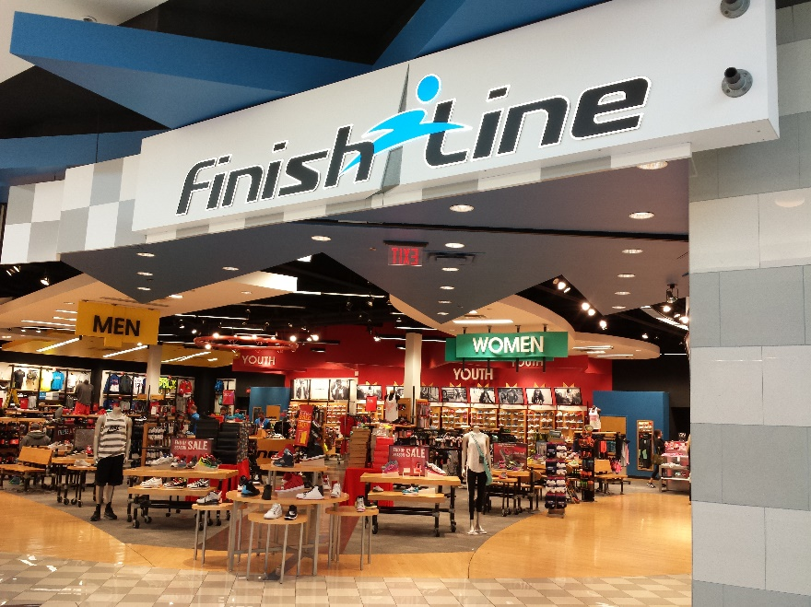
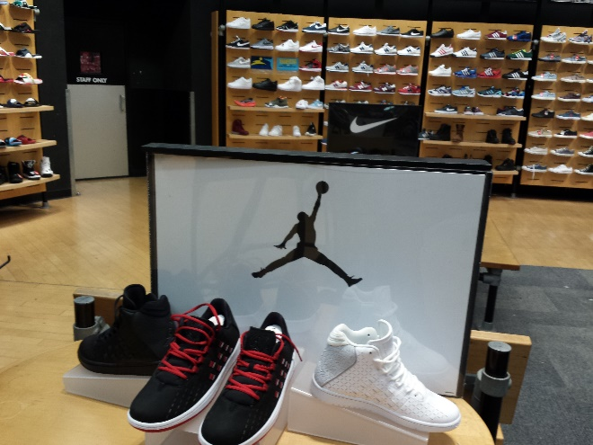
Intuition: Store Logo Searching
AP List | Store Name
 | Macy’s
 | AT&T
 | Starbucks
… | …
Store Logo Searching

Slide 10
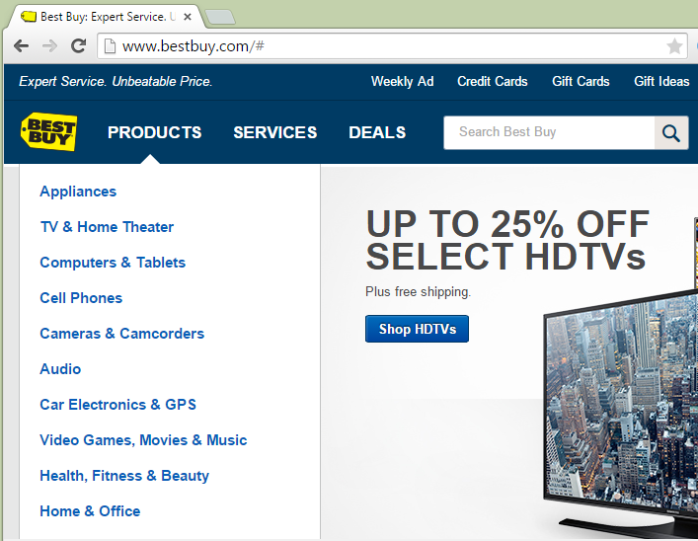
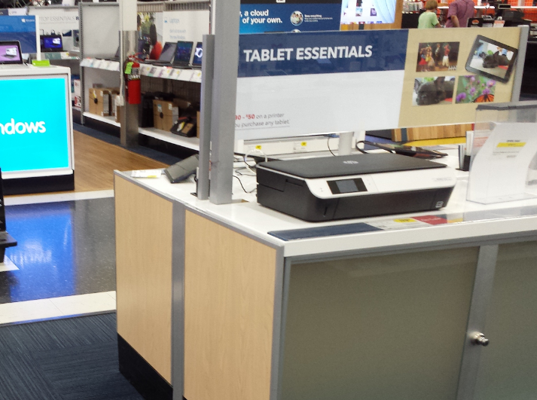
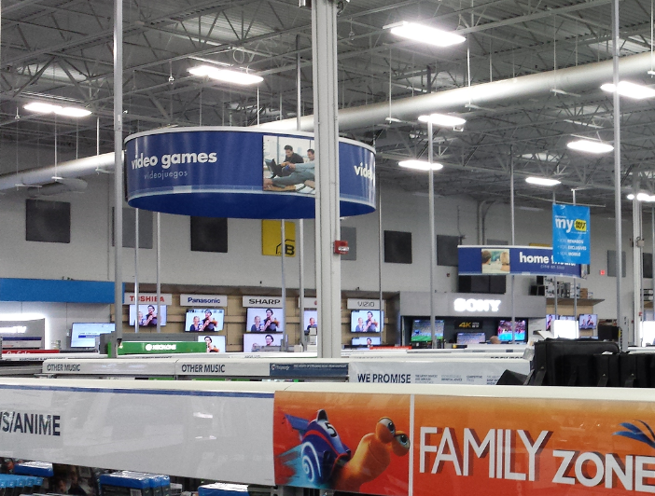
Intuition: Matching In-store Text with Website Text
AP List | Store Name
 | Macy’s
 | AT&T
 | Starbucks
… | …
Website Text Matching

Slide 11
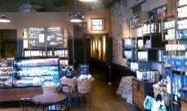
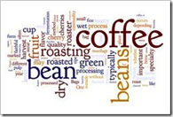
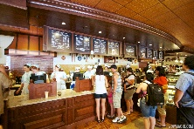
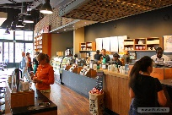
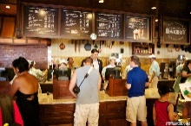
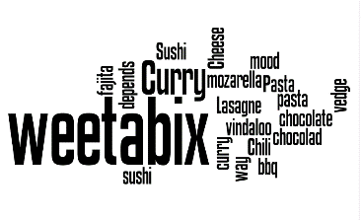
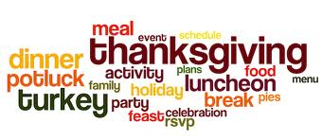
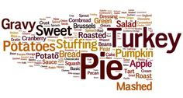
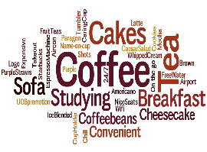
Intuition: Matching In-store Text with Website Text
OCR
AutoLabel Matching In-store Text with Website Text
AP List | Store Name
 | Starbucks
 | Starbucks
 | Starbucks
 | Starbucks
… | …
Matching In-store Text with Website Text
Text From Webpages
Fusion Cafe
Whole Foods
Panera
Starbucks

Slide 12
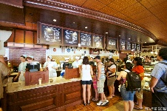
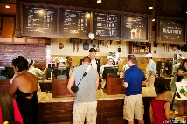
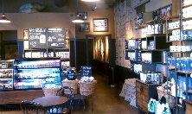
A Bigger Picture
?
AP List | Store Name
 | Starbucks
 | Starbucks
 | Starbucks
 | Starbucks
… | …
 | Staples
 | Staples
 | Staples
… | …
 | Dollar Tree
 | Dollar Tree
 | Dollar Tree
… | …
Best Buy
Dollar Tree
Staples
Starbucks
AutoLabel Matching In-store Text with Website Text

Slide 13
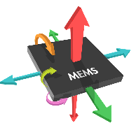
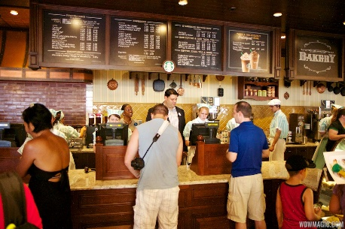
In-store Text Extraction
Blurred Image Filter
OCR

Slide 14
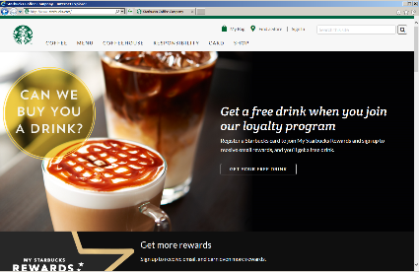
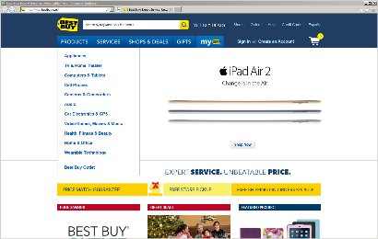
Website Text Extraction
Google Map Search
Google Web Search
Fusion Cafe
Whole Foods
Panera
Starbucks

Slide 15
Bag-of-Words Text Matching
Text From In-store Photos
Extract Nouns and Proper Names
Assign TF-IDF Weight
Calculate Cosine Similarity
Text From Webpages
Fusion Cafe
Whole Foods
Panera
Starbucks

Slide 16
Preliminary Evaluation

Slide 17
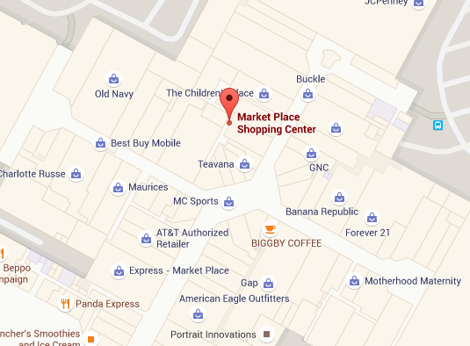
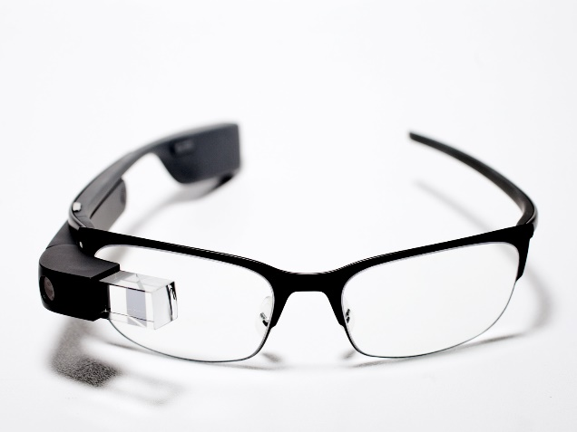
Data Collection
18 stores in a shopping mall - 2 nutrition stores - 3 sportswear stores - 3 electronics stores - 4 appeal stores - 6 other businesses
Google Glass takes panoramic videos Smartphone records Wi-Fi AP data
16 – 72 photos with text / store

Slide 18
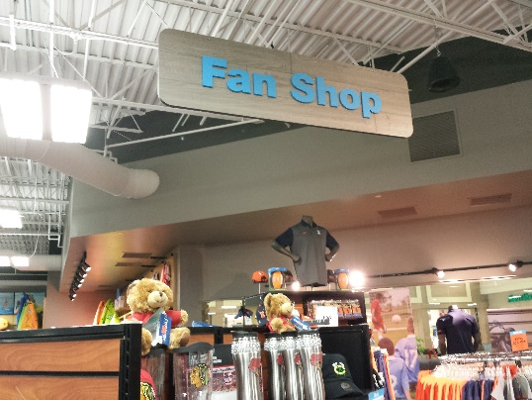
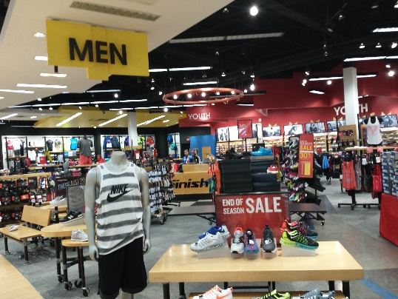
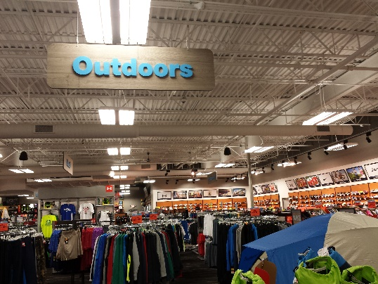
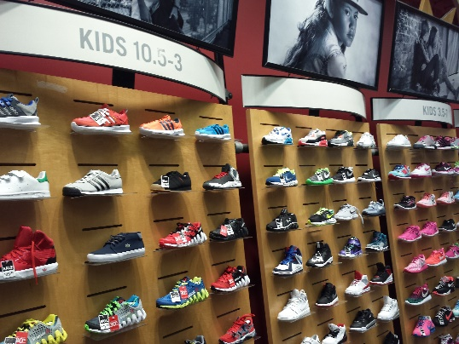
Evaluation
Different stores have dissimilar text.
MC Sports Store
Finish Line Store

Slide 19
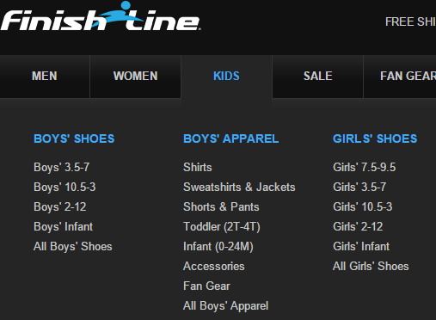
Evaluation
Different stores have dissimilar text.
Different stores’ websites have dissimilar text.
MC Sports Website
Finish Line Website

Slide 20
Evaluation
Different stores have dissimilar text.
Different stores’ websites have dissimilar text.
Each store matches best with its own website
MC Sports Website
MC Sports Store
MC Sports Store

Slide 21
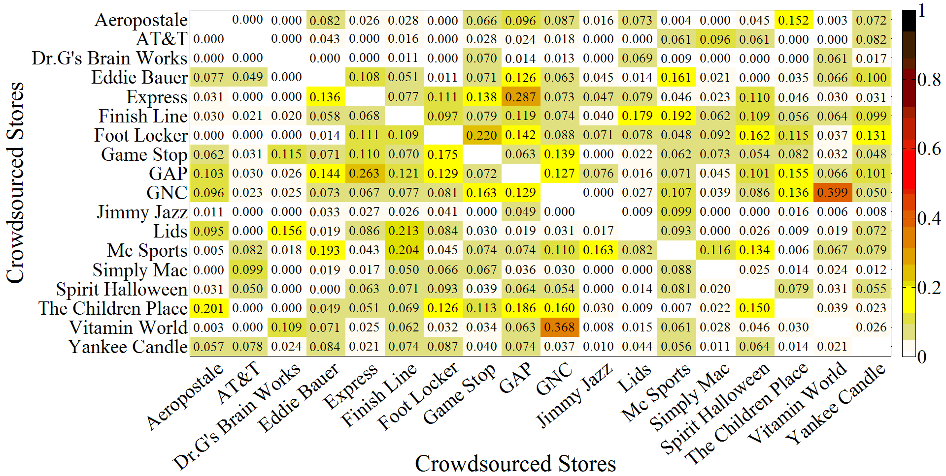
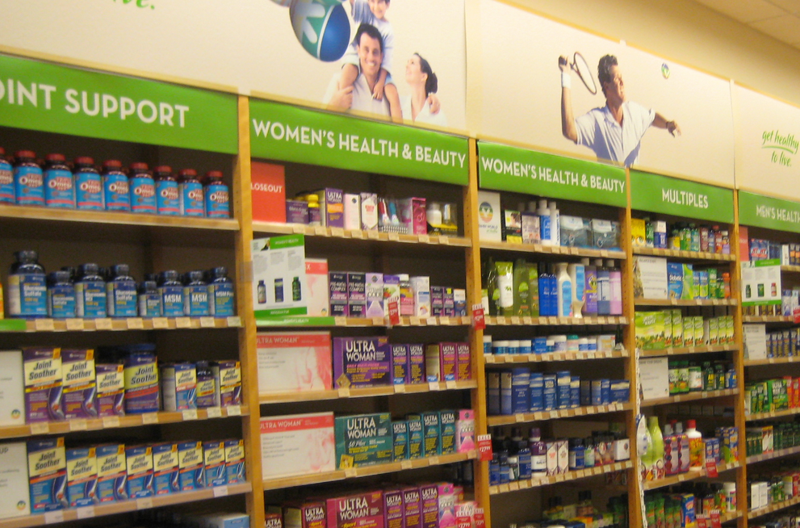
How Similar Are Text In Different Stores?

Slide 22
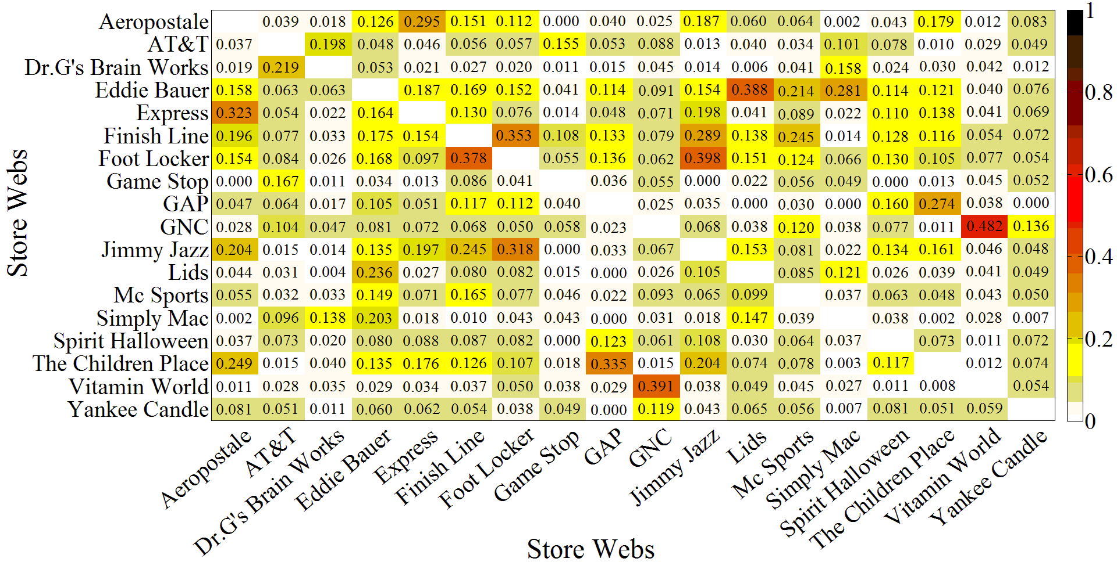
How Similar Are Text In Different Websites?

Slide 23
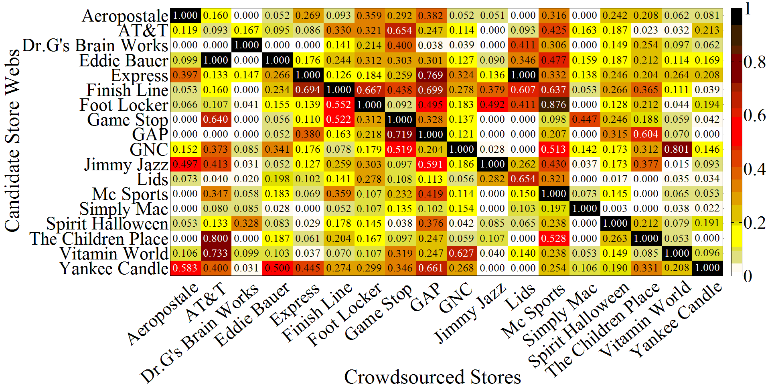
Does Each Store Matches Best with Its Own Website?
Match one physical store (GNC) with 18 websites

Slide 24
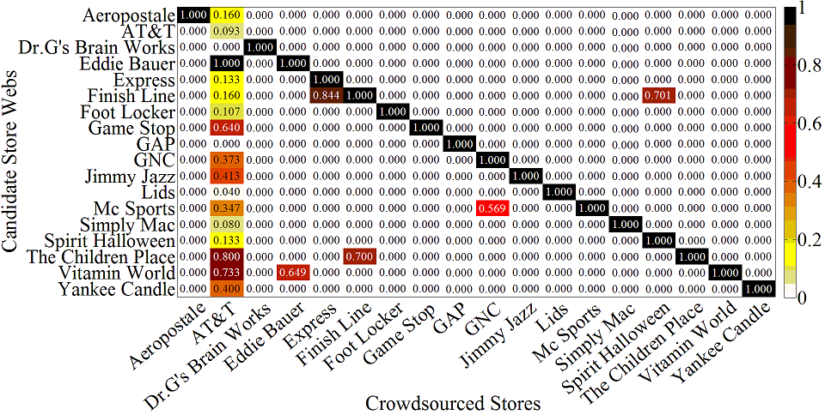
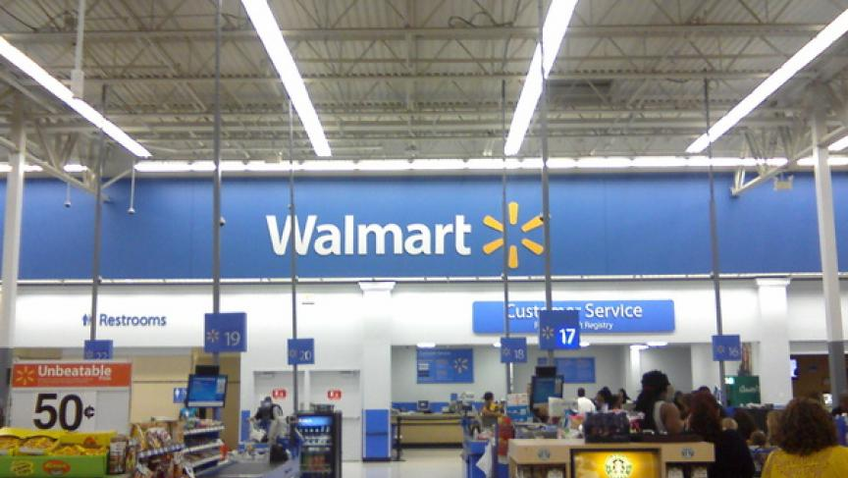
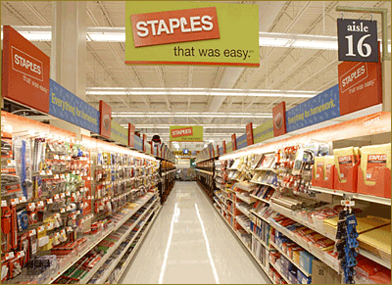
Improvement: Using Store Names

Slide 25
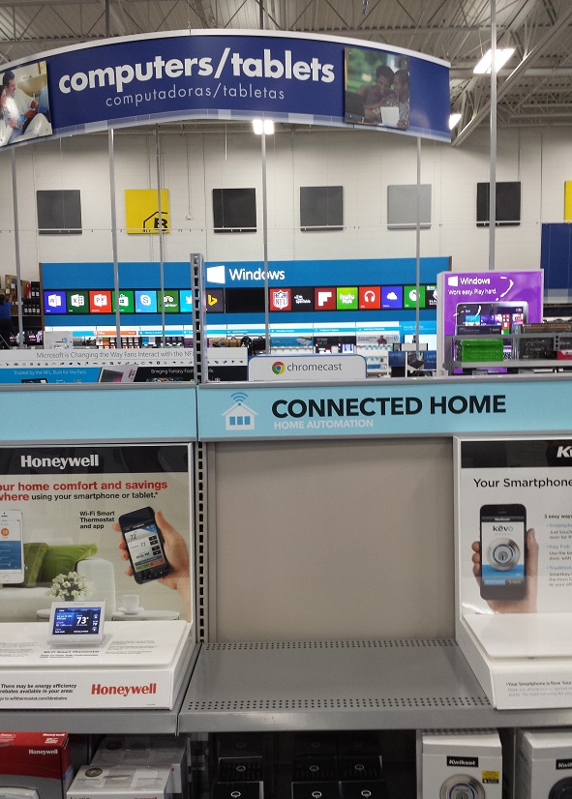
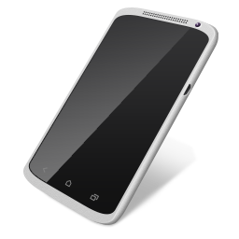
Matching with Partial Data
Matching with limited number of photos - Varying # of photos per store: 5, 10, …, all
Matching with specific portion of text
- In-store: above/at eye level
Above eye level
At eye level
Below eye level

Slide 26
Matching with Partial Data
Matching with limited number of photos - Varying # of photos per store: 5, 10, …, all
Matching with specific portion of text
- In-store: above/at eye level
- Website: menus
✓
✗
✓

Slide 27
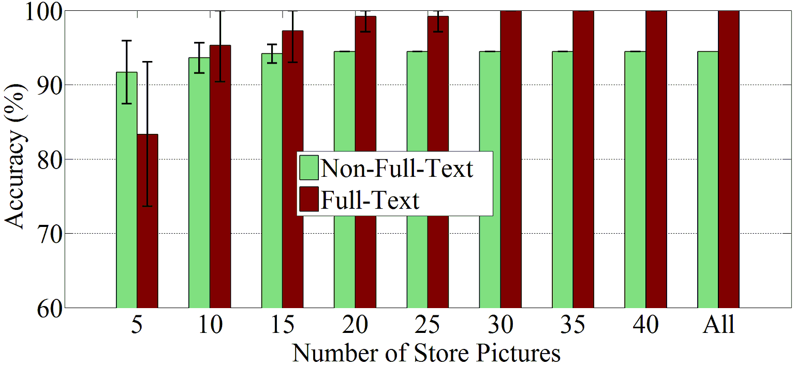
Matching with Partial Data: Evaluation
10 photos with text per store are good enough!
Partial Text
Full Text

Slide 28
Limitations and On-going Work
Need to evaluate with more stores, in various areas
Need to understand website and physical store structure well for better text matching
Need to have a good clustering algorithm
Clustering
Matching

Slide 29
Conclusion
AutoLabel is a solution for semantic localization.
?

Slide 30
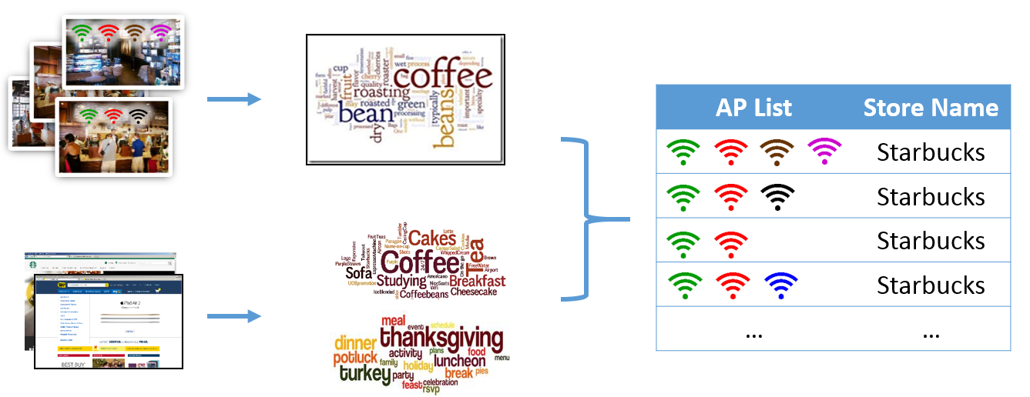
Conclusion
AutoLabel is a solution for semantic localization.
AutoLabel matches physical sites with web sites through text matching, and gives a mapping from Wi-Fi access points to semantic store names.

Slide 31
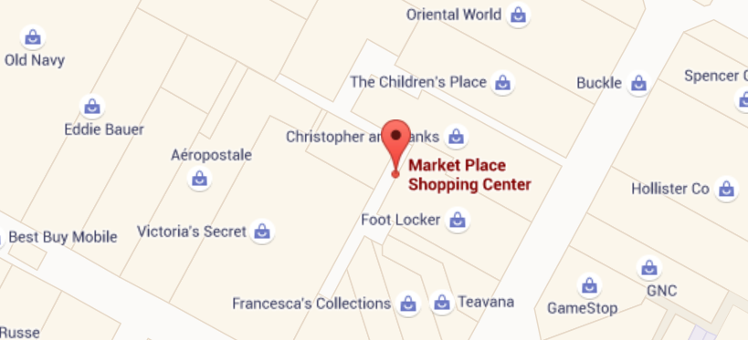
Conclusion
AutoLabel is a solution for semantic localization.
AutoLabel matches physical sites with web sites through text matching, and gives a mapping from Wi-Fi access points to semantic store names.
Feasibility is verified through preliminary evaluation.

Slide 32
Conclusion
AutoLabel is a solution for semantic localization.
AutoLabel matches physical sites with web sites through text matching, and gives a mapping from Wi-Fi access points to semantic store names.
Feasibility is verified through preliminary evaluation.
TEXT
Physical Stores
Websites
Physical Locations
Semantic Locations

Slide 33
Thanks for your attention!
Questions?
Paper available at http://synrg.csl.illinois.edu/

