Slide 1

MoLe
Motion Leaks through Smartwatch Sensors
He Wang
Ted Tsung-Te Lai
Romit Roy Choudhury
UIUC
MobiCom’15 Presentation

Slide 2
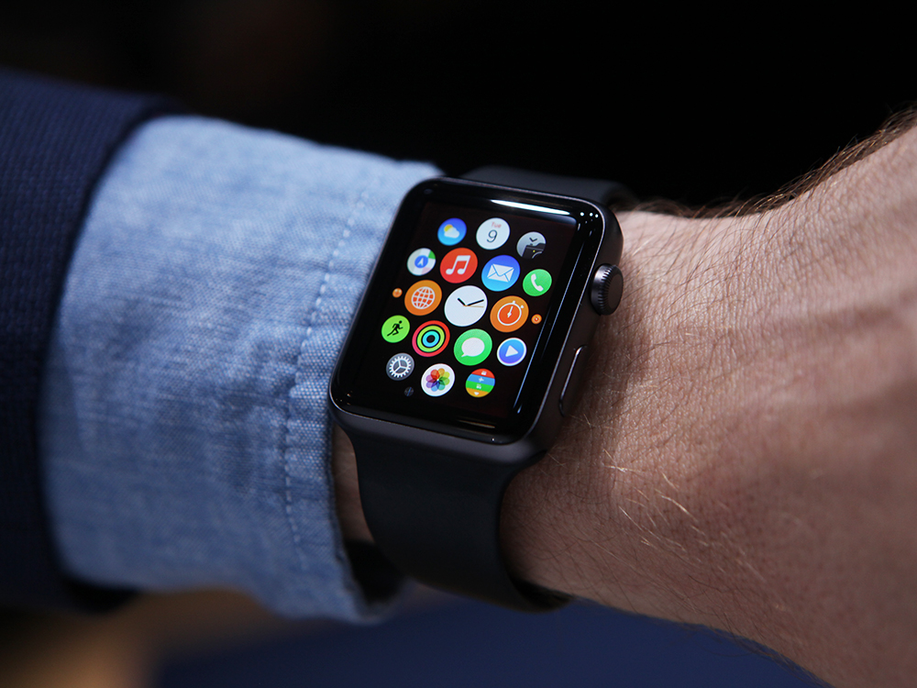
Your Watch Knows About You
More Than You Think?

Slide 3
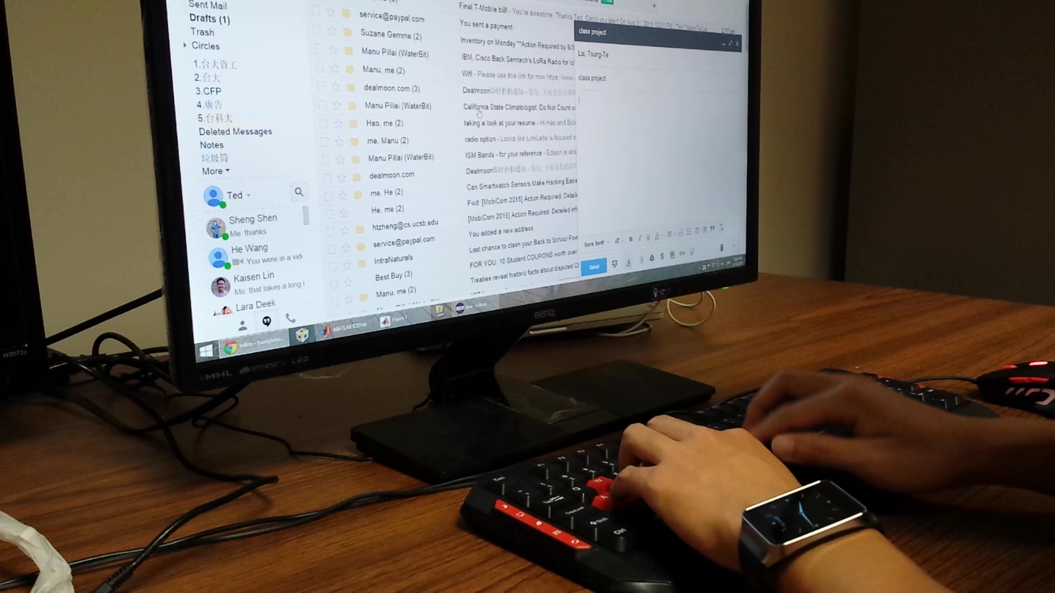
Watch = Spy? Monitor Typing in Background?

Slide 4
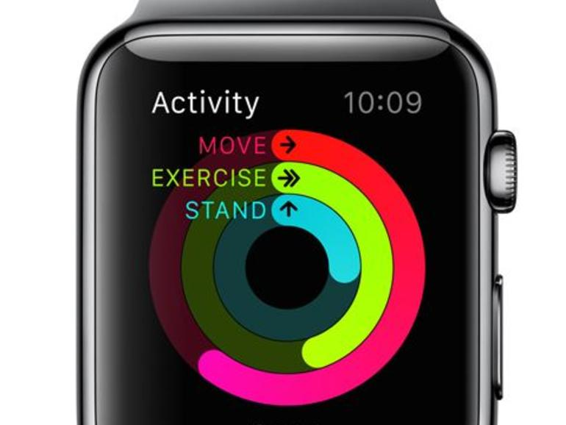
Watch motion sensor to infer input words?

Slide 5
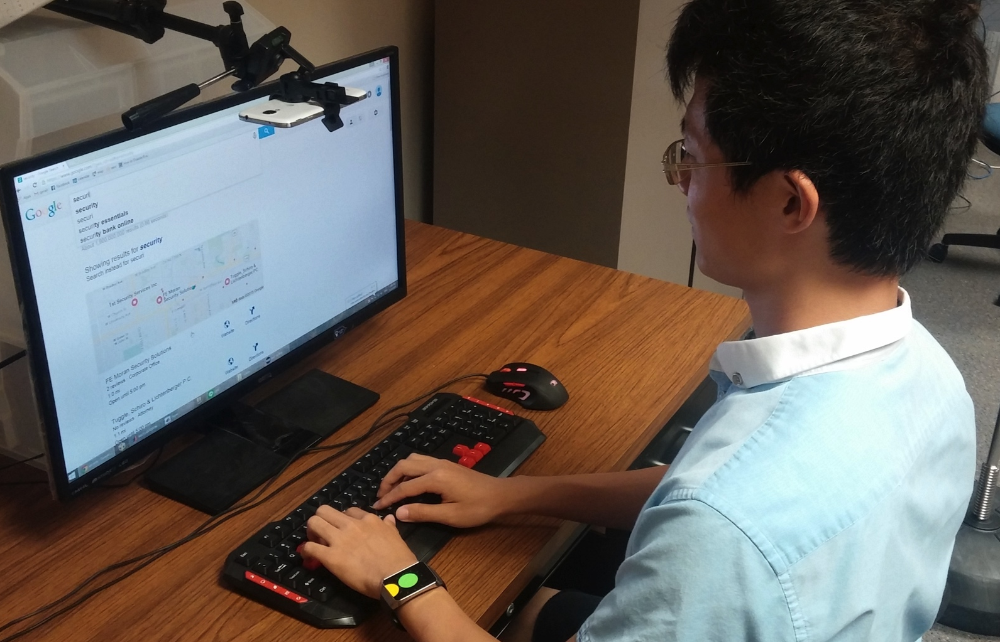
Understand Human Typing

Slide 6
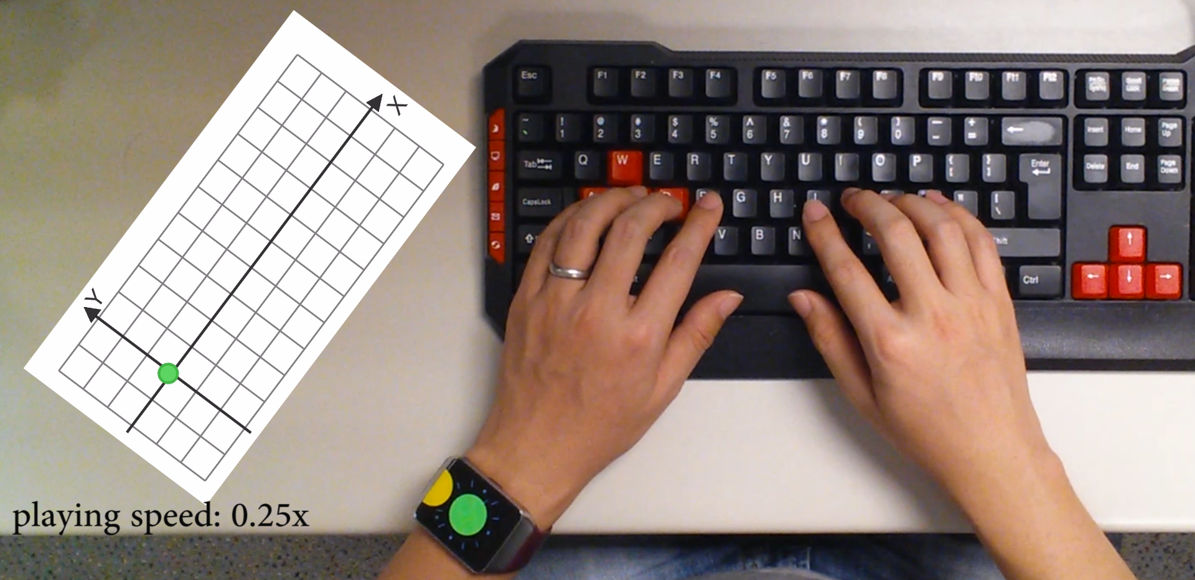
Correlation Between Watch Movement and keystrokes
watch
movement
groundtruth

Slide 7
Design Challenges
Noisy sensor data
Watch location ≠ keystroke
Information from the other hand is missing

Slide 8

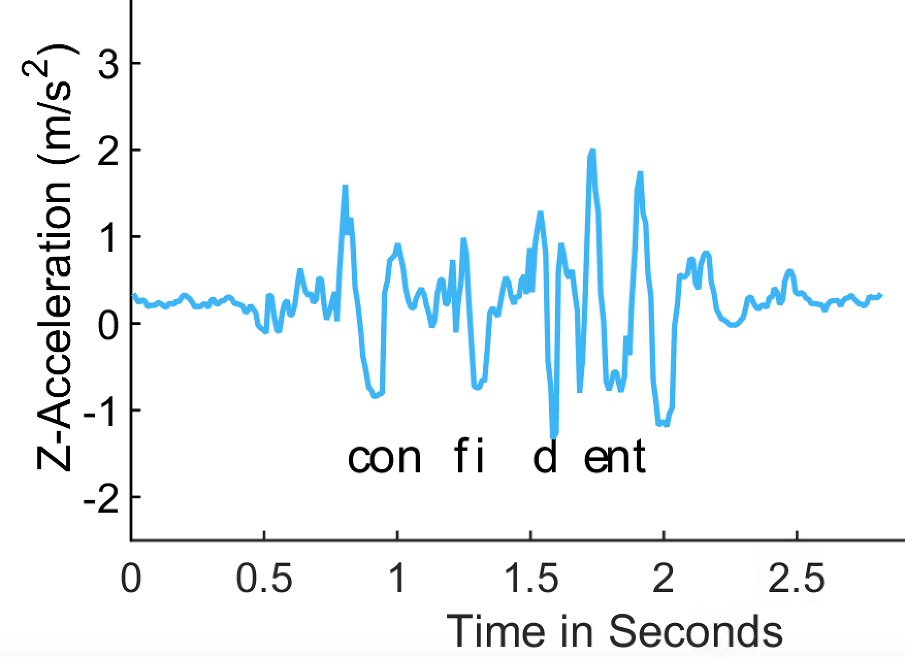
Keystroke Time
Use z-acceleration to infer keystroke time
true positive
false positive
Z-acceleration

Slide 9
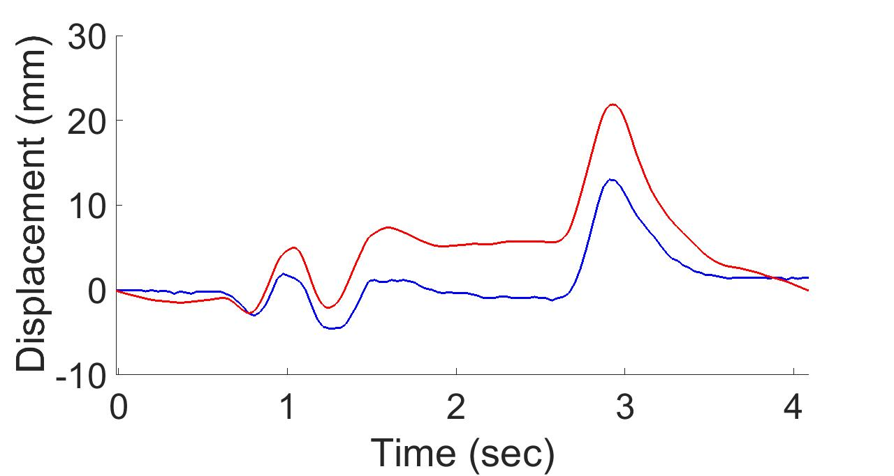
Watch Displacement
Use Android linear acceleration to estimate watch displacement
Android API
ground truth

Slide 10
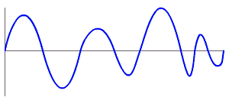
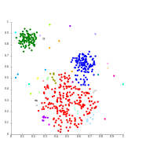
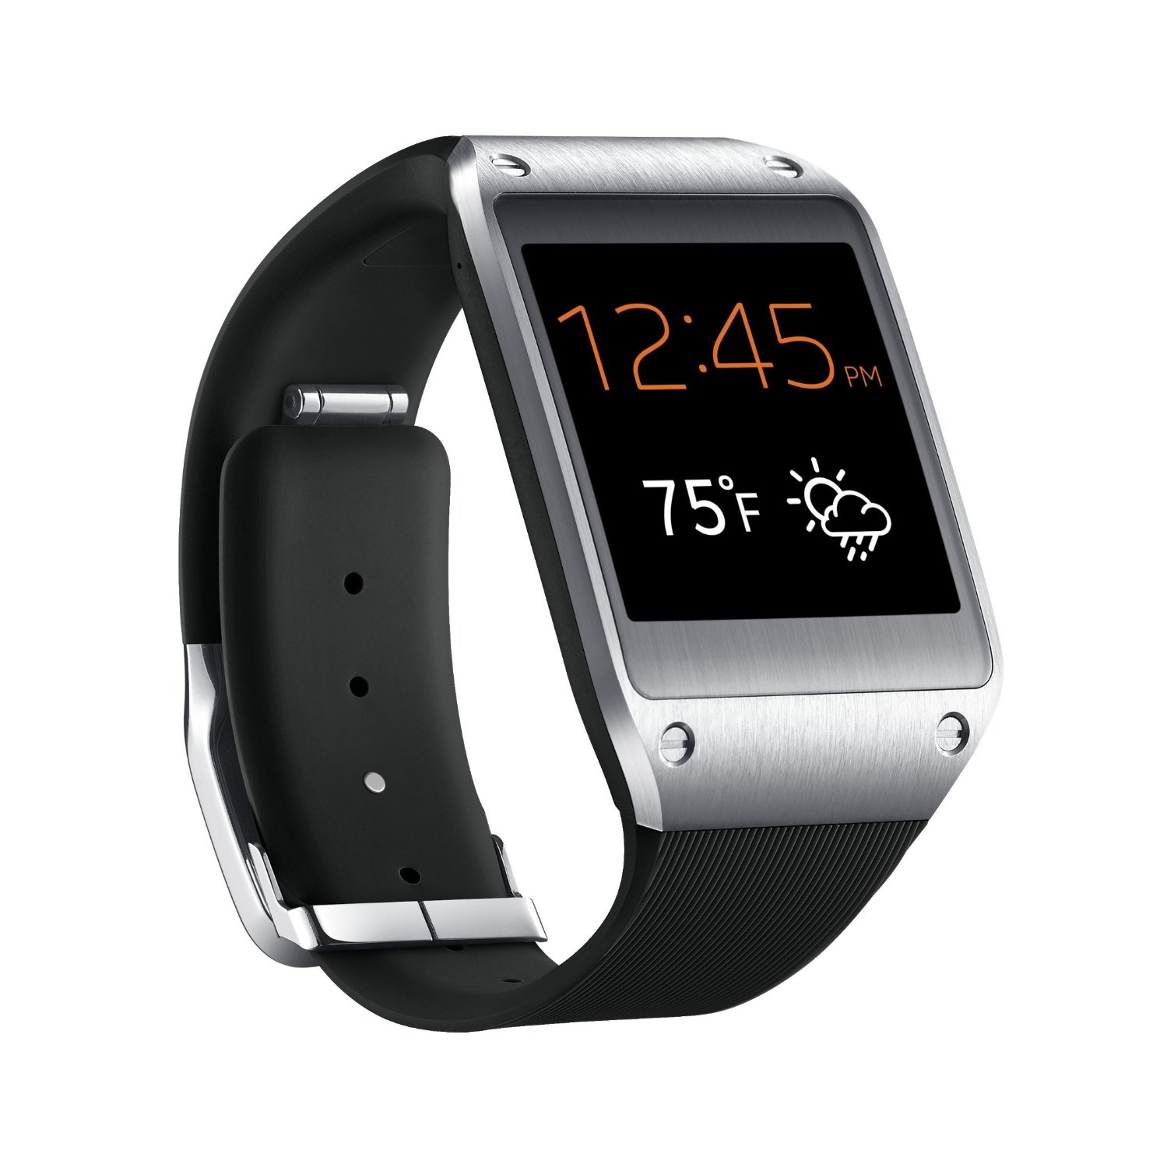
MoLe Architecture
Keystroke
Detector
Time
Location
User Data

Slide 11
Design Challenges
Noisy sensor data
Watch location ≠ keystroke
Information from the other hand is missing

Slide 12
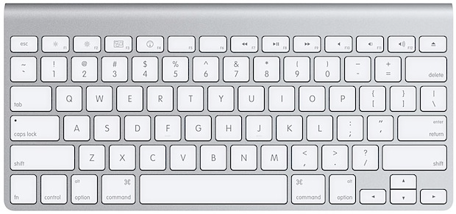
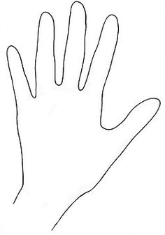
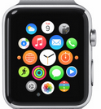
Watch Location ≠ Keystroke
Y Displacement
0
-10
20
X Displacement
Y Displacement (mm)
10
0
-10
-10 0 10 20
X Displacement (mm)

Slide 13
Watch Location ≠ Keystroke
Groundtruth location
20
Y Displacement (mm)
10
0
c
-10
-10 0 10 20
X Displacement (mm)

Slide 14
Watch Location ≠ Keystroke
Groundtruth location
20
Y Displacement (mm)
10
c
0
c
-10
-10 0 10 20
X Displacement (mm)

Slide 15
Watch Location ≠ Keystroke
Groundtruth location
20
Y Displacement (mm)
10
0
x
c
-10
-10 0 10 20
X Displacement (mm)

Slide 16
Watch Location ≠ Keystroke
Groundtruth location
20
Y Displacement (mm)
10
c
x
0
x
c
-10
-10 0 10 20
X Displacement (mm)

Slide 17
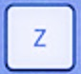
Watch Location ≠ Keystroke
Groundtruth location
20
Y Displacement (mm)
10
0
x
z
c
-10
-10 0 10 20
X Displacement (mm)

Slide 18
Watch Location ≠ Keystroke
Groundtruth location
20
Y Displacement (mm)
10
z
c
cluster
x
0
x
z
c
-10
-10 0 10 20
X Displacement (mm)

Slide 19
Watch Location ≠ Keystroke
Groundtruth location
20
q
Y Displacement (mm)
r
10
w
e
a
d
s
f
0
b
t
x
g
z
c
v
-10
-10 0 10 20
X Displacement (mm)

Slide 20
Watch Location ≠ Keystroke
Unlabeled keystrokes
20
Y Displacement (mm)
10
0
-10
-10 0 10 20
X Displacement (mm)

Slide 21
MoLe Architecture
Keystroke
Detector
Time
Location
User Data

Slide 22
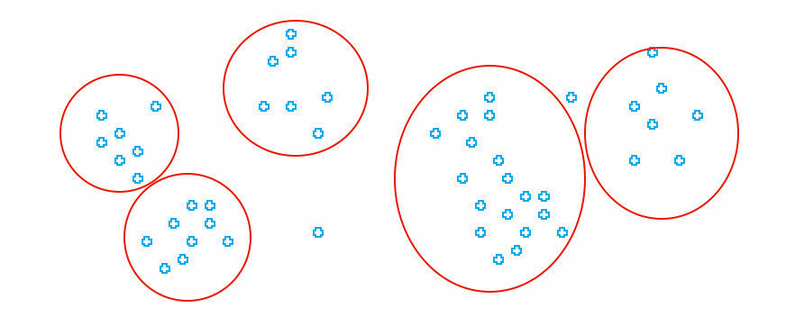
MoLe Architecture
Attacker Training Data
Attacker Point Cloud
a b c d
Keystroke
Detector
Point
Cloud
Fitting
Time
Location
Unlabeled Point Cloud
User Data

Slide 23
Design Challenges
Noisy sensor data
Watch location ≠ keystroke
Information from the other hand is missing

Slide 24
Right Hand Keystrokes Are Missing

Slide 25
MoLe Architecture
Attacker Training Data
Attacker Point Cloud
a b c d
Keystroke
Detector
Point
Cloud
Fitting
Time
Location
Unlabeled Point Cloud
User Data

Slide 26

MoLe Architecture
Attacker Training Data
Rank of Word_{i}
Attacker Point Cloud
a b c d
Keystroke
Detector
Point
Cloud
Fitting
Bayesian
Inference
P(O|W_{i})
Time
Location
Word W_{i}
Unlabeled Point Cloud
Observation ( O )
User Data
Dictionary

Slide 27
Outline
Motivation & Challenge
MoLe
  Keystroke detectors
  Point cloud fitting
  Bayesian inference
Evaluation
Limitations
Conclusion

Slide 28
MoLe Architecture
Attacker Training Data
Rank of Word_{i}
Attacker Point Cloud
a b c d
Keystroke
Detector
Point
Cloud
Fitting
Bayesian
Inference
P(O|W_{i})
Time
Location
Word W_{i}
Unlabeled Point Cloud
Observation ( O )
User Data
Dictionary

Slide 29
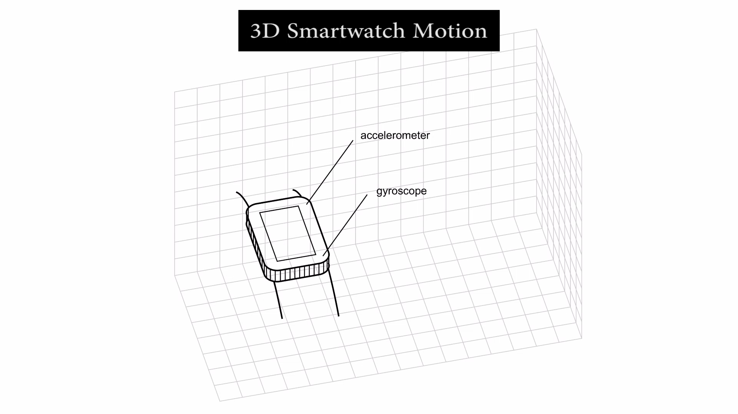
Keystroke Detector

Slide 30
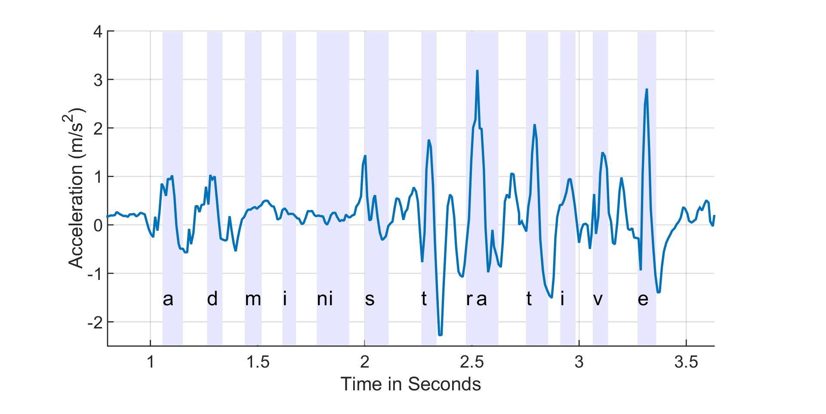
Keystroke Detector - Time
Z-acceleration
z-axis linear acceleration

Slide 31
Keystroke Detector - Time
Peak detection generates errors
z-axis linear acceleration
true detection
false detection

Slide 32
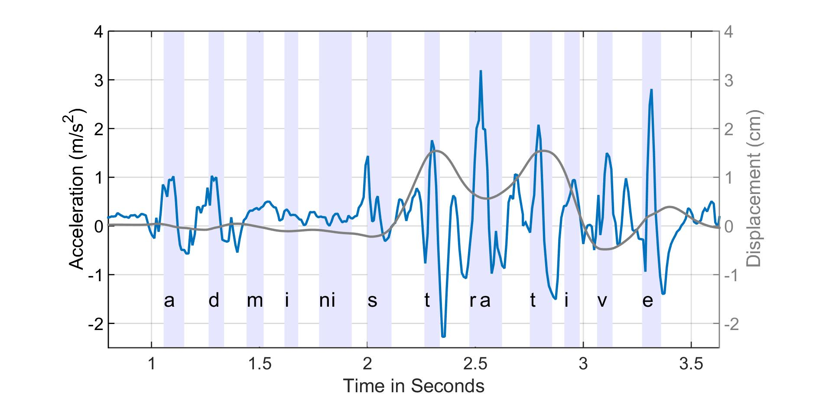
Keystroke Detector - Time
Peak detection generates errors
z-axis linear acceleration
x-axis displacement
true detection
false detection

Slide 33
Keystroke Detector - Time
Use a low threshold peak detection to generate candidates
z-axis linear acceleration
candidates

Slide 34
Keystroke Detector - Time
Apply bagged decision tree to classify keystrokes
z-axis linear acceleration
keystroke
non-keystroke

Slide 35
Keystroke Detector - Time
True positive False positive

Slide 36
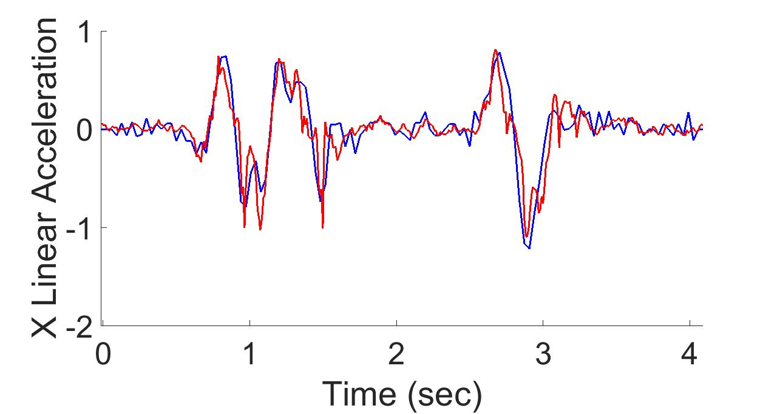
Keystroke Detector - Displacement
ground truth
Android API
double integral with mean removal

Slide 37
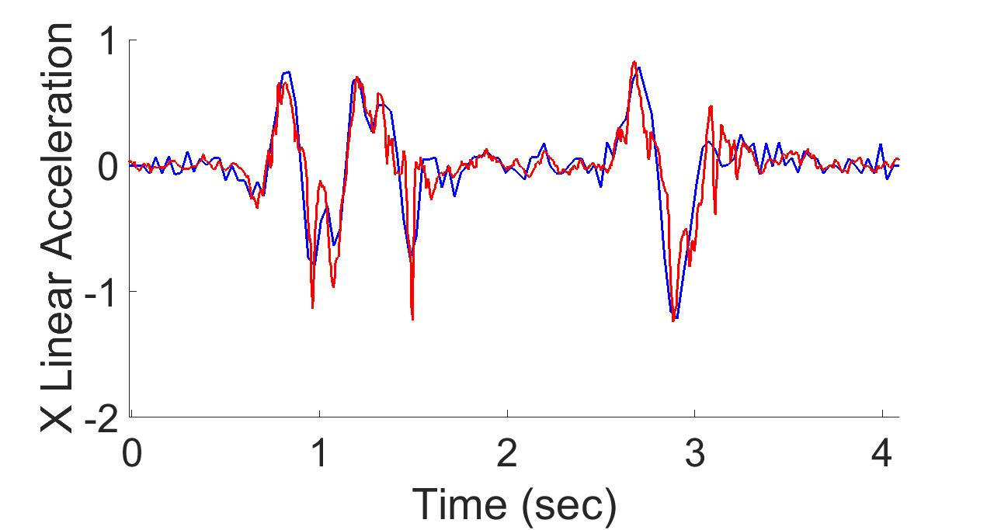
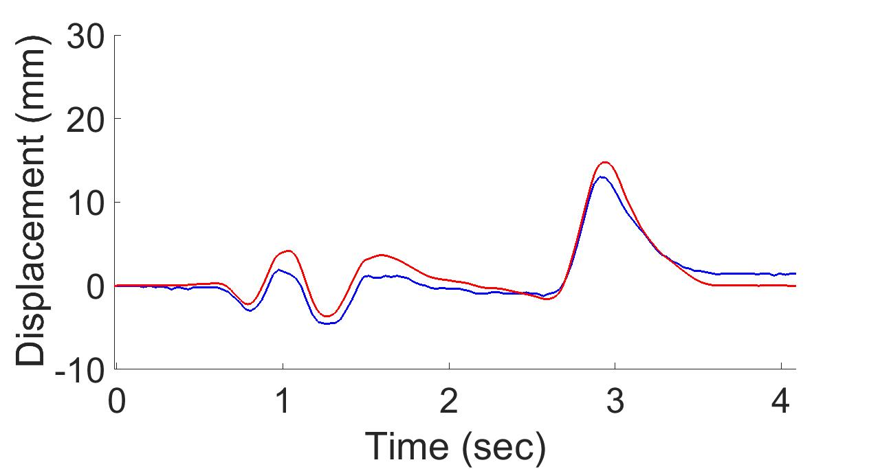
Keystroke Detector - Displacement
ground truth
MoLe
- use gyro to estimate and remove gravity
(with Kalman filter)
double integral with mean removal

Slide 38
Keystroke Detector - Displacement
Mole median error < 1.5mm
Android median error < 2.5mm

Slide 39
MoLe Architecture
Attacker Training Data
Rank of Word_{i}
Attacker Point Cloud
a b c d
Keystroke
Detector
Point
Cloud
Fitting
Bayesian
Inference
P(O|W_{i})
Time
Location
Word W_{i}
Unlabeled Point Cloud
Observation ( O )
User Data
Dictionary

Slide 40
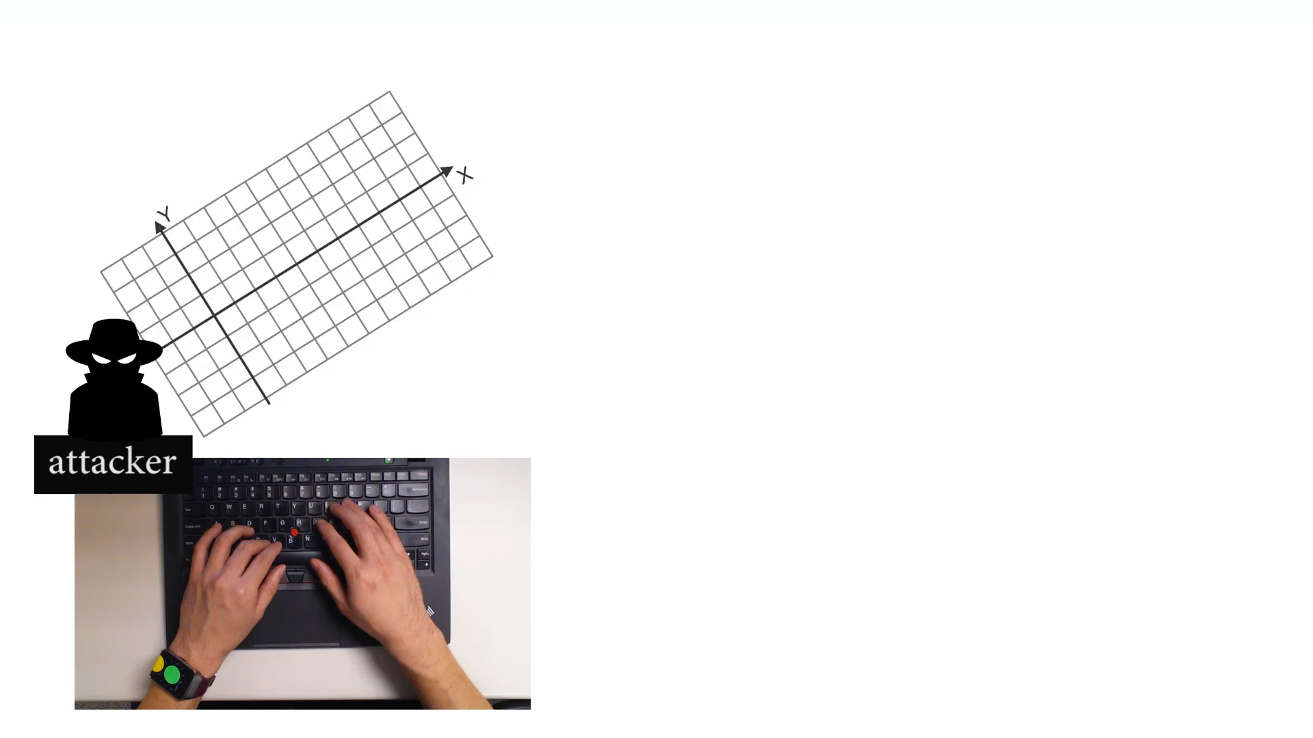
Point Cloud Fitting

Slide 41
Point Cloud Fitting
attacker training data
20
Y Displacement (mm)
Q
10
W
0
A
T
X
-10
-10 0 10 20
X Displacement (mm)

Slide 42
Point Cloud Fitting
user data (unlabeled)
attacker training data
20
Y Displacement (mm)
Q
10
W
0
A
T
X
-10
-10 0 10 20
X Displacement (mm)

Slide 43
Point Cloud Fitting
user data (unlabeled)
attacker training data
20
Y Displacement (mm)
Find convex hulls and centroids
10
0
-10
-10 0 10 20
X Displacement (mm)

Slide 44
Point Cloud Fitting
user data (unlabeled)
attacker training data
20
Y Displacement (mm)
Q
Find convex hulls and centroids
Rotate and scale
10
W
0
A
T
X
-10
-10 0 10 20
X Displacement (mm)

Slide 45
MoLe Architecture
Attacker Training Data
Rank of Word_{i}
Attacker Point Cloud
a b c d
Keystroke
Detector
Point
Cloud
Fitting
Bayesian
Inference
P(O|W_{i})
Time
Location
Word W_{i}
Unlabeled Point Cloud
Observation ( O )
User Data
Dictionary

Slide 46


Bayesian Inference
Input “confident”
Observed
watch motion
MoLe output list
Rank | word guess
1 | confident
2 | consider
3 | commander
… | …
4999 | are
5000 | is
Compute
likelihood
word₁
word₂
word₃
…
word₄₉₉₉
word₅₀₀₀

Slide 47
Bayesian Inference
prob of observation
W_{i}: Candidate word_{i} in dictionary
O: Motion observation

Slide 48
Bayesian Inference
word frequency
W_{i}: Candidate word_{i} in dictionary
O: Motion observation

Slide 49
Bayesian Inference
Likelihood function
W_{i}: Candidate word_{i} in dictionary
O: Motion observation

Slide 50
Observations
Number of keystrokes
Location of keystrokes
Time interval between keystrokes

Slide 51
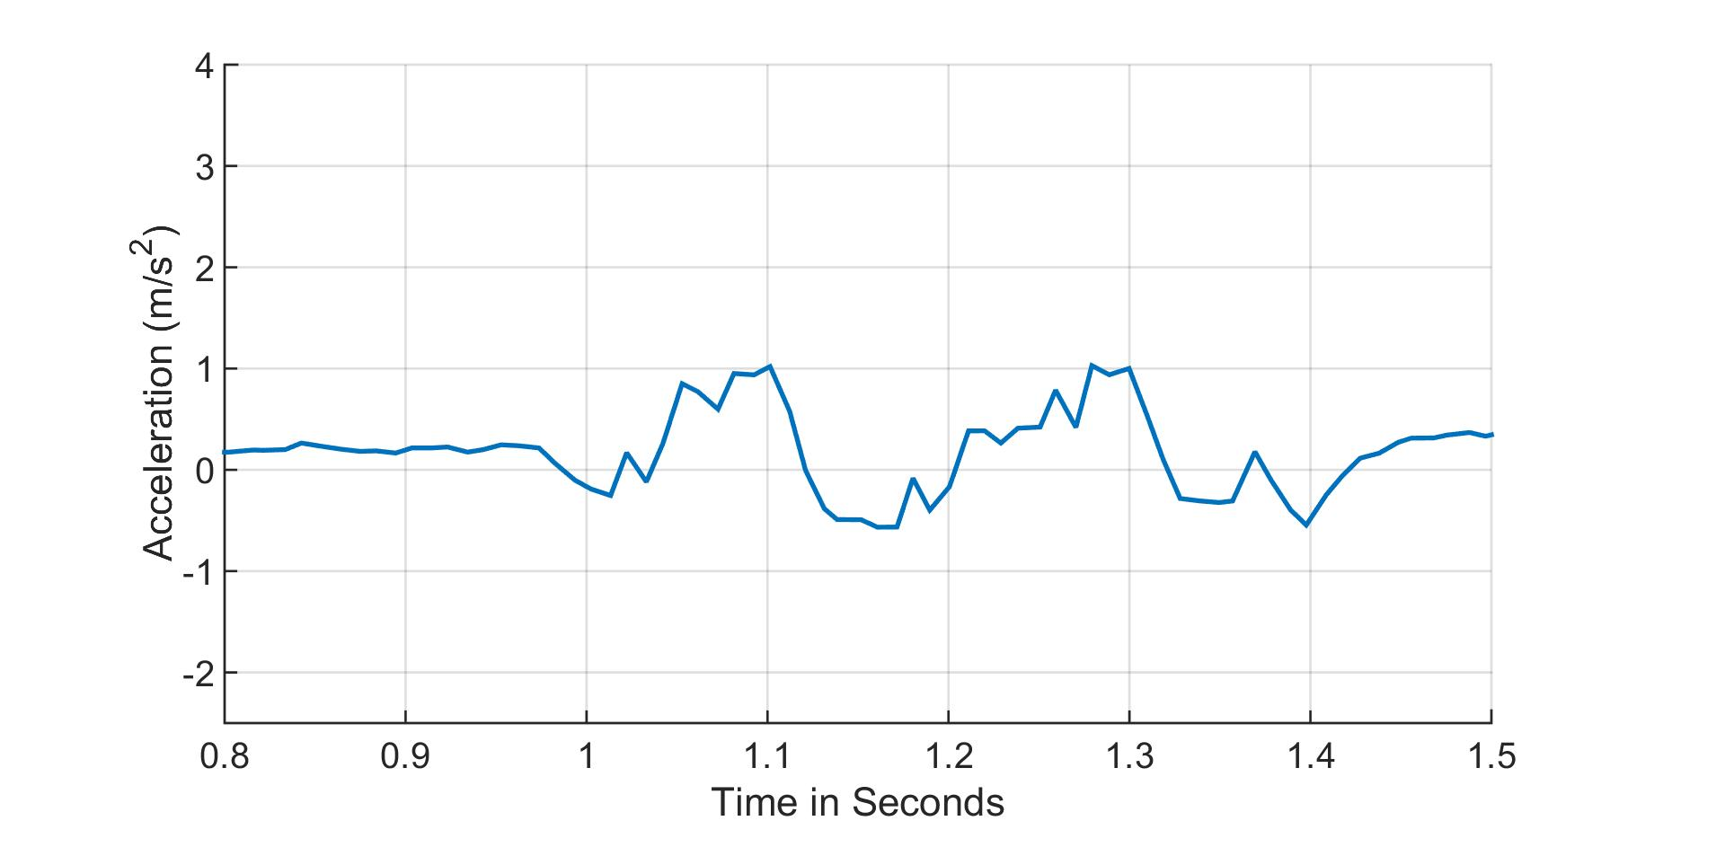
Observation 1: Number of Keystrokes
likely
the (2)
fine (2)
2 keystrokes
detected
unlikely
administrative (9)
comprehensive (7)
keystroke

Slide 52
Observation 2: Location of Keystrokes
Point cloud (after fitting with training data)
20
Y Displacement (mm)
10
0
-10
-10 0 10 20
X Displacement (mm)

Slide 53
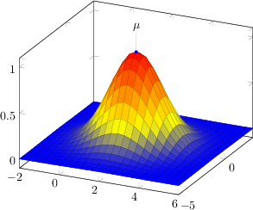
Observation 2: Location of Keystrokes
Model each keystroke location as Gaussian distribution
Point cloud (after fitting with training data)
20
q
Y Displacement (mm)
r
10
w
e
a
d
s
f
0
b
t
x
g
v
c
z
-10
-10 0 10 20
X Displacement (mm)

Slide 54
Observation 2: Location of Keystrokes
Model each keystroke location as Gaussian distribution
Point cloud (after fitting with training data)
20
q
Detected keystroke location
Y Displacement (mm)
r
10
w
e
a
d
s
f
0
b
t
x
g
v
c
z
-10
-10 0 10 20
X Displacement (mm)

Slide 55
Observation 2: Location of Keystrokes
Model each keystroke location as Gaussian distribution
Point cloud (after fitting with training data)
20
q
Detected keystroke location
Y Displacement (mm)
r
10
w
e
a
d
s
f
0
b
t
x
g
v
c
z
-10
-10 0 10 20
X Displacement (mm)

Slide 56
Observation 2: Location of Keystrokes
v->a
Location of v and r is different
20
Y Displacement (mm)
10
r->a
r->a
0
v->a
-10
-10 0 10 20
X Displacement (mm)

Slide 57
Observation 3: Time Interval
z-axis linear acceleration
keystroke
57

Slide 58
Observation 3: Time Interval
z-axis linear acceleration
keystroke
0.6 sec
58

Slide 59
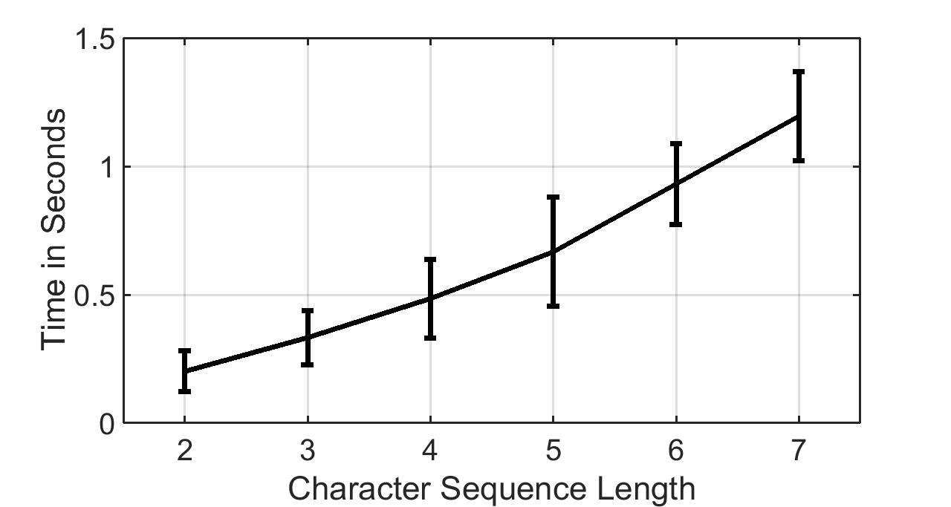
Observation 3: Time Interval
LL LRL LRRL LRRRL LRRRRL LRRRRRL

Slide 60
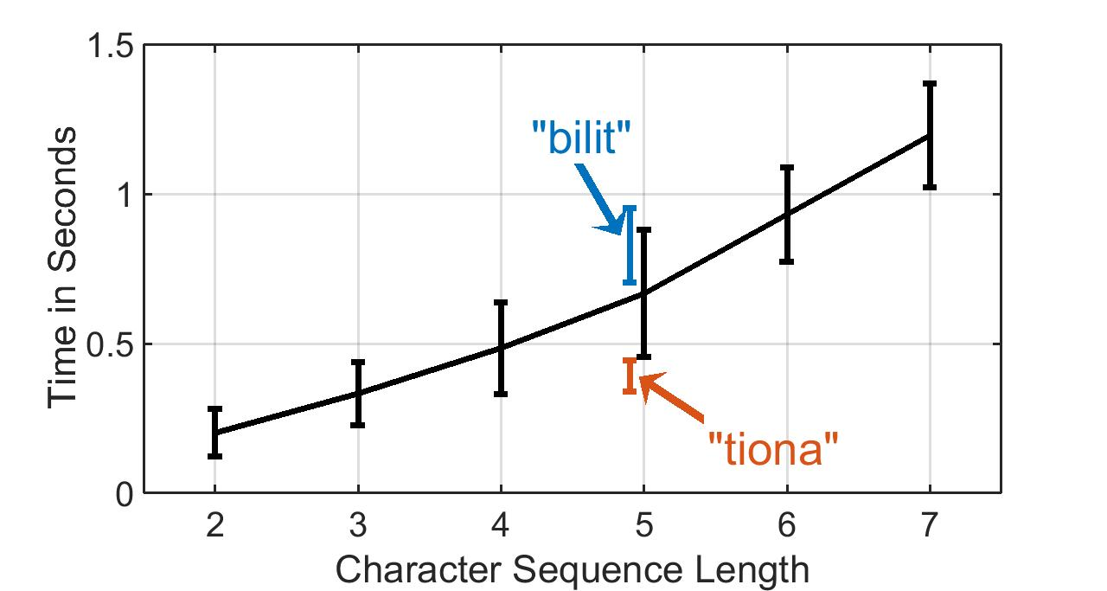
Observation 3: Time Interval

Slide 61
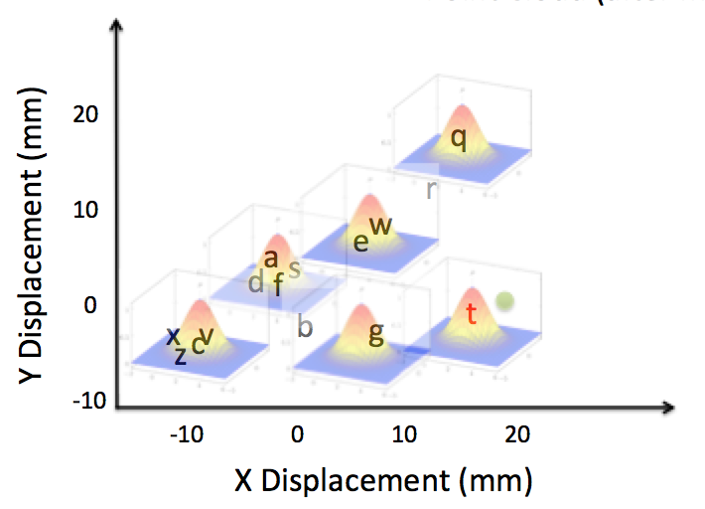
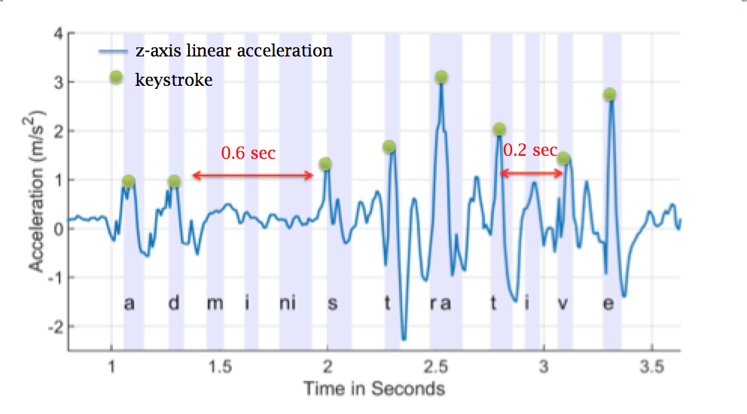
Bayesian Inference
The probability of the observed motion given word_{i}
Number of keystrokes
Location distribution
Time interval distribution

Slide 62
Outline
Motivation & Challenge
MoLe
Evaluation
Limitations
Conclusion

Slide 63
Experimental Setup
Samsung Galaxy Gear Live with Android Wear
  Sample accl and gyro at 200Hz
  Off-line Matlab analysis
8 Participants
  5 native speakers, 3 non-native speakers
  300 words for each subject, 2400 words total
  Words are randomly selected from 5000 most frequently used words
2 labeled point clouds (training data)
  2 persons collect offline data with Top-500 longest words

Slide 64
Evaluation Metrics
How well can Mole guess each word?
Observation improvements
Recovery via human observation

Slide 65
Rank CDF
Median rank = 24, 30 percentile rank = 5 (out of 5000 words)
When word length > 6, median rank = 10

Slide 66
Avg Rank Across Users
With perfect key press detection
median rank = 6, 30 percentile rank = 1

Slide 67
Evaluation Metrics
How well can Mole guess each word?
Observation improvements
Recovery via human observation

Slide 68
Observation Improvements
340
49
24

Slide 69
Evaluation Metrics
How well can Mole guess each word?
Observation improvements
Recovery via human observation

Slide 70
Can you guess the sentence?
Rank | W1 | W2 | W3 | W4 | W5 | W6 | W7 | w8
1 | motor | pistol | profound | technology | angel | those | that | disappear
2 | monitor | list | journalism | remaining | spray | today | tight | discourse
3 | them | but | originally | telephone | super | third | tightly | secondary
4 | the | lost | original | meanwhile | fire | through | thirty | adviser
5 | then | most | profile | headline | shore | towel | truth | discover

Slide 71
Can you guess the sentence?
“The most profound technologies are those that disappear”
- Mark Weiser, 1991
Rank | W1 | W2 | W3 | W4 | W5 | W6 | W7 | w8
1 | motor | pistol | profound | technology | angel | those | that | disappear
2 | monitor | list | journalism | remaining | spray | today | tight | discourse
3 | them | but | originally | telephone | super | third | tightly | secondary
4 | the | lost | original | meanwhile | fire | through | thirty | adviser
5 | then | most | profile | headline | shore | towel | truth | discover
are

Slide 72
Outline
Motivation & Challenge
MoLe
Evaluation
Limitations
Conclusion

Slide 73
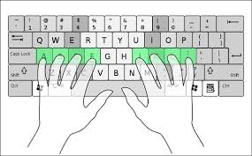
Limitations
Single word only
  Unable to detect space (could be right or left thumb)
English words only
  Digits and non-English words are not applicable
Required standard typing method

Slide 74
Outline
Motivation & Challenge
MoLe
Evaluation
Limitations
Conclusion

Slide 75
Conclusion
Mole: Motion Leaks through Smartwatch sensor
Identify leaks when using watch motion sensors to infer input words
Type a word W with length > 6, MoLe can shortlist 10 words (rank 10) on average that includes W

