Slide 1
Personalizing Head Related Transfer Functions for Earables
Zhijian Yang, Romit Roy Choudhury
ACM SIGCOMM 2021

Slide 2
Imagine you are wearing earphones … and you hear
Notes:
Imagine you are wearing earphones … and you hear a voice says

Slide 3
Imagine you are wearing earphones … and you hear
“Hello, please come this way”
“Hello, please come this way”
Notes:
“Hello, please come this way”

Slide 4
Imagine you are wearing earphones … and you hear
“Hello, please come this way”
“Hello, please come this way”
Can you tell if the sound is real or virtual?
Notes:
Do you think you can tell if the voice was played through the earbud … or was it a real person calling you from somewhere nearby?

Slide 5
Imagine you are wearing earphones … and you hear
“Hello, please come this way”
“Hello, please come this way”
Can you tell if the sound is real or virtual?
With today’s earphones, you easily can.
Notes:
With today’s earbud sounds, you can easily tell the difference.

Slide 6
Imagine you are wearing earphones … and you hear
“Hello, please come this way”
“Hello, please come this way”
Can you tell if the sound is real or virtual?
With today’s earphones, you easily can.
But is it possible to make the virtual sound indistinguishable with real one?

Slide 7
Imagine you are wearing earphones … and you hear
“Hello, please come this way”
“Hello, please come this way”
Can you tell if the sound is real or virtual?
With today’s earphones, you easily can.
But is it possible to make the virtual sound indistinguishable with real one?
In other words, can we fool the brain … so it cannot tell the difference ?

Slide 8
“Hello, please come this way”
“Hello, please come this way”
Can you tell if the sound is real or virtual?
In other words, can we fool the brain … so it cannot tell the difference ?
Notes:
Imagine you are wearing an earbud … and imagine a voice says “hey you, come here”. Do you think you can tell if the voice was played through the earbud … or was it a real person calling you from somewhere nearby?
With today’s earbud sounds, you can easily tell the difference.
But wait … is it possible to design the voice sound carefully so that you CANNOT tell the difference between the artificial and real one? In other words, can I fool your brain into thinking that the earbud sound is actually a real sound?

Slide 9
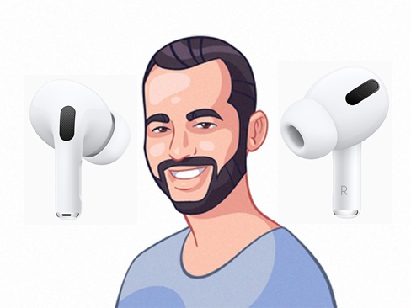
“Hello, please come this way”
“Hello, please come this way”
Can you tell if the sound is real or virtual?
In other words, can we fool the brain … so it cannot tell the difference ?
This paper aims to design a filter , such that …
Filter the sound
Sounds real!!
Any voice or sound
Notes:
This paper aims to design a filter, such that when it’s applied on the original sound, it can trick the brain to believe this is an actual sound

Slide 10
This paper aims to design a filter , such that …
Filter the sound
Sounds real!!
Any voice or sound

Slide 11
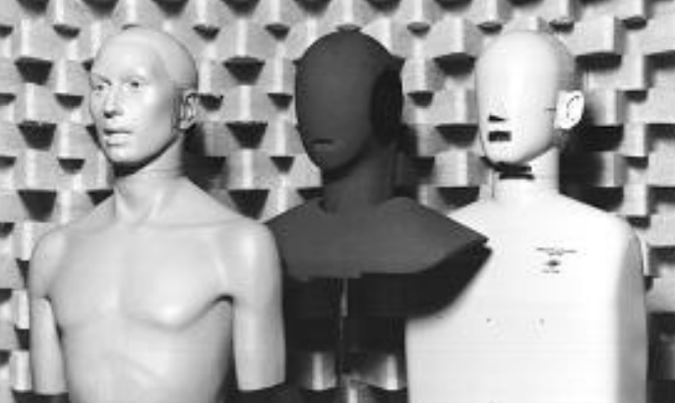
This paper aims to design a filter , such that …
Filter the sound
Sounds real!!
Any voice or sound
This filter is called: Head related transfer function (HRTF)
HRTF research began as early as the 1960s
but HRTF design is still a challenging problem
Notes:
People have been using artificially created heads to understand how signals bounce around the head and ear since long ago, but the complex geometry of human anatomy makes this difficult.

Slide 12
This filter is called: Head related transfer function (HRTF)
but HRTF design is still a challenging problem
1. how the sound bends or diffracts around your cheek and face

Slide 13
This filter is called: Head related transfer function (HRTF)
but HRTF design is still a challenging problem
Pinna
1. how the sound bends or diffracts around your cheek and face
HRTF($θ$)
2. how the real signal bounces inside your pinna
Signal Scattering
If the earbud can learn your personalized HRTF … then fooling your brain is easy.
HRTF filter
Then a lot of applications can be enabled…
Notes:
We essentially needed to pass the original sound signal through the HRTF filter, and then a realistic spatial audio can be created.
Then a lot of applications can be enabled…

Slide 14
If the earbud can learn your personalized HRTF … then fooling your brain is easy.
HRTF filter
Then a lot of applications can be enabled…
Spatial Audio Navigation

Slide 16
If the earbud can learn your personalized HRTF … then fooling your brain is easy.
HRTF filter
Then a lot of applications can be enabled…
Virtual Immersive Meeting with 360 Audio
Spatial Audio Navigation
VR Gaming

Slide 17
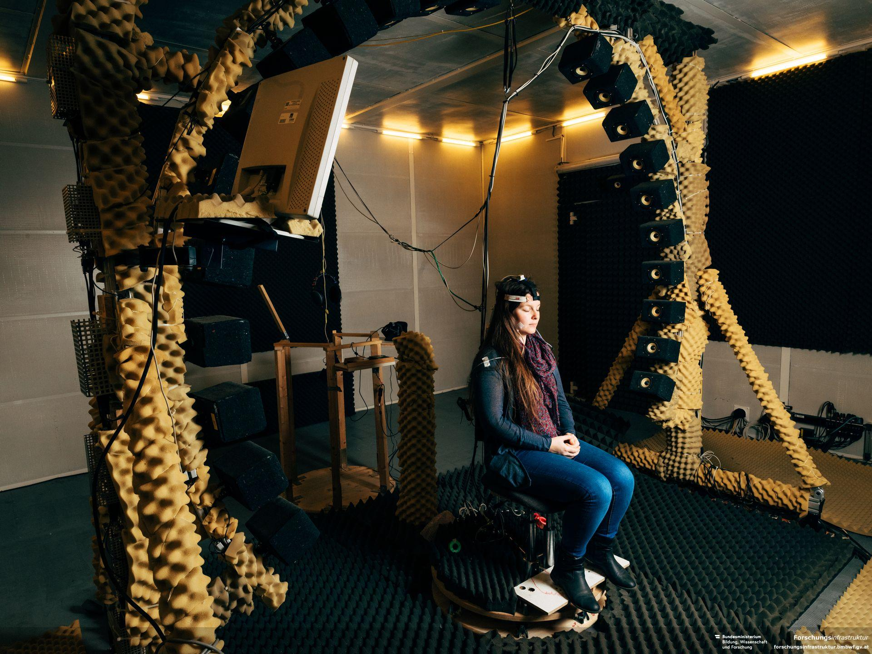
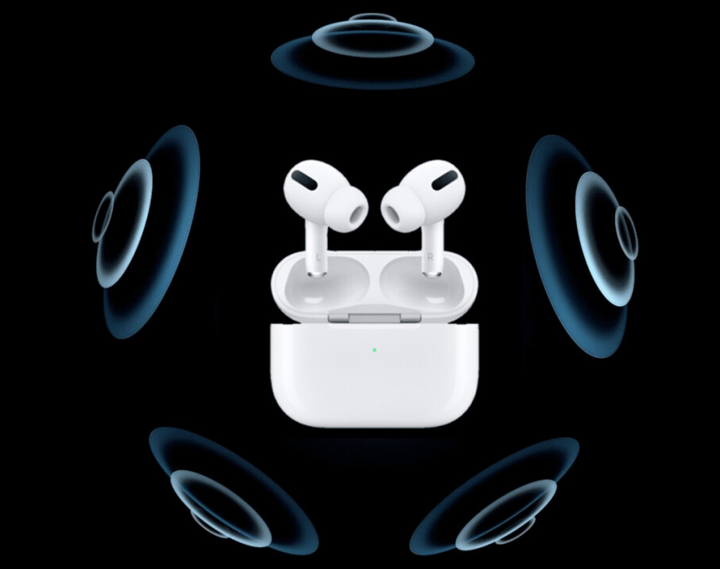
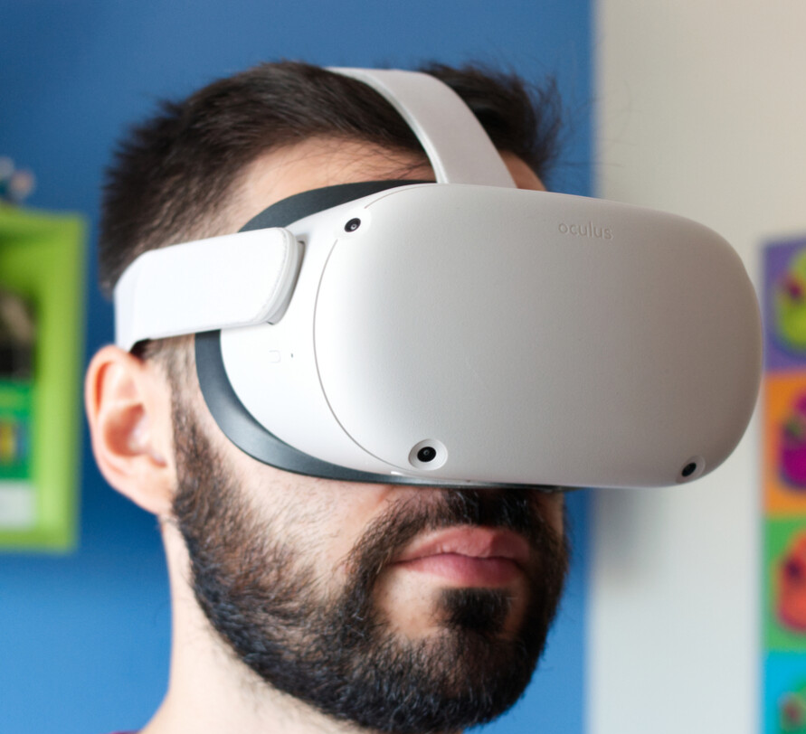
It is extremely hard to understand how your head and ear affect sound.
How is HRTF measurement performed today?
In very controlled settings.
Spatial audio products are using generic HRTF
Generic HRTF is not optimal.
Acoustic chamber
Big rotating speaker array
Difficult to obtain
Notes:
A user is asked to sit in a large acoustic chamber and wear in-ear microphones. A large rotating speaker array can then simulate the sound effect of a sound source at any given angle. In this way, HRTFs can be estimated.
This means, the spatial audio products we see these days, like the apple airpods pro and oculus quest are using global HRTF.
Global HRTF is not optimal. We did our study.

Slide 18
Generic HRTF is not optimal.
We ask user to identify the sound direction.
Generic HRTF leads to as large as 60 degrees externalization error!!
Notes:
We plotted the heatmaps here. In the first heatmap, we plot the self - xcorr between a user’s own HRTF at different angles, which is diagonal. In the second heatmap, we plot the xcorr between a user’s own HRTF and global HRTF, which is obviously not digonal.

Slide 19
It is extremely hard to understand how your head and ear affect sound.
How is HRTF measurement performed today?
In very controlled settings.
Spatial audio products are using global HRTF
Acoustic chamber
Big rotating speaker array
Generic HRTF leads to as large as 60 degrees externalization error!!
Difficult to obtain

Slide 20
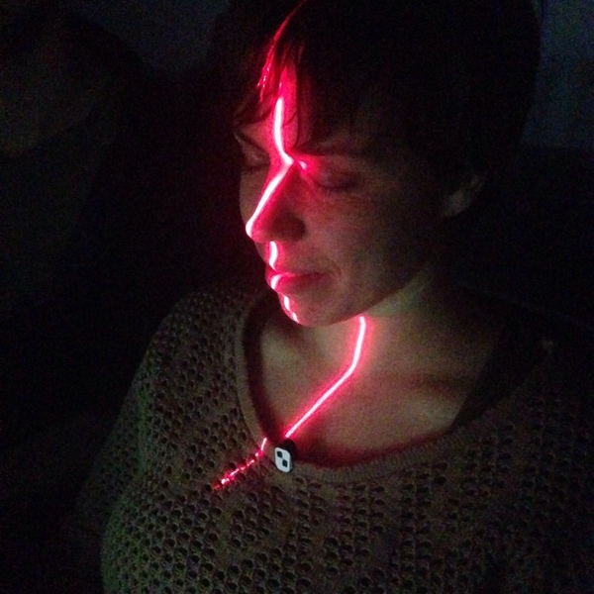
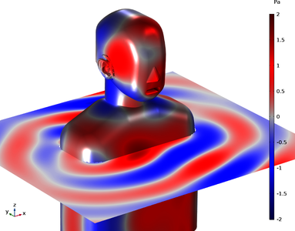
It is extremely hard to understand how your head and ear affect sound.
How is HRTF measurement performed today?
In very controlled settings.
Can we personalize HRTF without acoustic chamber?
3D scan
Acoustic simulation/ML
Material (skin, hair) property difficult to estimate.
Acoustic chamber
Big rotating speaker array
Difficult to obtain
Notes:
Can we personalize HRTF without acoustic chamber?
Previous researchers have used …

Slide 21
It is extremely hard to understand how your head and ear affect sound.
How is HRTF measurement performed today?
In very controlled settings.
Can we personalize HRTF without acoustic chamber?
This paper asks: can we build a system allowing easy personalized HRTF estimation at home?
3D scan
Acoustic simulation/ML
Material (skin, hair) property difficult to estimate.
Acoustic chamber
Big rotating speaker array
Difficult to obtain
Notes:
Can we personalize HRTF without acoustic chamber?
Previous researchers have used …

Slide 22
This paper asks: can we build a system allowing easy personalized HRTF estimation at home?
Here is our basic idea for UNIQ:
Smartphone as transmitter.
In-ear microphone as receiver.
HRTF estimated by rotating phone around the head.
The remaining slides are organized as following:
UNIQ System Sketch
2 technical parts
Phone localization
Near-far HRTF conversion
Implementation & Evaluation
Notes:
Here is our basic idea for UNIQ:

Slide 23
UNIQ: System Sketch

Slide 24
UNIQ: System Sketch
Use smartphone as a transmitter
Smartphone transmits a known signal 𝑠
Two in-ear microphones receive signals $r$
User moves the phone; IMU records motion
Front
Front
P
(phone)
P
(phone)
L
L
R
R

Slide 25
UNIQ: System Sketch
Use smartphone as a transmitter
Smartphone transmits a known signal 𝑠
Two in-ear microphones receive signals $r$
User moves the phone; IMU records motion
Estimate channel h from known s and r
Localize phone using IMU + Mic fusion
Front
P
(phone)
$$h$$
$$h$$
L
R
If we have the precise phone location, then we have near field HRTF

Slide 26
UNIQ: System Sketch
Use smartphone as a transmitter
Smartphone transmits a known signal 𝑠
Two in-ear microphones receive signals $r$
User moves the phone; IMU records motion
Estimate channel h from known s and r
Localize phone using IMU + Mic fusion
Near to far field HRTF conversion
Front
P
(phone)
$$h$$
$$h$$
L
R
Near field is not enough since we want to create the effect for far field
Let’s start with:
Technical Part 1: Phone Localization

Slide 27
Technical Part 1: Phone Localization
Goal: As user rotates the phone around the head,
localize each phone location
Assume we know the distance between mic, and there’s no head
Then localization is straightforward…
$$d_{i,L}$$
$$d_{i,R}$$
L
R
$θ_{i}$,
$$r_{i}$$

Slide 28
Technical Part 1: Phone Localization
Goal: As user rotates the phone around the head,
localize each phone location
Assume we know the distance between mic, and there’s no head
Then localization is straightforward…
But what happens when there’s a head in between?
Signal diffracts around head
To model diffraction, we need head size & shape
Diffraction-aware sensor fusion
$$d_{i,L}$$
$$d_{i,R}$$
L
R
Front
Front
$P_{i}$
(phone)
(unknown!)
$$d_{i,L}$$
$$d_{i,L}$$
$$d_{i,R}$$
$$d_{i,R}$$
$$α_{i}$$
L
L
R
R
$θ_{i}$,
$$r_{i}$$

Slide 29
Technical Part 1: Phone Localization
Goal: As user rotates the phone around the head,
localize each phone location
Assume we know the distance between mic, and there’s no head
Then localization is straightforward…
But what happens when there’s a head in between?
Signal diffracts around head
To model diffraction, we need head size & shape
Diffraction-aware sensor fusion
Phone IMU gives $θ_{i}$ -> $α_{i}$
Diffraction based trilateration gives $P_{i}$ -> $α_{i}$
Over-determined: jointly solve for head shape and phone loc.
$$d_{i,L}$$
$$d_{i,R}$$
L
R
$$θ_{i}$$
$$θ_{i}$$
Front
Front
$P_{i}$
(phone)
(unknown!)
$$d_{i,L}$$
$$d_{i,L}$$
$$r_{i}$$
$$r_{i}$$
$$d_{i,R}$$
$$d_{i,R}$$
$$α_{i}$$
$$α_{i}$$
L
L
R
R
$θ_{i}$,
$$r_{i}$$

Slide 30
We have phone location estimated now.
By mapping the phone location with the acoustic channel, we get the near field HRTF

Slide 31
We have phone location estimated now.
By mapping the phone location with the acoustic channel, we get the near field HRTF
But in most of the cases, we will need far field HRTF
Our next module:
Near - Far Conversion
Far
Field
$$α$$
Near
Field
Near field HRTF: coming from a point source
Far field HRTF: coming from parallel lines

Slide 32
Technical Part 2:
Near - Far Conversion

Slide 33
Technical Part 2:
Near - Far Conversion
Goal: synthesize the far-field HRTF at angle
$θ$, using near field HRTFs on trajectory A
Far field source
$$θ$$
L
R
A (Near field trajectory)

Slide 34
Technical Part 2:
Near - Far Conversion
Goal: synthesize the far-field HRTF at angle
$θ$, using near field HRTFs on trajectory A
Intuition: far field HRTF is a recombination of different rays for near field HRTF at different locations
$$X_{1}$$
$$X_{2}$$
$$X_{3}$$
L
R
A (Near field trajectory)

Slide 35
Technical Part 2:
Near - Far Conversion
Goal: synthesize the far-field HRTF at angle
$θ$, using near field HRTFs on trajectory A
Intuition: far field HRTF is a recombination of different rays for near field HRTF at different locations
$$X_{1}$$
$$X_{2}$$
$$X_{3}$$
L
R
A (Near field trajectory)

Slide 36
Technical Part 2:
Near - Far Conversion
Goal: synthesize the far-field HRTF at angle
$θ$, using near field HRTFs on trajectory A
Intuition: far field HRTF is a recombination of different rays for near field HRTF at different locations
$$X_{1}$$
$$X_{2}$$
$$X_{3}$$
$$θ$$
L
R
A (Near field trajectory)

Slide 37
Technical Part 2:
Near - Far Conversion
Goal: synthesize the far-field HRTF at angle
$θ$, using near field HRTFs on trajectory A
Intuition: far field HRTF is a recombination of different rays for near field HRTF at different locations
The decomposition for near field HRTF is a difficult problem
See detailed discussions in the paper
$$X_{1}$$
$$X_{2}$$
Far field source
$$X_{3}$$
$$θ$$
L
R
A (Near field trajectory)
We now have the far field HRTF estimated.
UNIQ HRTF
Sounds real!!
Any voice or sound

Slide 38
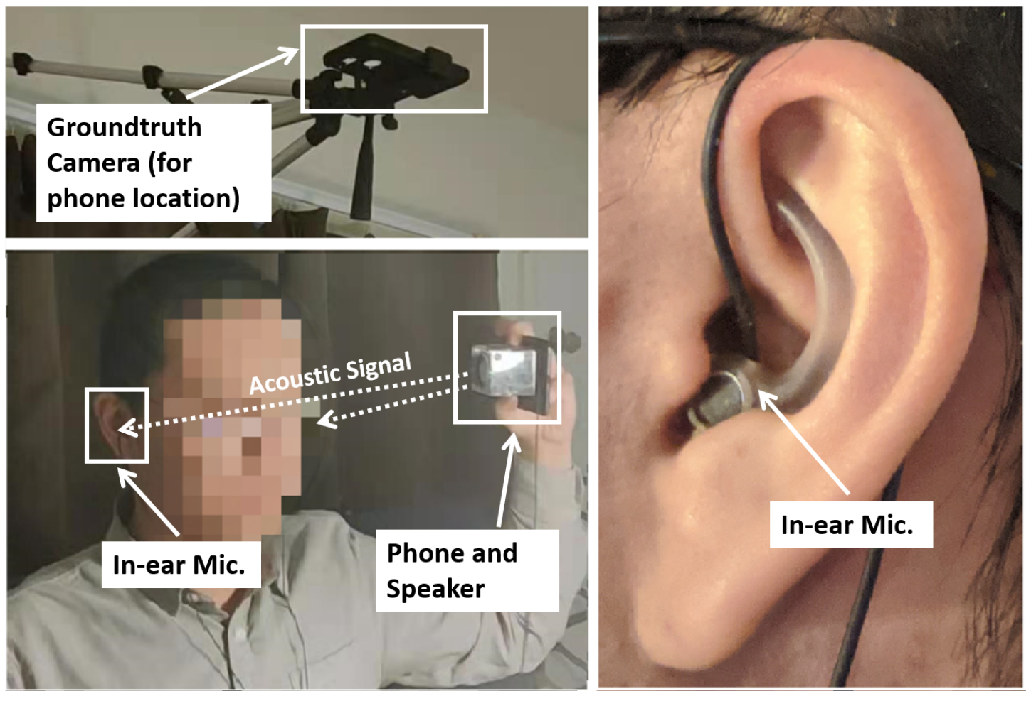
Implementation and Evaluation
We implemented UNIQ on COTS mobile devices
Notes:
Finally, let me talk about implementation and evaluation. We implemented UNIQ on COTS mobile devices , including a smartphone, speaker, and in-ear microphone.

Slide 39
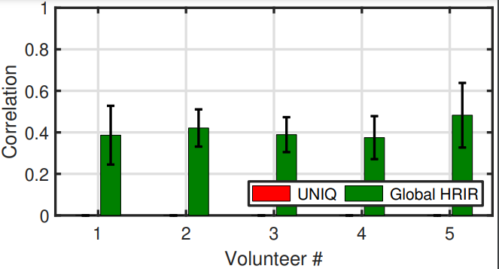
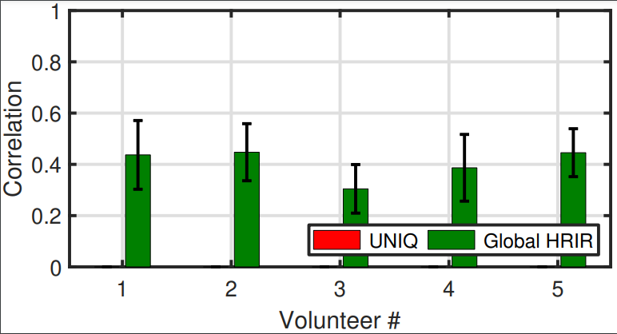
Implementation and Evaluation
Notes:
We show that UNIQ generates HRTF 1.8x more accurate than global HRTF.
In terms of estimating real world sound AoA, UNIQ can decrease the error of by 3X than if we use a global HRTF.

Slide 40
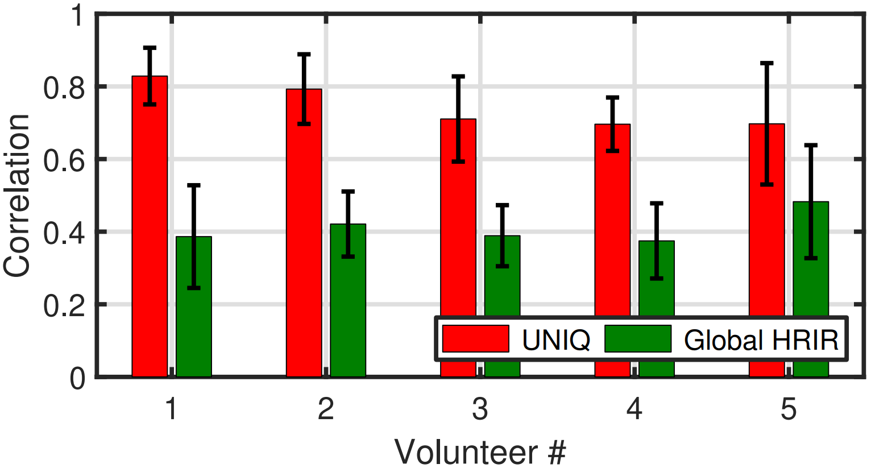
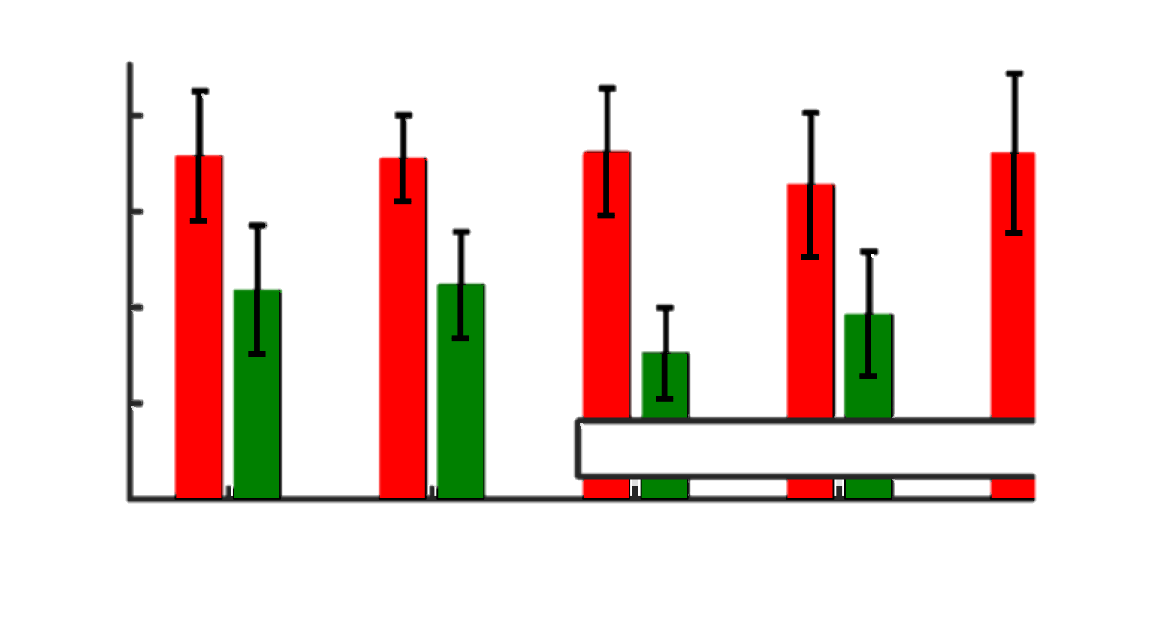
Implementation and Evaluation
UNIQ generates HRTF 1.8x more accurate than generic HRTF
More results in the paper
Notes:
We show that UNIQ generates HRTF 1.8x more accurate than global HRTF.
In terms of estimating real world sound AoA, UNIQ can decrease the error of by 3X than if we use a global HRTF.

Slide 41
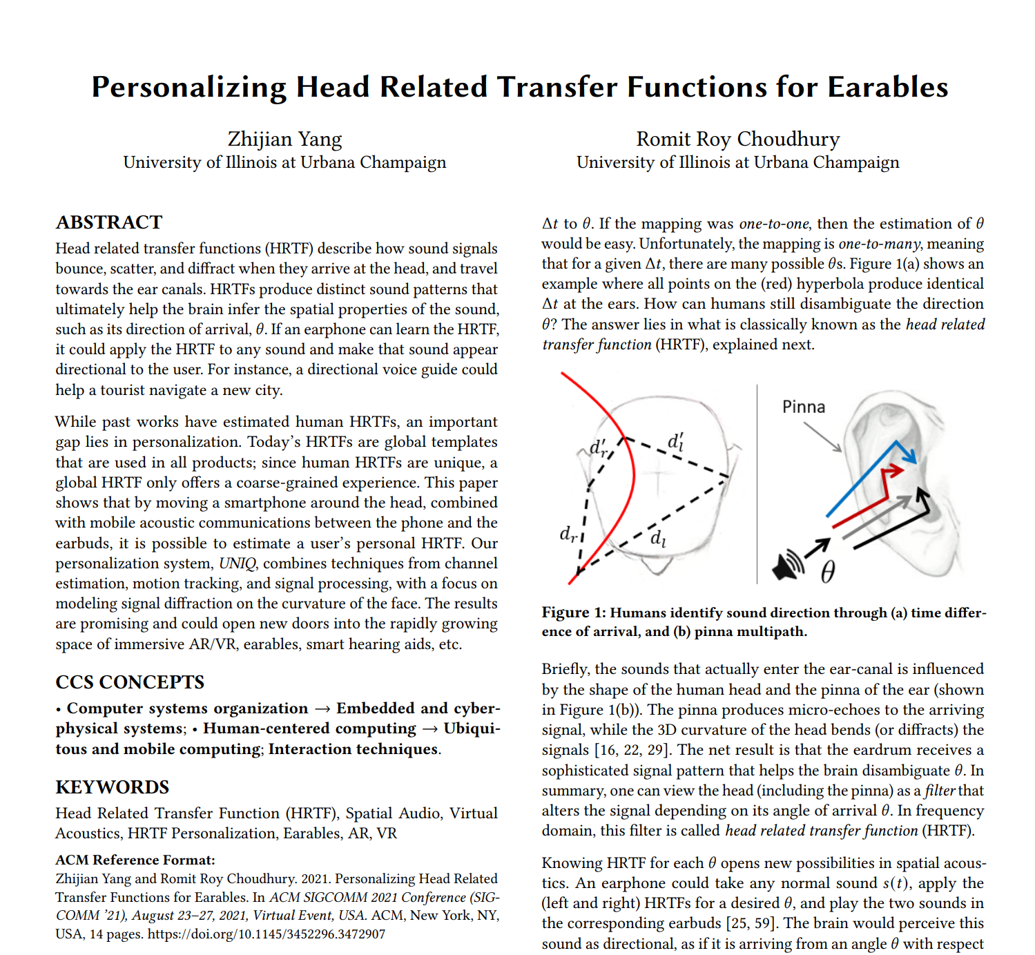
More details in the paper …
Thanks.
Zhijian
Romit

Slide 42
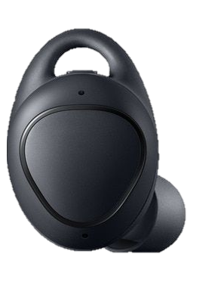
Other than making user hear better, what else can personalized HRTF do?
We present one application here: binaural AoA estimation
Hearing aids beamforming

Slide 43
Other than making user hear better, what else can personalized HRTF do?
We present one application here: binaural AoA estimation
Hearing aids beamforming
$$AoA_{1}$$
$$AoA_{2}$$
$$AoA_{n}$$
Sound based user localization

Slide 44
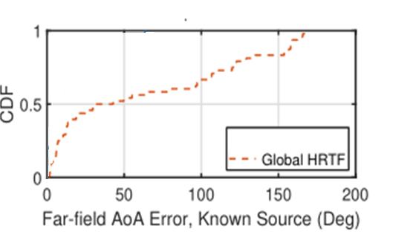
Other than making user hear better, what else can personalized HRTF do?
We present one application here: binaural AoA estimation
Binaural recording
binaural AoA estimation
AoA
Estimated HRTF
Hearing aids beamforming
$$AoA_{1}$$
$$AoA_{2}$$
$$AoA_{n}$$
Sound based user localization

Slide 45
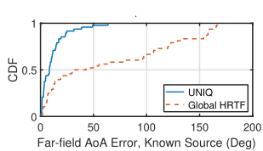
Other than making user hear better, what else can personalized HRTF do?
We present one application here: binaural AoA estimation
Binaural recording
binaural AoA estimation
AoA
Estimated HRTF
Hearing aids beamforming
$$AoA_{1}$$
$$AoA_{2}$$
$$AoA_{n}$$
For estimating real world sound direction: UNIQ can decrease the error of by 3X
Sound based user localization

