Slide 1
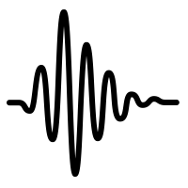
EarSense: Earphones as a Teeth
Activity Sensor
Jay Prakash
Zhijian Yang, Yu-Lin Wei, Haitham Hassanieh and Romit Roy Choudhury
Notes:
1. Good Evening, I am Jay … a visiting PhD student at UIUC. I am doing my PhD from SUTD, Singapore.
I would like to introduce our research Earsense … which was conceptualized with a vision of exploiting teeth as an activity sensor.

Slide 2
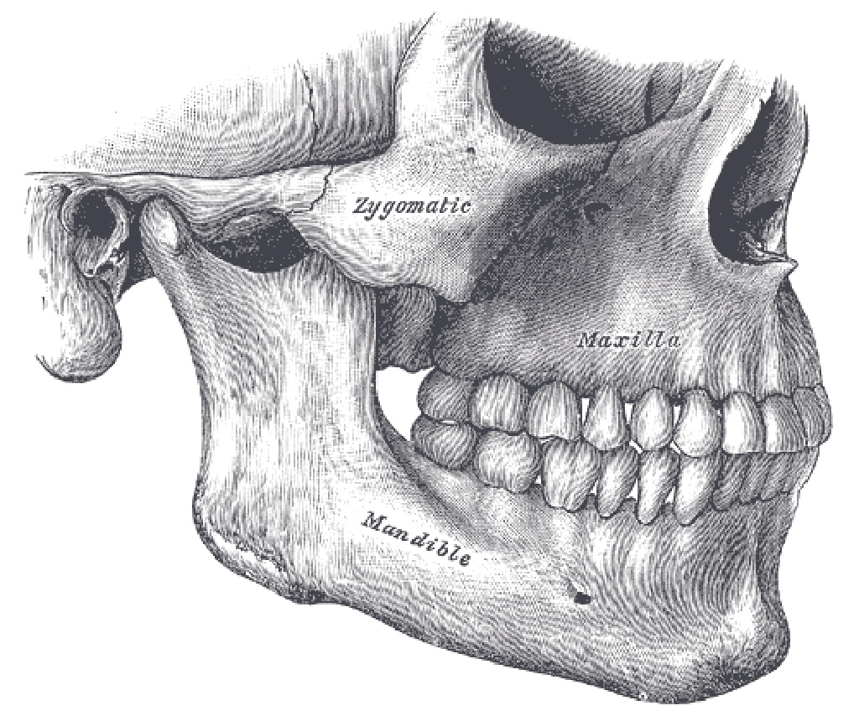
Basis of EarSense
Zygoma
Maxilla
Mandible
Vibrations from the teeth conduct through skull and arrive at eardrum.
Notes:
2. Earsense is based on the premise that … vibrations generated from human teeth … would conduct through the jaw and skull bones … and eventually arrive at the eardrum.

Slide 3
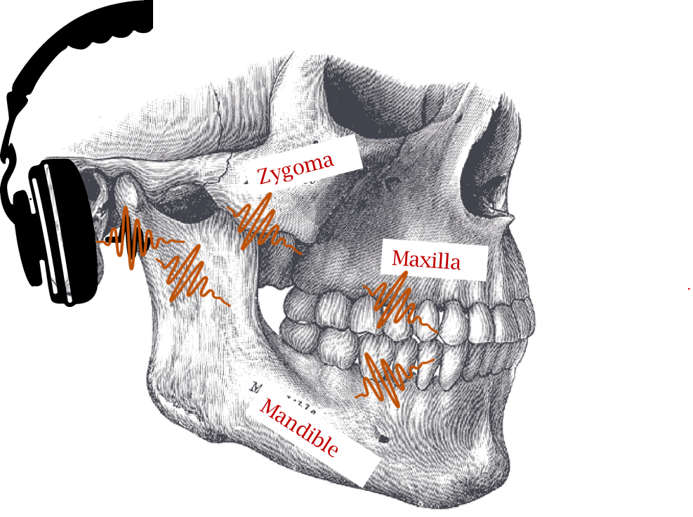
This paper asks:
1
Can off-the-shelf earphones
sense these surface vibrations?
Notes:
3. This paper asks two questions:
One … can today’s off-the-shelf earphones be used to pick up the vibration signal?

Slide 4
This paper asks:
1
Can off-the-shelf earphones
Sense these surface vibrations?
2
Can vibration signals be analyzed
to infer gestures and source locations?
Left
signal
Left
signal
Teeth Gesture,
Infer
Infer
Location
Right
signal
Notes:
4. And two … can we analyze these vibrations … and infer the actions or gestures of the teeth … and even the teeth locations where such gestures were made

Slide 5
Why?
Notes:
5. Before describing details, an obvious question arises … Why should we care?

Slide 6
Left
signal
Teeth Gesture,
Range of Applications …
Infer
Location
Right
signal
Notes:
6. We envision a wide range of applications from healthcare to user interfaces

Slide 7
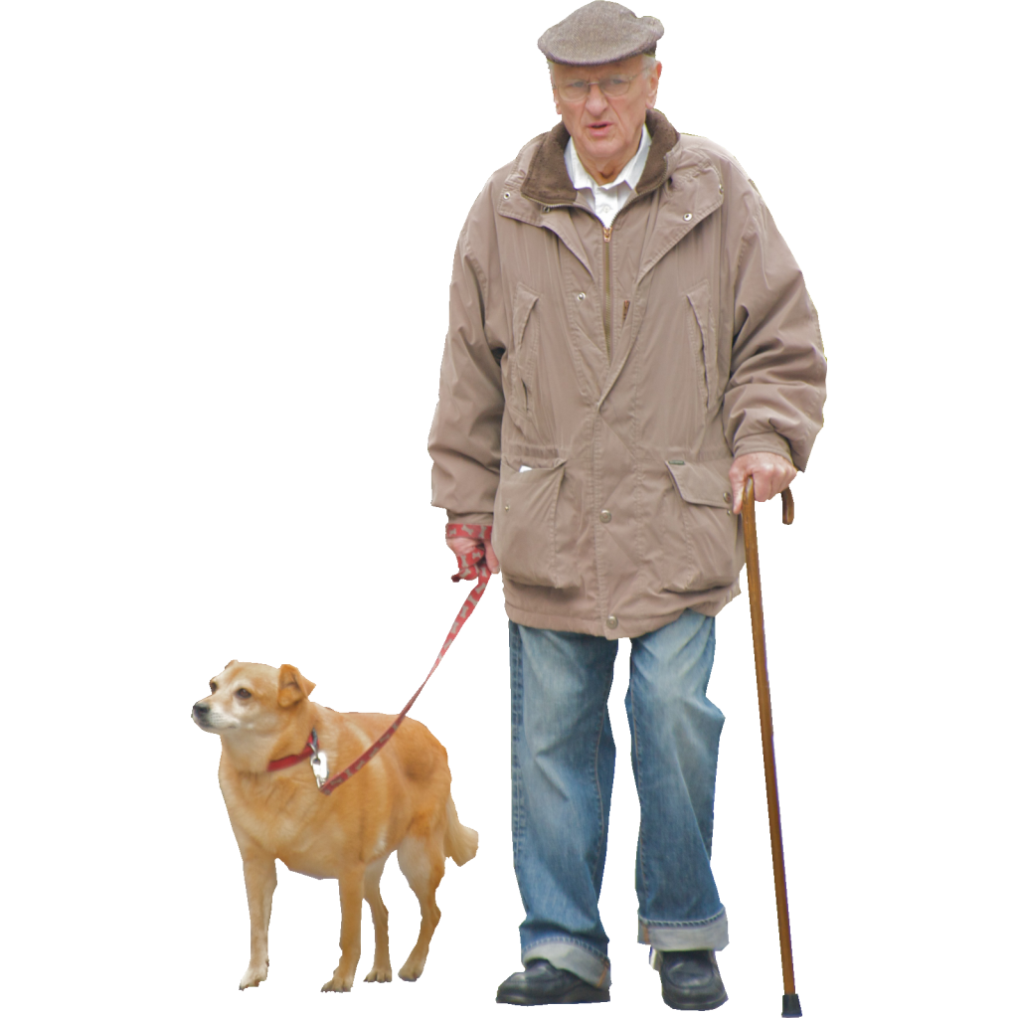
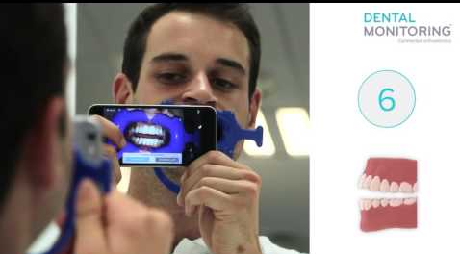
Left
signal
Teeth Gesture,
Range of Applications …
Infer
Location
Health
Right
signal
Seizure alert from teeth chatter …
no need for alert dog
Remote Dental Monitoring
Notes:
7. Consider the case of seizures. Today, patients go out with trained dogs that can alert the patient before the onset of a seizure. However, it has been observed that teeth chattering precedes a seizure. EarSense might be able to detect this teeth activity and alert the patient. EarSense may also be used in remote dental monitoring, where vibration data from the teeth can be uploaded for clinical analysis.

Slide 8
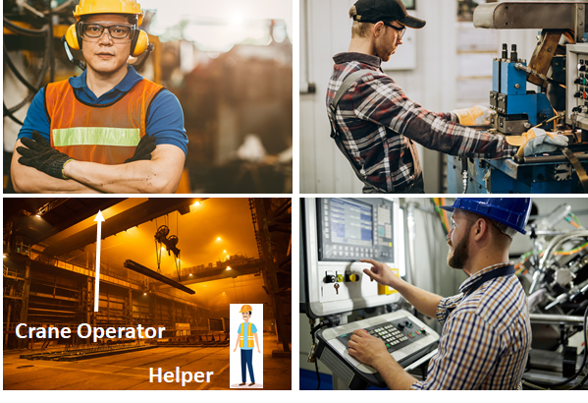
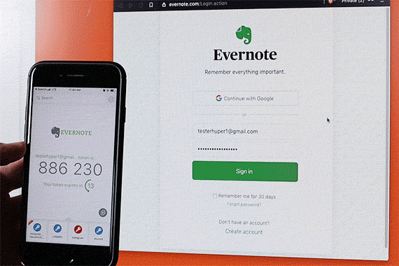
Left
signal
Teeth Gesture,
Range of Applications …
Infer
Location
Health
UI
Right
signal
Simple hands-free interfaces
Type PIN numbers with teeth
Notes:
In factories or hospitals ... where workers are wearing gloves or have their hands full ... EarSense can be used to perform simple actions or send commands.
EarSense may be helpful even in everyday use ... a person could type in a PIN number on her phone, or click and scroll while wearing a gloves in winter.

Slide 9
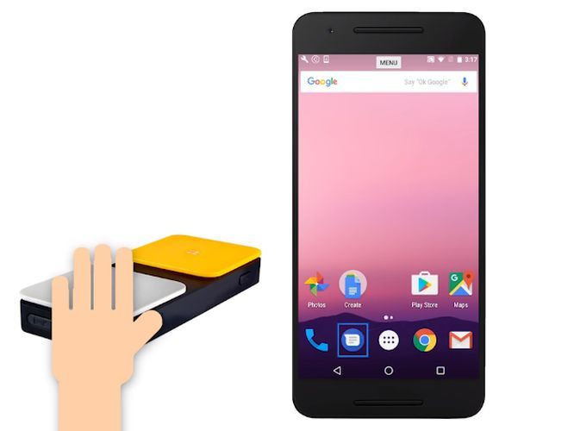
Left
signal
Teeth Gesture,
Range of Applications …
Infer
Location
Health
UI
Accessibility
Right
signal
Replace Android Switch with EarSense
Notes:
Finally, EarSense can help accessibility ... such as by replacing the Android Switch ... which today has to be bought as a separate accessory.

Slide 10
Left
signal
Teeth Gesture,
Range of Applications …
Infer
Location
Health
UI
Accessibility
Right
signal
Privacy Preserving
Contactless/Hand-free
Ease of interactions
Notes:
10. Importantly, gestures through earphones would be privacy preserving, support contactless and hand-free short interactions and also enhance the usability.

Slide 11
How?
Notes:
So what make EarSense possible?

Slide 12
We demonstrate:
Earphone speakers can be re-purposed
as a vibration sensor
Notes:
12. Our first pillar is based on the exploitation that COTS earphone speakers can be programmed as vibration sensors

Slide 13
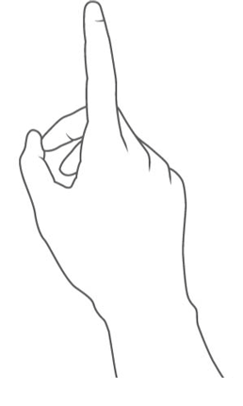
When external vibrations impinge on the speaker, voltage is produced
Left
signal
Right
signal
Notes:
The idea is based on the very basic principle of electromagnetic duality.
If diaphragms of speakers are vibrated through external force, electrical signals are generated in both the channels.

Slide 14
When external vibrations impinge on the speaker, voltage is produced
This toggles the speaker
as a sensor
(behaving like a microphone)
Left
signal
Right
signal
Notes:
14. Building on this phenomenon, we intend to re-purpose the earphone as a vibration microphone.
In other words, the speaker can act like a microphone ... and hence ... can sense vibrations that conduct through the face and skull.

Slide 15
Can we toggle automatically?
Speakers Microphone
Notes:
But, the system in practice would require an automated toggling between the two.

Slide 16
Can we toggle automatically?
Speakers Microphone
Yes, PIN 14-17 can be programmed as either speaker or microphone (called jack re-tasking)
Notes:
Yes, we can. We do on the fly toggling, which is to and fro conversion of speakers to microphones, using software based jack-retasking on PINs.

Slide 17
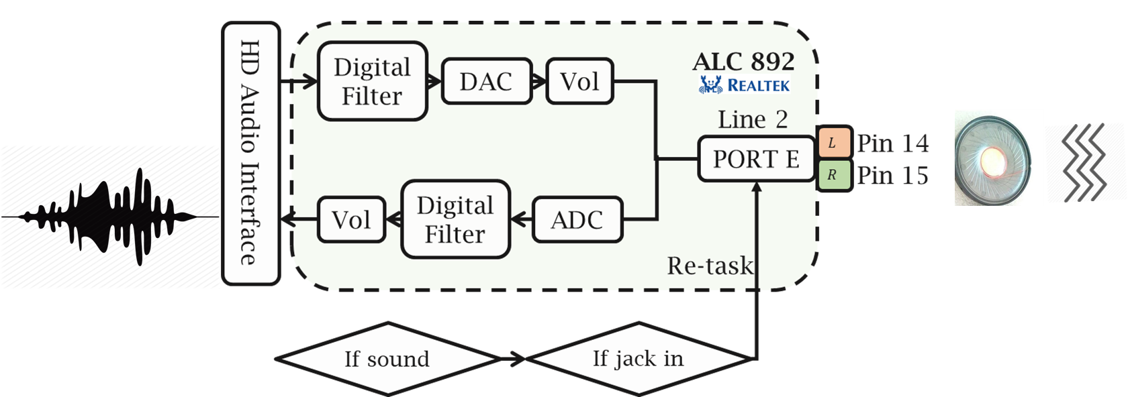
Can we toggle automatically?
Speakers Microphone
Yes, PIN 14-17 can be programmed as either speaker or microphone (called jack re-tasking)
And possible in software
(few lines of code change)
Notes:
17. Pin 14-17 of Realtek Audio codec chips were programmed to act as a microphone is there is no sound being played.

Slide 18
We demonstrate:
2. Feasibility to infer teeth gestures and locations
Notes:
Having captured the signals at two channels, let’s study feasibility of using stereo signals for inferring teeth gestures and locations.

Slide 19
We demonstrate:
2. Feasibility to infer teeth gestures and locations
EarSense decodes 3 types of teeth gestures across 7 locations
Notes:
EarSense decodes 3 types of teeth gestures across 7 locations

Slide 20
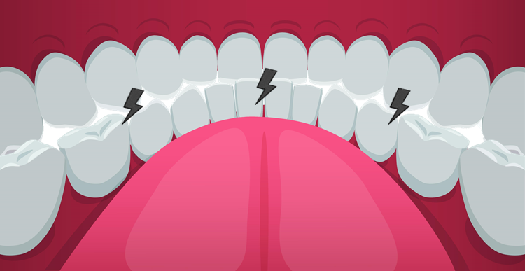
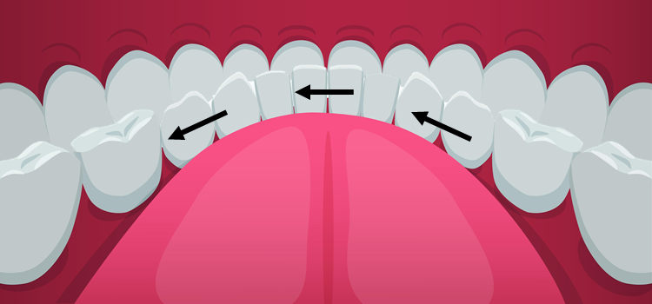
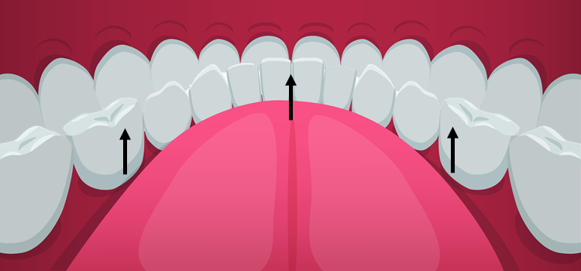
We demonstrate:
2. Feasibility to infer teeth gestures and locations
EarSense decodes 3 types of teeth gestures across 7 locations
3 Taps
2 Horizontal Slides
2 Vertical Slides
Left/Middle/Right Tap
Left-to-Right and Right-to-Left
Up-to-Down and Down-to-Up
Notes:
These include 3 location sof tap: left, middle and right. 2 horizontal slides: left-to right and vice versa and 2 vertical slides up-to-down and vice verca.

Slide 21
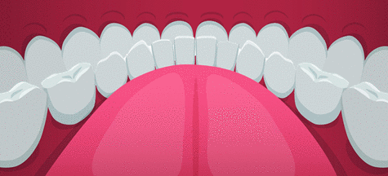
We demonstrate:
2. Feasibility to infer teeth gestures and locations
EarSense decodes 3 types of teeth gestures across 7 locations
3 Taps
2 Horizontal Slides
2 Vertical Slides
Left/Middle/Right Tap
Left-to-Right and Right-to-Left
Up-to-Down and Down-to-Up
Example: Left Tap
Notes:
An example of left tap in shown in this animation.

Slide 22
We demonstrate:
2. Feasibility to infer teeth gestures and locations
EarSense decodes 3 types of teeth gestures across 7 locations
3 Taps
2 Horizontal Slides
2 Vertical Slides
Left/Middle/Right Tap
Left-to-Right and Right-to-Left
Up-to-Down and Down-to-Up
Example: Left Tap
Complete teeth gesture inference is a 3 Step Process
Notes:
For Earsense, the teeth gesture inference is a 3 step process.

Slide 23
EarSense: 3 Step Process
1
Teeth Activity
Notes:
First, we detect if there is actually a teeth related activity. This classification is based on frequency domain analysis and study of harmonics.

Slide 24
EarSense: 3 Step Process
1
2
Teeth Activity
Tap/
Slide
Notes:
Once we are sure of a teeth activity, we estimate if it is a tap or a slide.

Slide 25
EarSense: 3 Step Process
1
2
Tap
Spectral Features
Template correlation
Signal durations
Teeth Activity
Tap/
Slide
Slide
Notes:
Classification between tap and slide is based on analysis of spectral features, template correlations and signal durations. Taps are impulsive, hence, create a wide band signal.

Slide 26
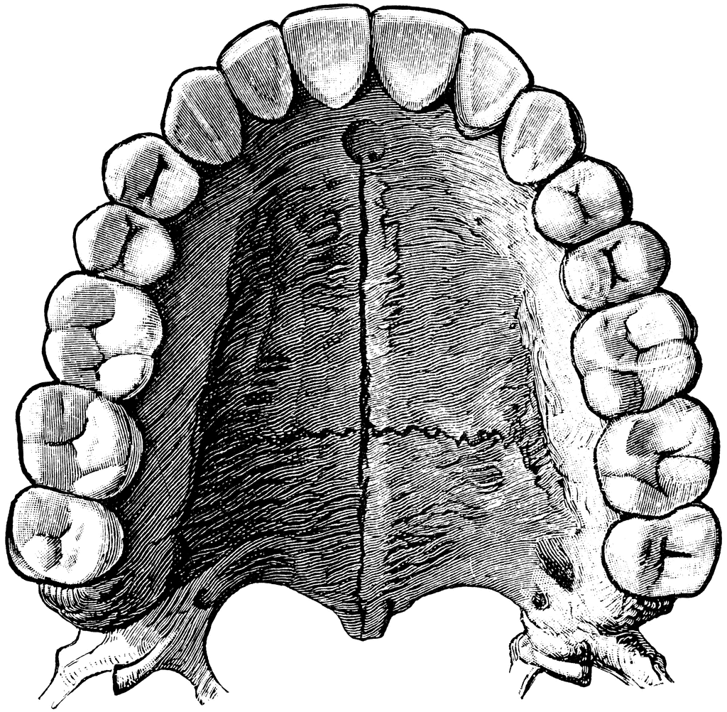
EarSense: 3 Step Process
3
Tap Detected
Localization of tap
$$s$$
$d_{sc}$
c
Notes:
If a tap is detected, we proceed with it’s localization.

Slide 27
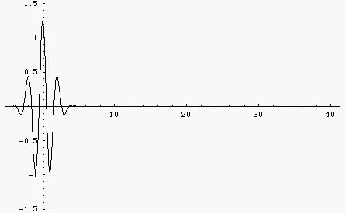
EarSense: 3 Step Process
3
Tap Detected
Localization of tap
Teeth is a dispersive medium
$$s$$
$d_{sc}$
c
Non-Dispersive
Dispersive
Notes:
The challenge here is that, teeth behaves as a dispersive medium. Vibration signals of different frequencies travel at different speed.

Slide 28
EarSense: 3 Step Process
3
Tap Detected
Localization of tap
$$S_{r}$$
$S_{r}$(t) != $S_{l}(t+Δ_{t})$
$$S_{l}$$
Teeth is a dispersive medium
$$s$$
$d_{sc}$
c
Non-Dispersive
Dispersive
Notes:
Hence, left and right channels are not delayed versions of each other. Since, signals are not symmetric, standard delay analysis will not suffice here.

Slide 29
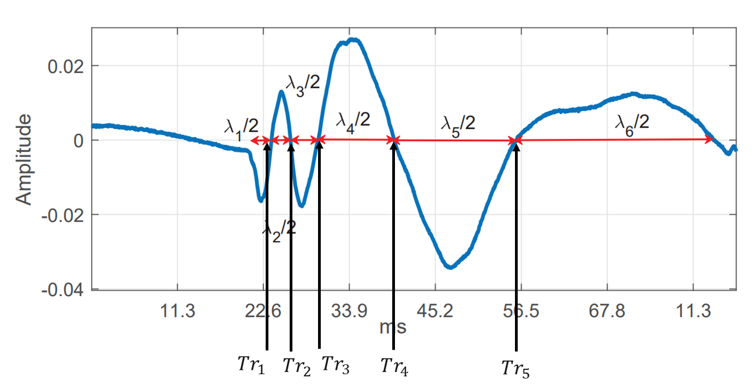
EarSense: 3 Step Process
3
Tap Detected
Localization of tap
$$S_{r}$$
$$S_{l}$$
Notes:
As we saw before, the signals generated during tap are wideband. Because of dispersion, high frequency waves reach first to the ear. We find zero-crossing instances of the received signals at both the channels.

Slide 30
EarSense: 3 Step Process
3
Tap Detected
Localization of tap
$$S_{r}$$
$$S_{l}$$
$ZcD=[T_{r1}−Tl_{1},T_{r2}−Tl_{2},$ $T_{r3}−Tl_{3},……,T_{rN}−Tl_{N}]$
Zero-Crossing Difference
Notes:
Differences between zero crossing time at left and right channel is calculate. The intuition is here is that, farther the location of tap from the earphones, more dispersion would be observed. Hence waves would be more stretched out along time axis.

Slide 31
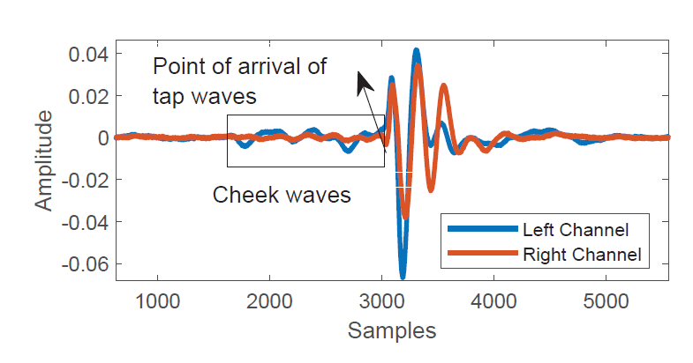
EarSense: 3 Step Process
3
Tap Detected
Localization of tap
$$S_{r}$$
$$S_{l}$$
Contraction and relaxation of muscles around ear: Generation of weak cheek waves.
Notes:
Also, we exploit occurrence of an interesting phenomenon. Our cheek muscles move more towards the side of teeth activity, right before the teeth strike each other. These contractions and relaxations generate waves.

Slide 32
EarSense: 3 Step Process
3
Tap Detected
Localization of tap
$$S_{r}$$
$$Energy_{Cheek Waves}$$
$$S_{l}$$
Contraction and relaxation of muscles around ear: Generation of weak cheek waves.
Notes:
We measure energy of these weak waves, right before detection of a tap and report about the probable location of the activity.

Slide 33
EarSense: 3 Step Process
3
Tap Detected
Localization of tap
EarSense
$$S_{r}$$
Zero-Crossing Difference
Cheek Waves Dominance
L/M/R Tap
$$S_{l}$$
TDoA of low frequencies
Notes:
As a whole, tap detection uses fusion of 3 techniques on the stereo signals: zero-crossing differences, dominance of cheek waves and time-difference of arrival of lower frequencies. Using a joint voting Earsense reports wether middle, left or right tap was done.

Slide 34
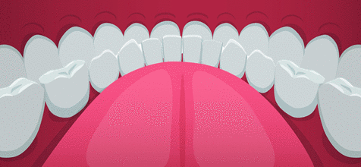
EarSense: 3 Step Process
3
Tracking Slide
Location of friction shifts from left to right
Notes:
We exploit a differentiating opportunity with the slides. As can be seen in the animation, the location of friction shifts during a slide.

Slide 35
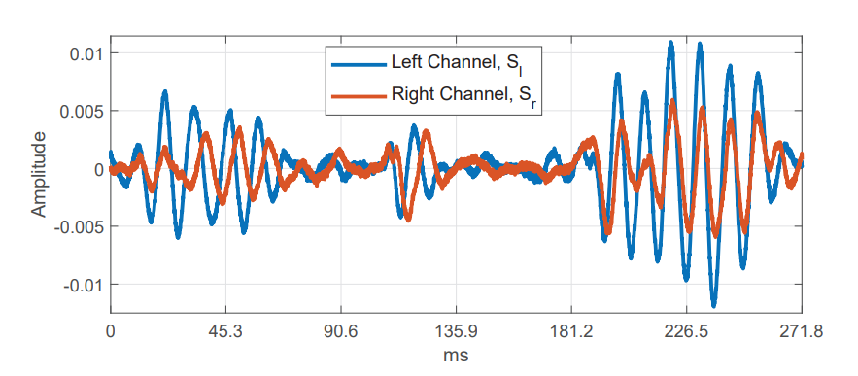
EarSense: 3 Step Process
3
Tracking Slide
Location of friction shifts from left to right
Delays between the channels changes
Notes:
This change of point of contact leads to variation in relative delays between left and right channels, as the teeth move from an end to the other.

Slide 36
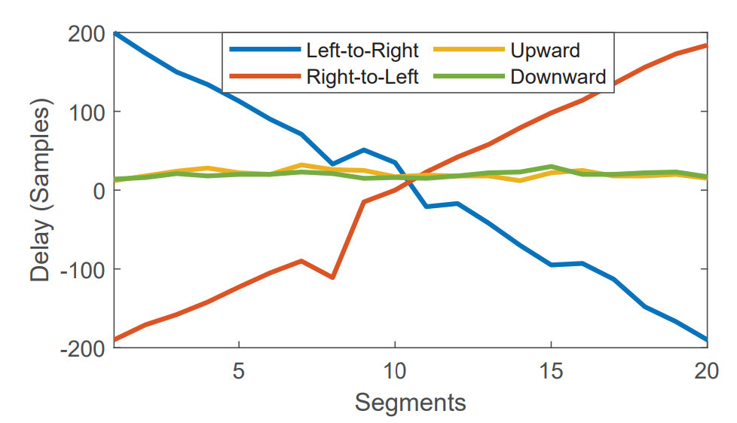
EarSense: 3 Step Process
3
Tracking Slide
Delays between the channels shifts
Delays profiles are created
Notes:
Hence, we designed a delay profile based classifier to identify among the 4 slides. We can use delay vs time profile to classify among horizontal and vertical slides.
The delays changes both magnitude and sign as the slide progresses. While vertical slides have near 0 delays, the delays for horizontal slides spans across two extremes..

Slide 37
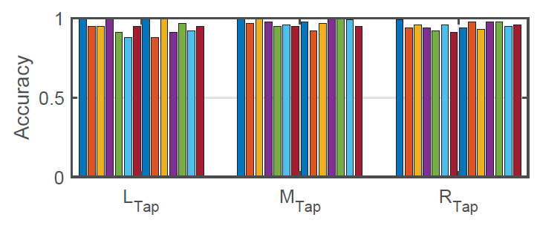
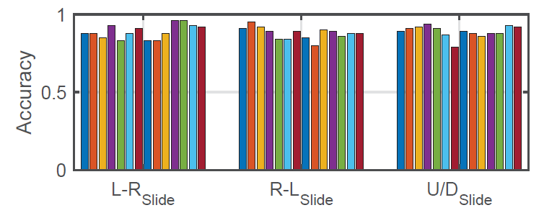
EarSense Evaluation
Uniform performance across users
Notes:
Earsense was evaluated across multiple earphones and target uses. Our evaluation proves that the processing chain which is not only accurate but scalable as well. The performance is uniform across different users for all the gestures.

Slide 38
This paper develops EarSense and shows:
1
Off-the-shelf earphones can
sense facial surface vibrations?
2
Vibration signals can be analyzed
to infer teeth gestures and their locations?
Left
signal
Left
signal
Teeth Gesture,
Infer
Infer
Location
Right
signal
Notes:
To conclude, this paper claims that we can use off the shelf earphones to sense facial surface vibrations. These vibrations signals can give idea about teeth gestures and even the location of the corresponding activity.

Slide 39
We foresee using Earbuds to SMS and in-app OTPs
Notes:
I would like to conclude with a demo video which we foresee as one of the uses cases of Earsense. While accessing online portals, when we encounter two factorauthentication we are mandated to enter OTP codes either through SMS or through a dedicated applications. How about replacing number with teeth gestures. Wont’t it enhance usability and increase the adoption of TFA which is lower than 25%! We believe it will.

Slide 40
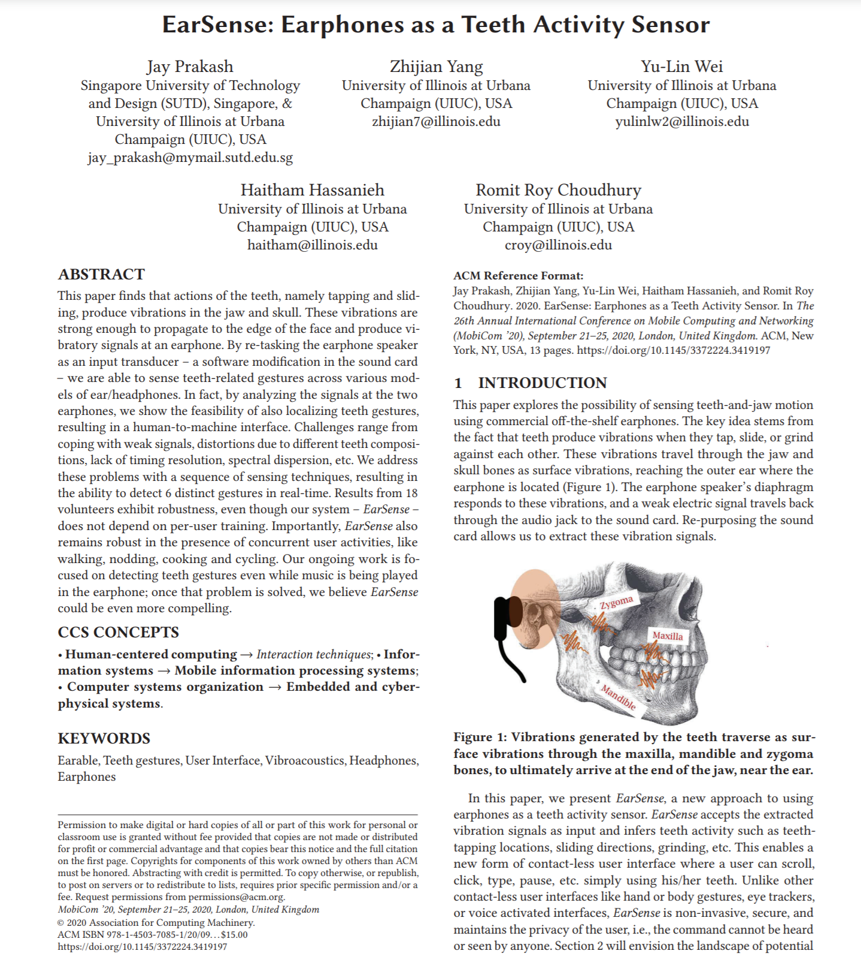
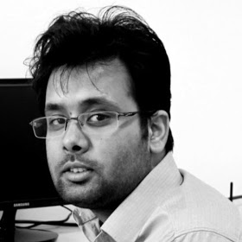
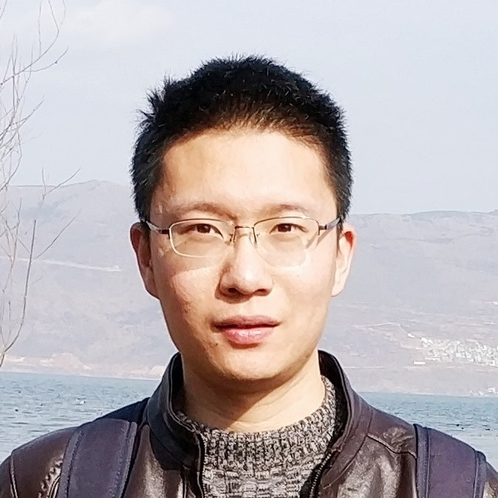
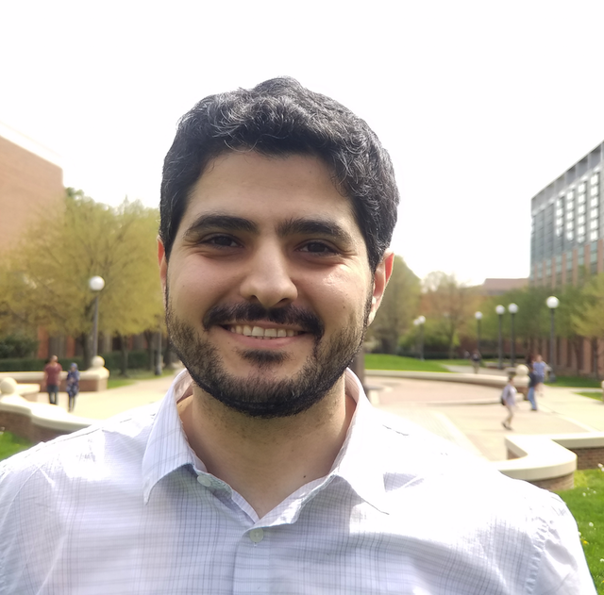
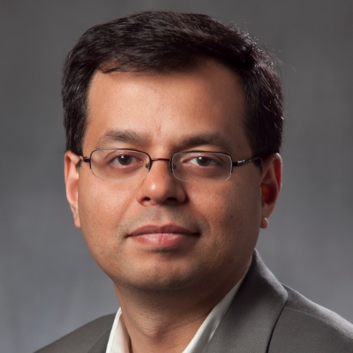
Much more in the paper …
Thanks.
Jay
Zhijian
Yu-Lin
Haitham
Romit
Notes:
We request to have a look at our paper for a details. We would be glad to disxuss and push this rapidly evolving field around earable computing.

