Slide 1
If You See Something, Swipe towards It Crowd-sourced Event Localization using Smartphones
Robin Wentao Ouyang Animesh Srivastava
Prithvi Prabahar Romit Roy Choudhury
Merideth Addicott F. Joseph McClernon

Slide 2
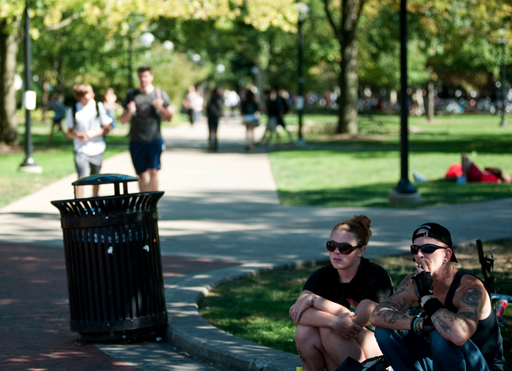

Slide 4
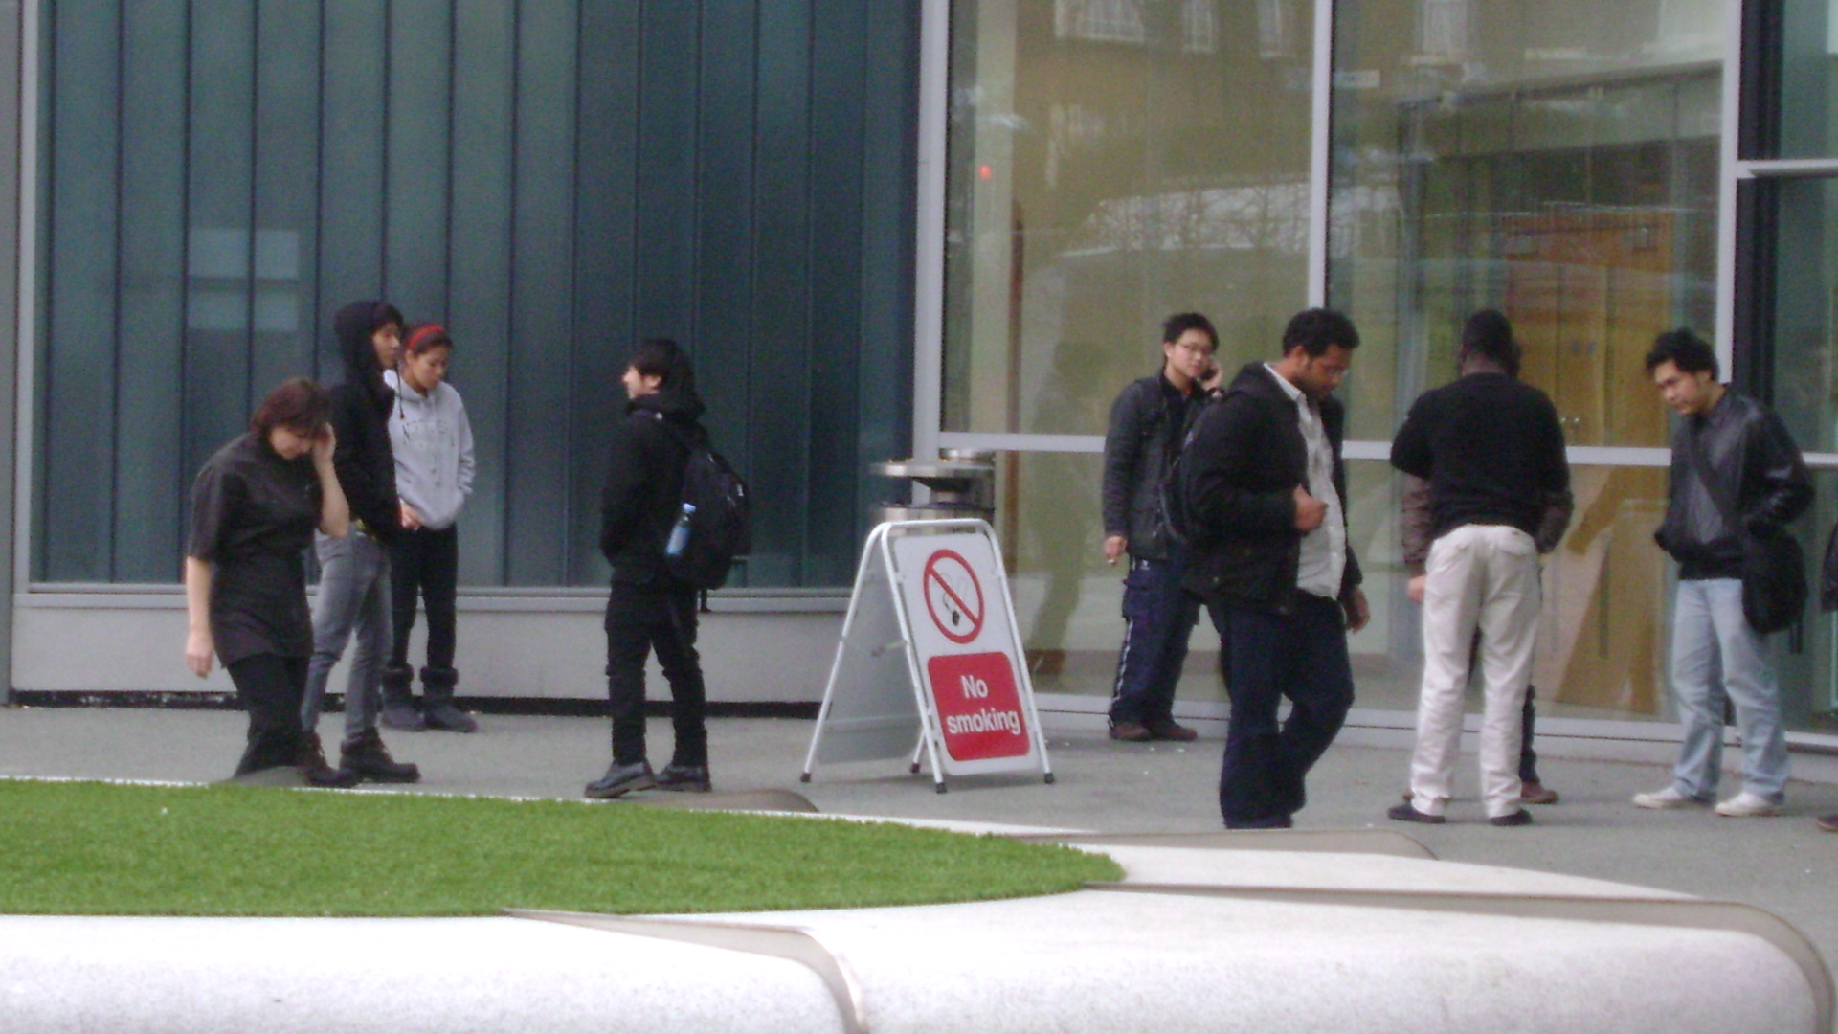

Slide 5
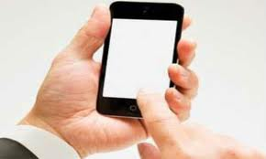
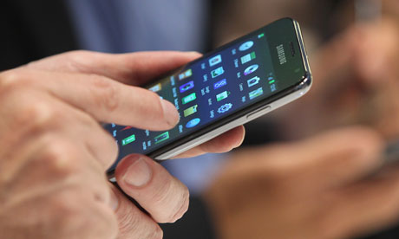
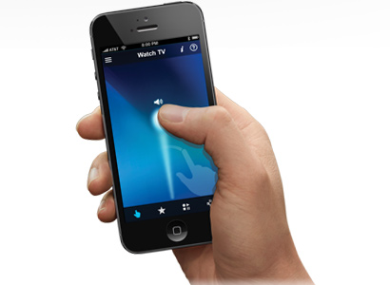

Slide 6
Smoking Location = <x, y>

Slide 7
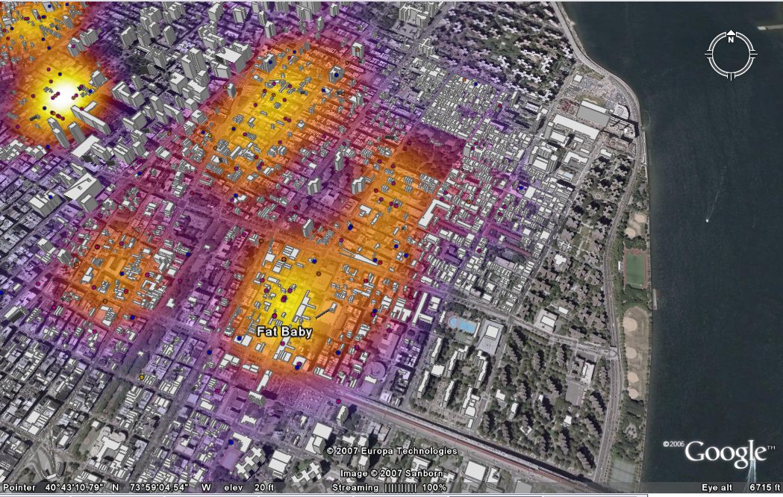
Crowd-sourced Heatmap

Slide 9
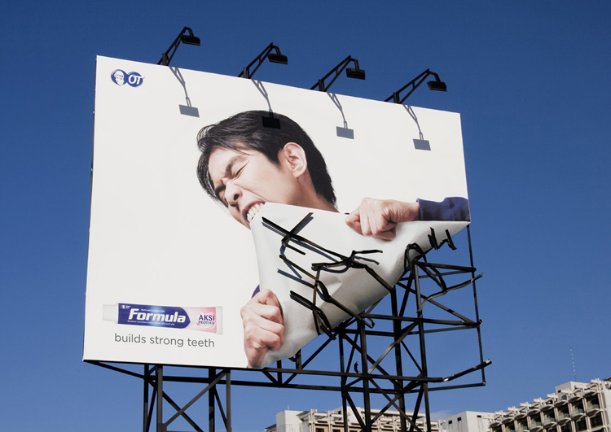

Slide 10
Core Problem Statement Given n smartphone swipes in a given area … compute the location of one or multiple objects/events

Slide 11
Core Problem Statement Given n smartphone swipes in a given area … compute the location of one or multiple objects/events
Swipe = < Device location + Compass direction + Swipe direction >

Slide 12
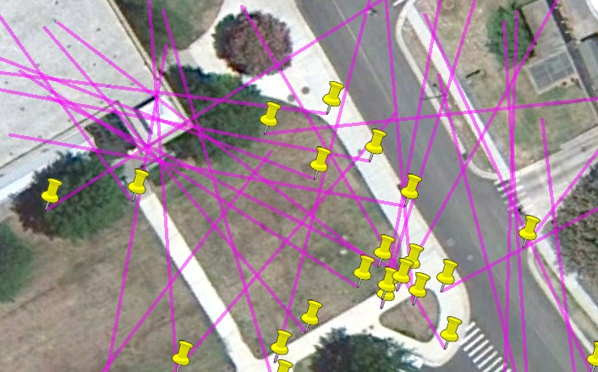
Not Trivial
10 m
Notes:
Swipes are within the same temporal cluster

Slide 13
Challenges
Phone location erroneous
Due to GPS errors
Phone orientation erroneous
Due to compass offsets, ambient magnetic fields
Human swipe directions
Imprecise due to quick action
Perhaps even walking/commuting while swiping
Swipe event correspondence
Which swipe is for which event?

Slide 14
iSee: Architecture
iSee Server
Basic Data Analysis
Grid-based event localization
Cloud
Temporal analysis and location refinement
Event locations
& time
Screen
Swipe
GPS
Compass
Accl.
Time

Slide 15
Basic event analysis
Represent each swipe as a trapezoid
To capture GPS uncertainty and compass/swipe angle error
Swipe intersection
*
Trapezoid intersection
True Location
L₂
L₃
L₁
T₂
T₃
T₁
Trapezoid

Slide 16
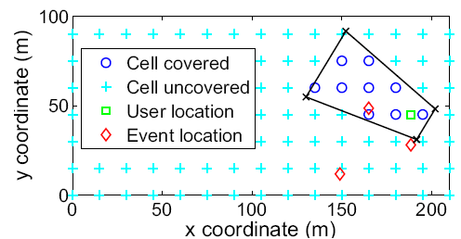
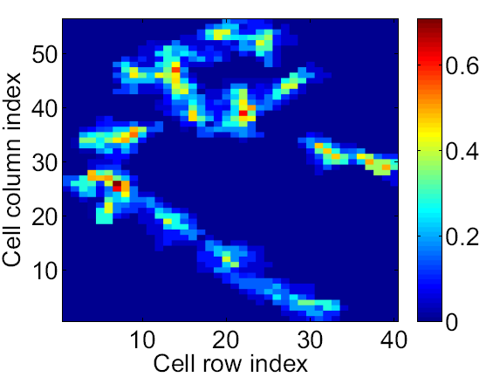
Basic event analysis
Project each trapezoid onto grid cells
• Which cell centers are inside
• Independent processing
• Linear complexity
Swipe-cell indicator matrix
Cell
 | c₁ | c₂ | c₃
s₁ | 1 | 1 | 0
s₂ | 1 | 0 | 0
s₃ | 0 | 1 | 1
Swipe
Notes:
Project trapezoid onto cells -> determine which cell centers are inside a trapezoid

Slide 17
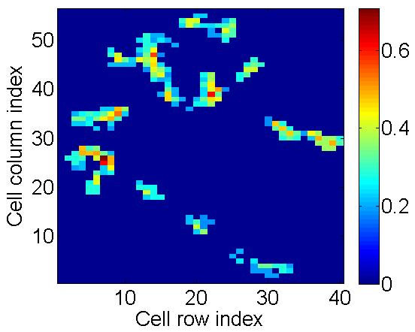
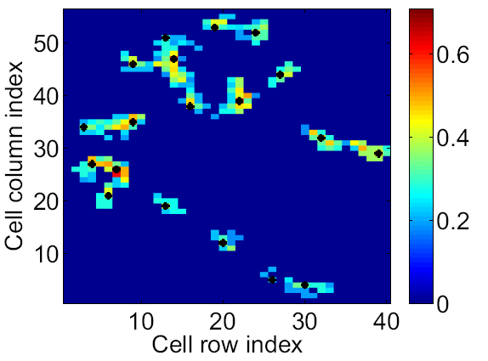
Grid-based Event Localization (GEL)
Filtering
Connected
component
Local Max
Notes:
Processing on cell confidence matrix is efficient -> its size is independent of # swipes
Map filtering -> filter out noise and unreliable cells
Connected component detection -> there should be at least one hotspot in each connected component
2D local max detection & pruning -> hotspot should have locally higher confidence than its neighboring cells; if there is no 2D local max detected in a connected component, use the cell with the max confidence as the hotspot location

Slide 18
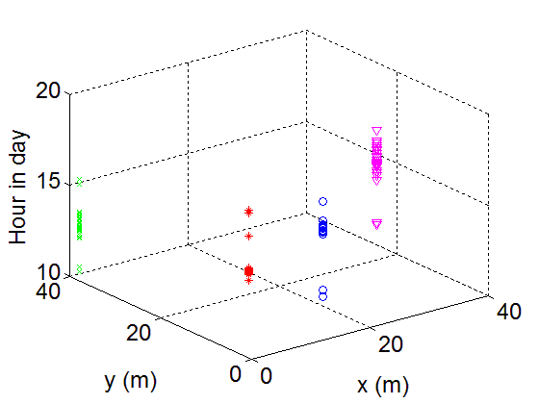
Temporal analysis
Match swipes to hotspots
Hierarchical clustering in termporal domain (with refinement)
Event occurrence interval estimation
 | c₁ | c₂ | c₃
s₁ | 1 | 1 | 0
s₂ | 1 | 0 | 0
s₃ | 0 | 1 | 1
Spatio-temporal
clusters
Swipe-cell indicator matrix
Notes:
Clustering: (spatio-temporal clustering -> cluster refinement -> event occurrence time estimation)

Slide 19
Location Refinement
Swipes to hotspot correspondence complete
Optimize swipes for better localization
Minimize weighted GPS errors + angular errors
Weights = Function (GPS confidence)
Formulation
Notes:
Optimization: (minimize weighted GPS error + angle error such that the swipes intersect at the same location; the GPS error weight is proportional to its uncertainty)

Slide 20
Location Refinement
Swipes to hotspot correspondence complete
Optimize swipes for better localization
Minimize weighted GPS errors + angular errors
Weights = Function (GPS confidence)
Estimated location
True location
Notes:
Optimization: (minimize weighted GPS error + angle error such that the swipes intersect at the same location; the GPS error weight is proportional to its uncertainty)

Slide 21
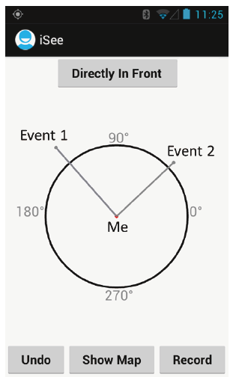
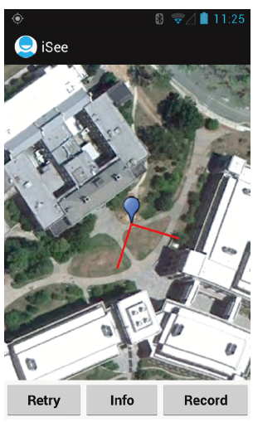
Implementation
User interface

Slide 22
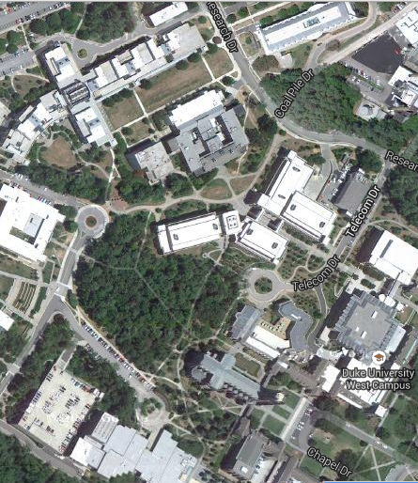
Experimental Setup
Area = 400 x 550 m²
Manually plant and remove 20 red
flags at different locations & time
Distance between neighbor flags ranged from 40m to 81m
Each flag lasted for 20 mins
6 volunteers; 6 days
682 swipes in total;
0.75 – 1.2 swipes per hotspot per user per day
Grid size: 10m
Max visible distance: 45m

Slide 23
Experimental Setup
Area = 400 x 550 m²
Manually plant and remove 20 red
flags at different locations & time
Distance between neighbor flags ranged from 40m to 81m
Each flag lasted for 20 mins
6 volunteers; 6 days
682 swipes in total;
0.75 – 1.2 swipes per hotspot per user per day
Grid size: 10m
Max visible distance: 45m
Schemes:
1) LIC – Line intersection and clustering (modified triangulation)
2) iSee (GEL) - Grid-based event localization
3) iSee (OLR) - optimization-based location refinement

Slide 24
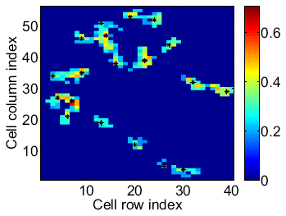
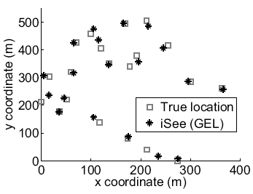
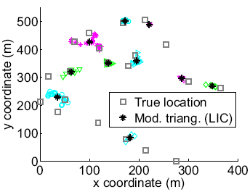
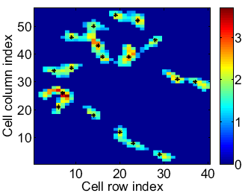
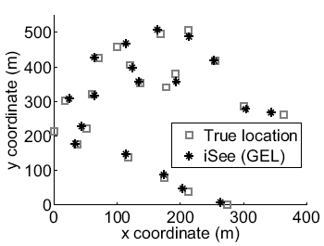
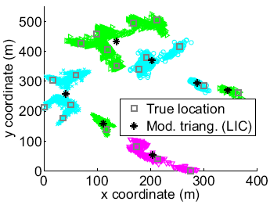
Comparing GEL with LIC
One day’s data → average 5.5 swipes per event location
Six days’ data → average 34.2 swipes per event location
Notes:
Advantages of GEL: 1) It takes into account of the GPS and angular errors -> much higher detection rate and localization accuracy
2) Retrieving (backtracking) swipes is much more convenient -> check one column of the swipe-cell indicator matrix; while LIC needs to backtrack a) which intersections are in a cluster and b) which two swipes result in an intersection
3) Linear complexity -> the size of the cell confidence map is independent of the number of swipes; while LIC has quadratic complexity

Slide 25
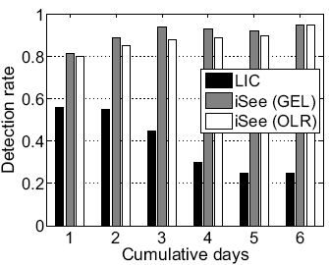
iSee Performance
Detection rate:
ratio of # detected and
true event locations
Notes:
An event location is detected if there is an estimated/reported location within 25m

Slide 26
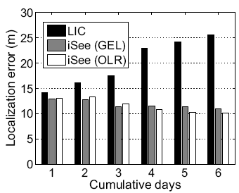
iSee Performance
Localization error:
Distance from reported
loc. to nearest true loc.
Notes:
An event location is detected if there is an estimated/reported location within 25m

Slide 27
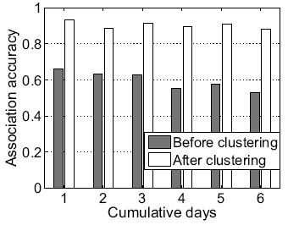
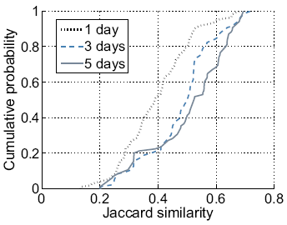
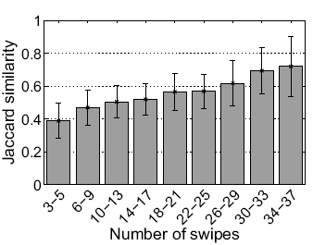
Temporal Clustering and Approximation
Association accuracy:
proportion of hotspots with correctly associated swipes
Jaccard similarity between estimated and true event
occurrence interval

Slide 28
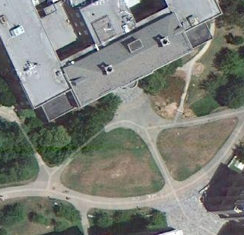
Follow Up Work
Enhance localization accuracy
A human being cannot see through a building → maximum visible distance can be adjusted by using Google Satellite view

Slide 29
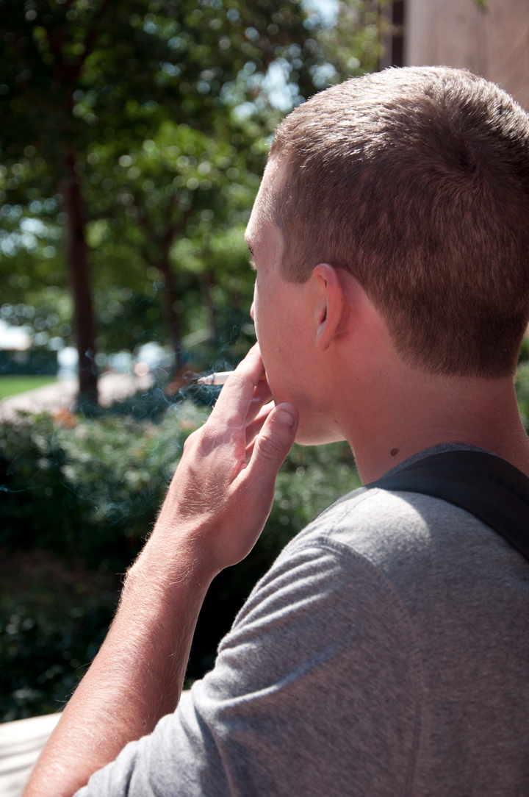
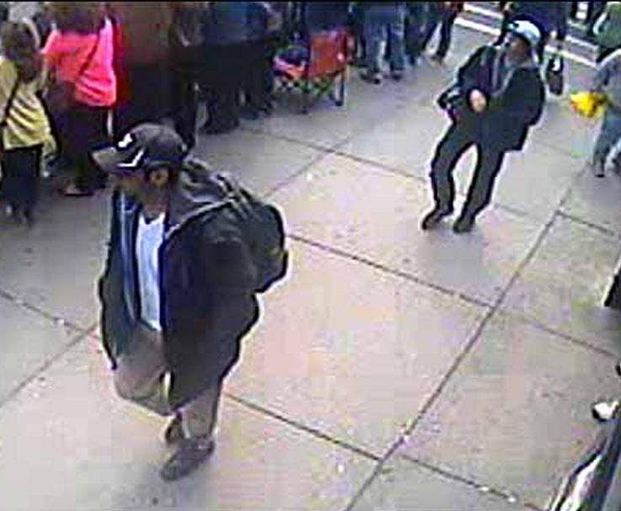
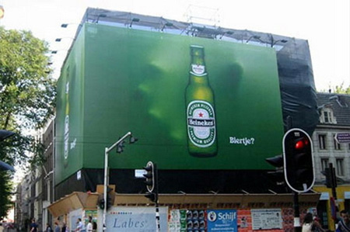
Take Away
A group-based primitive to localize objects around us …
thereby giving objects an address on-the-fly, which can then be used for overlaying information on them.

Slide 30
Thoughts?

Slide 31
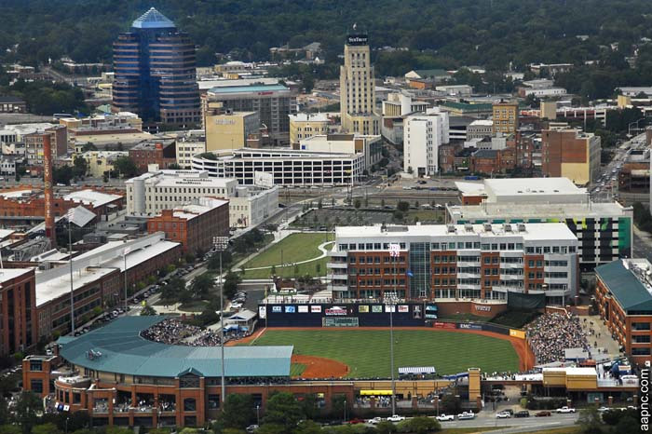

Slide 33
Follow Up Work
Hotspot and user ranking
Capture quality of hot-spots
Enhance localization accuracy
A human being cannot see through a building → maximum visible distance can be adjusted for each trapezoid
Smokers are more likely to smoke at the entrance of a building rather than in the middle of a road

Slide 35
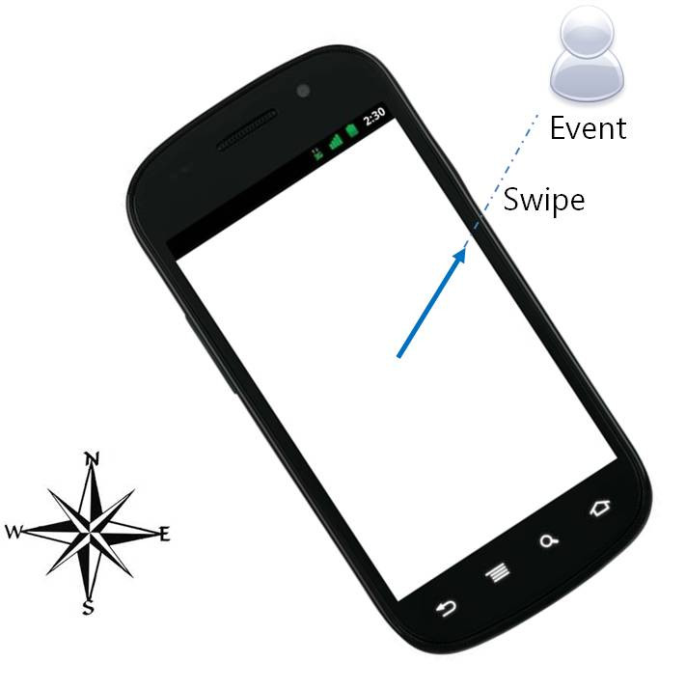
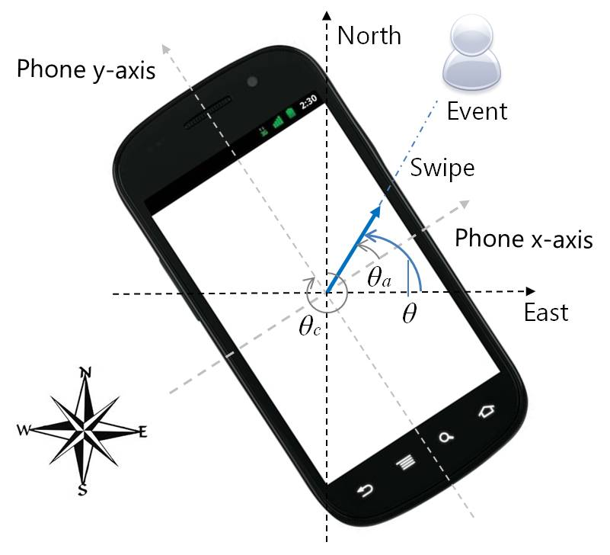
iSee
Applications: 1) Locating smokers, 2) Locating city graffiti.

Slide 36
Challenges
How many distinct event locations? Where are they? When did these events happen?
10 m
User swipe
No swipe-hotspot correspondence
Notes:
Swipes are within the same temporal cluster

Slide 37
Architecture
GPS
iSee Server
Compass
Basic Data Analysis
Grid-based event localization
Accl.
Internet
Temporal analysis and location refinement
Screen
Swipe
…
Time
Event locations
& time

Slide 38
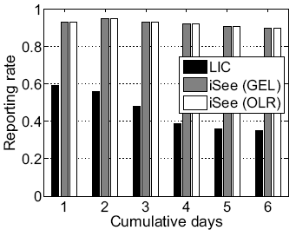
Localization Performance
Reporting rate: ratio of # reported
and true event locations
Detection rate: ratio of # detected
and true event locations
Localization error: distance from
reported loc. to nearest true loc.
Notes:
An event location is detected if there is an estimated/reported location within 25m

Slide 39
Localization Performance
Detection rate: ratio of # detected
and true event locations
Localization error: distance from
reported loc. to nearest true loc.
Notes:
An event location is detected if there is an estimated/reported location within 25m

Slide 40
Grid-based Event Localization (GEL)
Filtering
Connected
component
Local Max
Notes:
Processing on cell confidence matrix is efficient -> its size is independent of # swipes
Map filtering -> filter out noise and unreliable cells
Connected component detection -> there should be at least one hotspot in each connected component
2D local max detection & pruning -> hotspot should have locally higher confidence than its neighboring cells; if there is no 2D local max detected in a connected component, use the cell with the max confidence as the hotspot location

