Slide 1
InSight: Recognizing Humans without Face Recognition
He Wang,
Xuan Bao, Romit Roy Choudhury, Srihari Nelakuditi
Notes:
Hello everyone, welcome to the talk. I am very glad to talk about our work Insight:…
This is a join work with my college Xuan and my advisor Romit from Duke University and Srihari from USC.

Slide 2
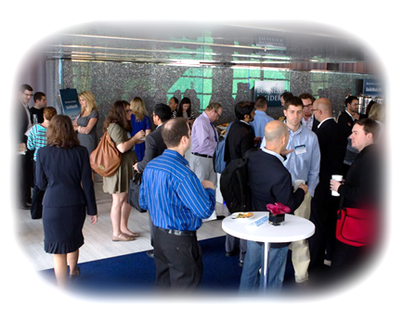
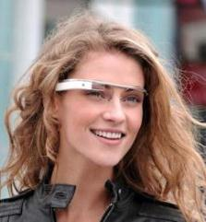
Motivation – Application Scenarios
share a ride to airport
Elle
Bret
Bob
2
Notes:
Here is the application scenario. Imagine in a conference lobby, people are chatting and walking around. we want to design an application such that When you look at them through Google glass, their virtual name tags will pop up on the display. Even better, you can see the messages they want to share around them. To enable this, we need human recognition. Face recognition could be one method. However, sometimes it is hard to see faces. But if we have seen these guys before, we can recognize them even from back. So, we believe some other visual information such as clothing and moving patters could be used to recognize humans as well. In this talk, we focus on clothing.
(1) Another sce, T-shirt (2) simulate humans: human can do it. Saw before… Can we do this? Observation (3) talk about motions in conclusion or beginning I see somebody with red. They are

Slide 3
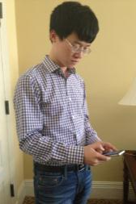
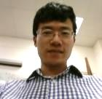
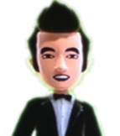
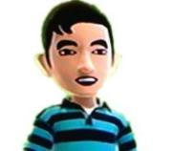
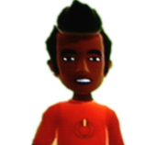
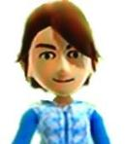
Overview – Self-Fingerprints
Cloud
Self-Fingerprints
Bret
Bob
John
Elle
Notes:
To enable the application we described, we first collect the profile for each user while they are using their phones, for example, checking email. Bret, Bob, John and Elle’ phones will take pictures of them and wirelessly upload the visual information to the cloud. We call these information self-fingerprints.

Slide 4
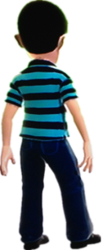
Overview – Recognition
Cloud
Glass
Notes:
Later, when you see these guys through your glass. Your glass will also extract visual information in the glass view. Then we can match the visual information from the cloud and the visual information from the glass. Let’s see who is this guy.

Slide 5
Overview – Recognition
Cloud
Glass
Notes:
Does this match? No. Does this match? No. Does this match? Yes!

Slide 6
Overview – Recognition
Cloud
Glass
Notes:
So this guy is bob.

Slide 7
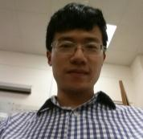
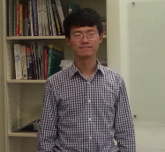
Challenges
Perspectives are different
Clothes have wrinkles
Lighting conditions change
Notes:
This may seem conceptually simple. However, there are a couple of challenges: perspectives (distances and angles) are different, because self-profile is taken close to user and glass view is always taken far from user. Another challenge is that clothes have wrinkles and these wrinkles are not stable; Also, lighting conditions may change.
To cope with this, we have to carefully design features which are both effective and robust.

Slide 8
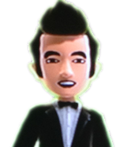
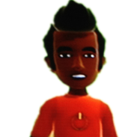
Extracting Fingerprints
Colors
Spatiograms
Patterns
Wavelets
Notes:
The features we use fall into two aspects: colors and patterns. To represent color fingerprints, we use spatiograms. To capture pattern fingerprints, we use wavelets.
Colors are very intuitive fingerprints. However, before calculating spatiograms, we need to perform color conversion.
Use a tech called ….

Slide 9
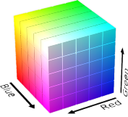
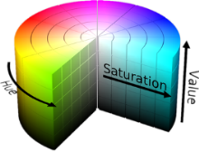
Extracting Fingerprints – Colors
Spatiograms
Color Conversion
RGB
HSV
Notes:
As we mentioned before, lighting conditions may change. The brighter red and darker red could from same clothes under different lighting conditions. To improve the robustness to different lighting conditions, we covert the color from RGB domain to HSV domain. The key idea is to decouple lighting from the other two dimensions.

Slide 10
Extracting Fingerprints – Colors
Spatiograms
color histogram
spatial distribution
RGB
HSV
Notes:
After converting color to HSV domain, we are ready to calculate spatiograms. Spatiograms are essentially color histograms with spatial distributions encoded in their structures. Spatiograms count the number for each particular color, which will form color histograms. From color histograms, we can distinguish these two cases: one is a mixture of black and blue, the other is red. Spatiograms also contain spatial distribution for each color. From the spatial distributions, we can distinguish these two cases: one has black on upper and lower part, the other has black on right part. These are color spatiograms.
Apart from colors, we also use patterns.

Slide 11
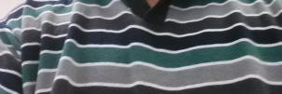
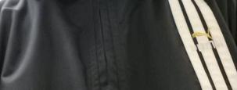
Extracting Fingerprints – Patterns
Wavelets
Wavelet sub-bands: vertical, horizontal and diagonal dimensions.
Notes:
To extract clothes patterns, we use wavelets. Wavelets have different sub-bands that can capture high frequency in vertical, horizontal and diagonal dimensions. The upper figure has horizontal stripes and the lower figure has vertical stripes. As we can see, wavelets sub-bands can capture the pattern difference.

Slide 12
Fingerprint Matching
Cloud
Matching Spatiograms
S = {n, µ, σ}
cloud
S = {n’, µ’, σ’}
glass
Similarity =
color histograms
spatial distributions
Glass
Notes:
Fingerprints are combination of colors and patterns. We use the same fingerprints for glass view also. Now we are ready to match.
Fingerprint matching contains two parts: matching spatiograms and matching wavelets.
To match spatiograms. We calculated the spatiograms from the cloud and from the glass. S_could are the spatiograms from the cloud, S_glass are the spatiograms from the glass view. Then we put the two spatiograms into similarity metric, which compares both color histograms and spatial distributions.

Slide 13
Fingerprint Matching
Cloud
Matching Wavelets
W = {f1, f2, f3,…}
cloud
W = {f1’, f2’, f3’,…}
glass
Bagged Decision Tree (BDT)
Glass
Notes:
To match wavelets, we first summarize wavelets sub-bands into several features such as mean energy and energy spatial distributions. Then we use Bagged Decision Tree to train classification model.

Slide 14
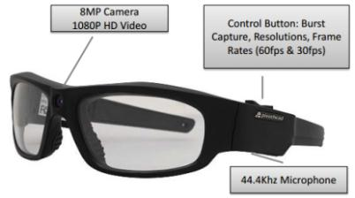
Evaluation Setting
PivotHead glass captured users from the front.
15 users was dressed in their regular attires.
Users actively used their smartphones.
Phone opportunistically took “proﬁle” pictures of the user.
Notes:
Because we don’t have google glass, to evaluate our system, we bought an pivothead glass which have an 8mega pixel camera in the center. One user wore the glass and capture other users from the front. In our preliminary test, users in the glass view did not overlap with each other. We conduct the experiments with 15 users dressed in their regular attires. We asked them to actively used their smartphones. The phone opportunistically took “profile” pictures of the user.
(Say from the back case later.)

Slide 15
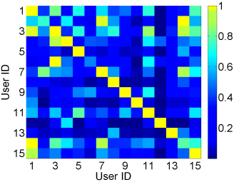
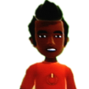
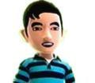
Evaluation - Matching Color Spatiograms
front
Notes:
We first evaluate matching color spatiograms. X-axle shows self-fingerprints, y-axle shows front view in the glass. The brighter the color, the higher the similarity. For example, in this row, this is the brightest color and we will match this user’s glass view to this self-fingerprint. We can see that color can work in some cases, however, it is not perfect.
Let’s see what happens with patterns.
Front view text

Slide 16
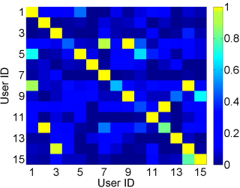
Evaluation - Matching Wavelets of Patterns
front
Notes:
The labels are the same as previous graph. X-axle shows self-fingerprints, y-axle shows front view in the glass. The brighter the color, the higher the similarity. We can see that pattern can work in some cases, however, it is not perfect too.
So, we try to combine the colors and patterns together by multiplying the their similarity scores.

Slide 17
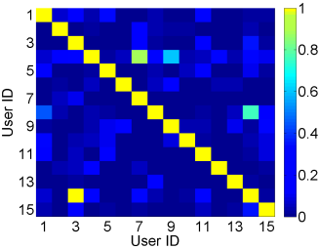
Evaluation – Combining Colors and Patterns
Evaluation –
front
Notes:
Here is the result of combining colors and patterns. In this graph, most of the diagonal elements are brightest, which means we can recognize most of the users.
However, this one is as bright as the diagonal element. Here are the corresponding pictures. As we can see, these two are similar in both colors and patterns. Both of them have grids and both of them have blue and white. Also, the color distributions are similar – a kind of normal distribution.
To be conservative, in these cases, our system will report unsure.
One may expect, as the number of people increase, the matching accuracy will go down. (If there are only 3 people around, the accuracy should be higher than 10 people cases. Now let’s take a look at matching performance with different numbers of people. )
(No change to the slide but emphasize how well the combination works and then carefully explain the failure case. Also, someone may ask how do we plan to address this case.)

Slide 18
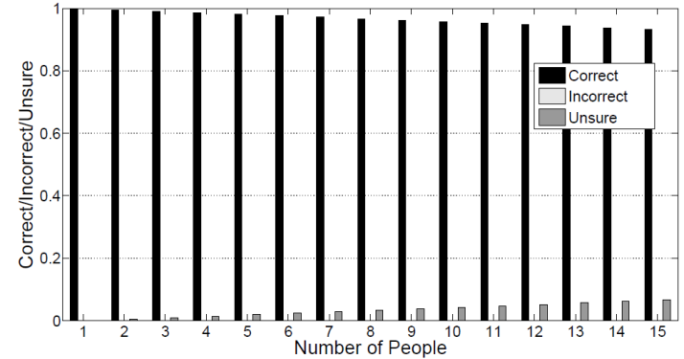
Evaluation – Performance with Self-Fingerprints
Matching front view
front
Notes:
To investigate this, we conduct experiments with different numbers of people. X-axle are the number of people. Take 2 people cases for example, we try all the combinations of 2 out of 15. And with 3, we try all the combination of 3 people and so on. Y-axle shows average correct, incorrect, unsure rates. As we mentioned, to be conservative, when we have more than one competitive high similarity sores, we will report unsure.
From the graph, we can see, as the number of people increases, the correct rates go down a little bit and unsure rates go up.
But overall the performance does not decrease too much. However, these are from matching front view to self-fingerprints cases.

Slide 19
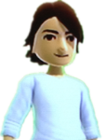
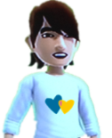
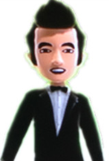
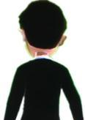
Self-fingerprints may not be Sufficient
Clothes’ difference is not captured when clothes are similar?
Clothes have different colors/patterns at the back?
Dan
Paul
Bret
Bret
Notes:
Self-fingerprints may not be Sufficient in some cases. Clothes could be similar and it’s possible that the phone’s cameras miss the different parts. For example, both Dan and Paul wear white shirts and theirs cameras didn’t capture enough difference. So, we cannot recognize them.
Also, some clothes have different colors and patterns at the back. Since we build the user’s profile from the front, when we see the users from the back, recognizing the user could be a problem.
However, there are opportunities to address these challenges.

Slide 20
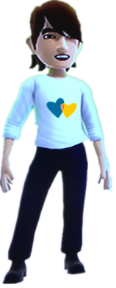
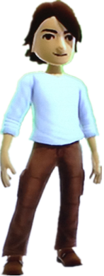
Refining the Self-Fingerprint (Similar Clothes)
Cloud
Cannot recognize!
Dan
Paul
Glass
Notes:
The first one is similar clothes example: Dan and Paul are wearing similar white shirts. Their cameras haven’t captured enough differences. The uploaded pictures that only says: “white shirts, no patterns”. Later, when you see them in your glass, even your glass can see the cute hearts on Dan’s shirt, because the cloud doesn’t have enough information, we still cannot recognize them.
(remove)

Slide 21
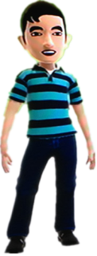
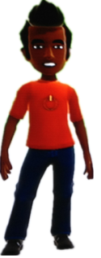
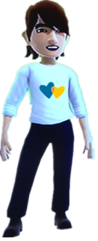
Refining the Self-Fingerprint (Similar Clothes)
Cloud
refining self-fingerprint
Bob
John
Dan
Glass
Notes:
Since people are moving naturally. Next time, when Dan hang out with Bob and John. Since Paul is not around, he will not confuse us. Now, we are able to recognize Dan. Even better, we can upload these new fingerprints for Dan to the cloud.
Now, we have an enriched version of fingerprints for Dan in the cloud. We should be able to do better in recognizing Dan.

Slide 22
Refining the Self-Fingerprint (Similar Clothes)
Cloud
Can recognize after refinement!
Dan
Paul
Glass
Notes:
Let’s say, Dan and Paul came together again. This time, we can recognize Dan, since we already have enriched fingerprints for Dan in the cloud.
This is a simple case of refining fingerprints.

Slide 23
Refining the Self-Fingerprint
Dan = {F1}
F1 F2
Dan = {F1, F2}
F2 F3
Dan = {F1, F2, F3}
Dan
Notes:
In general, when we recognize people with some features , we can also regard other features to refine the fingerprint.
Names to feature… voice …
For example, you get a chance to recognize Dan by feature F1. At the same time you can see more -- you see feature F2. Now Dan can be represented by a feature vector of <F1, F2>. Later, in some situations, we cannot see F1, however, we see F2 and at the same time we see F3. Thus we still can recognize Dan and enrich his feature vector as <F1, F2, F3>. Over time, we will be able to build a better and better version of fingerprints.

Slide 24
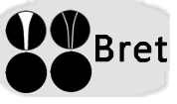
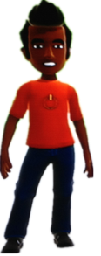
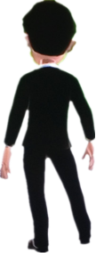
Refining the Self-Fingerprint (Back View)
Cloud
refining back view fingerprint
Bret
Glass
Notes:
The fingerprint refinement idea will also help us to solve the problem that clothes have different colors and patterns at the back.
Sometimes, people near Bret could wear very different clothes, so even we see him from back, we still can recognize him and enrich Bret’s back fingerprint and upload the back fingerprint to the cloud.
Since over time, we should be able to learn more and more back view fingerprints, the accuracy of matching back view should improve.

Slide 25
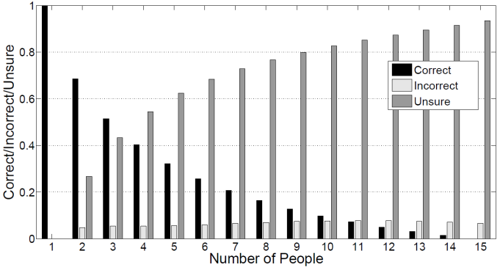
Evaluation – Performance with Self-Fingerprints
Matching back view
back
Notes:
Before we look at the performance with fingerprint refinement,
let’s take a look at the performance without fingerprint refinement. The graph shows the performance of matching back view to self-fingerprint. We can see that as number of people increases, the correct rates drop significantly. And at the same time, unsure rates increase significantly.

Slide 26
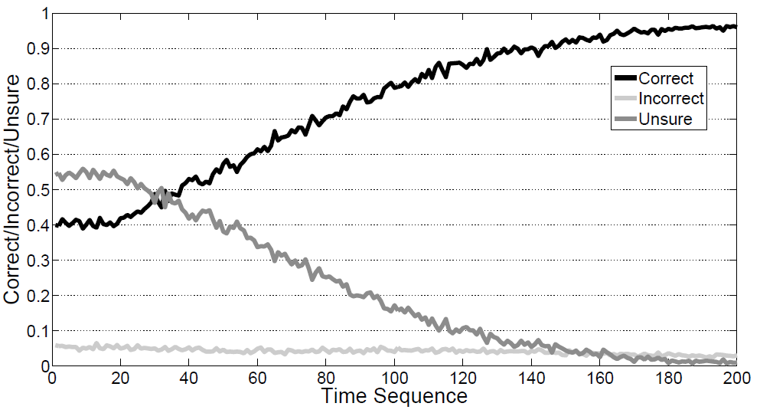
Evaluation – Performance with Refined Fingerprints
Matching back view after refining fingerprints
back
Notes:
Now, let’s see how much refined fingerprints helps. To simulate different people encounters, we randomly choose 4 people from 15 for 200 times. Each time, if we have chance, we will enrich back fingerprint and use that in later matching. So, over time, more and more users are associated with a back-fingerprint.
We can see the performance increased over time because of fingerprint refinement.

Slide 27
Discussion
Privacy of opportunistic pictures
User consent before uploading
Overlapping users in view
Fingerprint refinement helps
Incremental deployment with some non-participants
More time and mobility help
Cloud vs p2p
Different trade-offs
Notes:
So far, we have only focused on a small part, there are many more challenges and opportunities. We discuss a few here.
The first is incremental deployment, some people are not participants. These non-participants are likely to be mis-recognized. Thus InSight may enrich wrong fingerprints to cloud. To address, we need to wait for more chances to label non-participants as unknown. Time and mobility will help.
The Second is privacy of opportunistic pictures. Taking opportunistic pictures, while creating the self-fingerprint, may raise privacy issues. If Insight is used in some events, we can collect self-fingerprints by explicitly asking for pictures. If InSight is in regular use, one simple way to solve privacy issue is to ask users’ permission before uploading the profile.
Overlapping users in view is another challenge. For example, in some crowded gathering, maybe only a small part of their clothes are available. The refining fingerprint process may give some hope here. We need to evaluate this further. (delete this?)
Take pictures
infrastructure vs ad-hoc, both are reasonable in different settings.
Another open question is cloud vs p2p. In our talk, we use cloud as a central manager. However, cloud requires infrastructures. P2p … both of them are reasonable in different settings. We need to investigate these trade-offs.

Slide 28
Conclusion
Colors and patterns on clothes help ﬁngerprint humans.
Preliminary evaluation with 15 people provides promising results.
Other type of fingerprints exists such as motion.
Notes:
In this work, we show that colors and patterns on clothes are distinguishable ﬁngerprints.
Our preliminary experiment with 15 people, wearing natural clothes, suggest promise.
We can use visual fingerprints in human-centric augmented reality. These visual fingerprints are not limited to clothes. For example moving patterns might also contain valuable information. We will work on this in the future.
Goal of this work is to provide an new …: broadcast to visible vicinity. Apart from normal broadcast, multicast or unicast, one can say “broadcast the message to the people who can see me!”

Slide 29
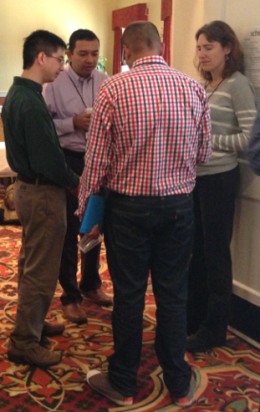
Anyone for beer after this talk?
Looking for interns
New Primitive for Broadcasting to Visible Vicinity.
29

Slide 30
Questions, Comments?
Thank You

