Slide 1


Closing the Gaps in Inertial Motion Tracking
Sheng Shen, Mahanth Gowda, Romit Roy Choudhury

Slide 2
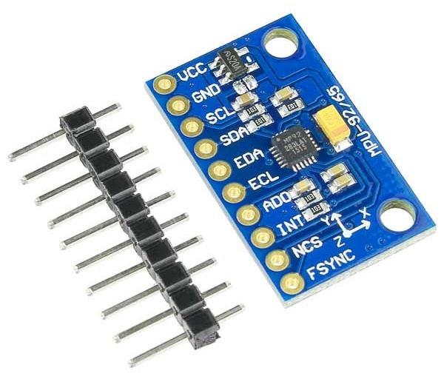
Inertial Measurement Unit (IMU)
Accelerometer
Gyroscope
Magnetometer

Slide 3
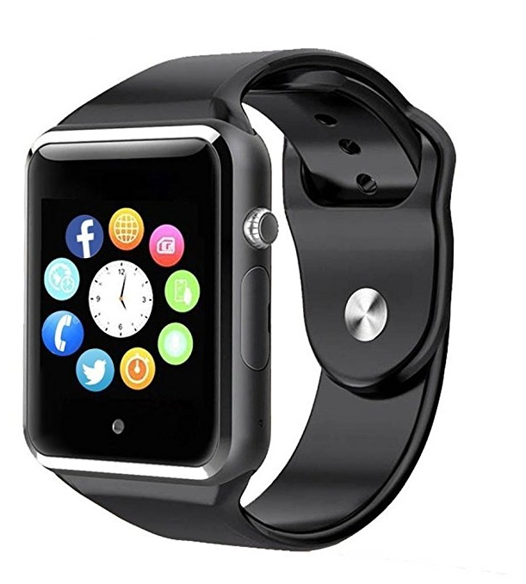
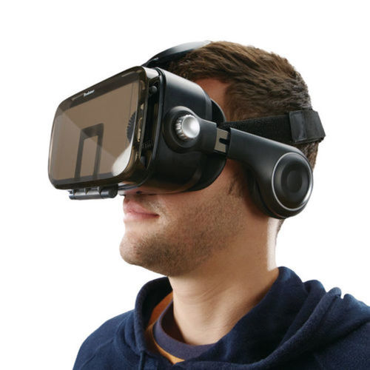

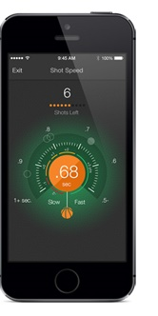

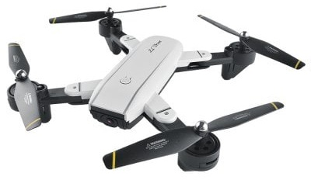
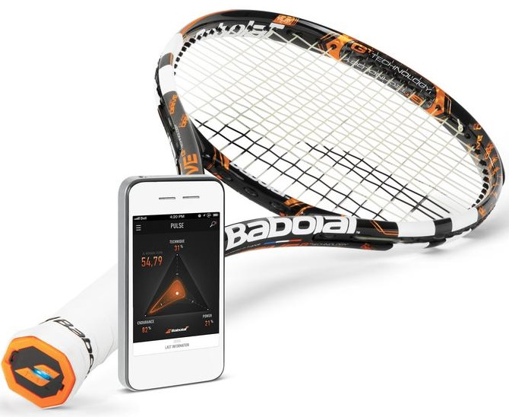
Inertial Measurement Unit (IMU)
Accelerometer
Gyroscope
Magnetometer

Slide 4
Inertial Measurement Unit (IMU)
Accelerometer
Gyroscope
Magnetometer
Wide applications in motion tracking

Slide 5
Lot of work in inertial motion tracking
IMU
Data
3D
Trajectory
Motion
Tracking
Algorithm
Open problem in mobile computing

Slide 6
Lot of work in inertial motion tracking
IMU
Data
3D
Trajectory
Motion
Tracking
Algorithm
Open problem in mobile computing
This paper doesn’t solve it either … however, makes progress

Slide 7
Lot of work in inertial motion tracking
IMU
Data
3D
Trajectory
Motion
Tracking
Algorithm
Open problem in mobile computing
This paper doesn’t solve it either … however, makes progress
Am struggling to explain our algorithm … so will start from scratch

Slide 8

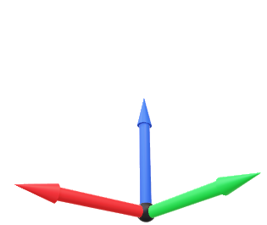

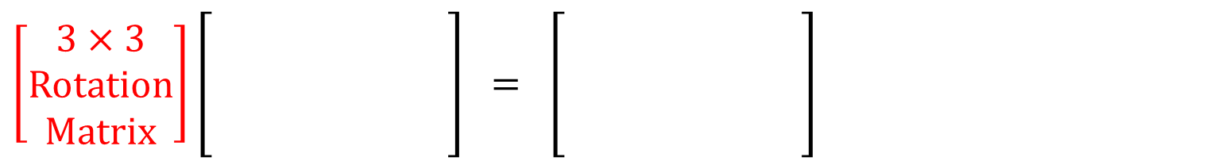
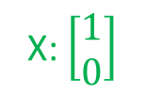

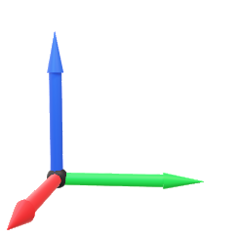

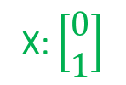
One Prerequisite Slide: Rotation Matrices
Rotation is a function
Y: $\left[\begin{matrix}0 \\ 1\end{matrix}\right]$
90°
X: $\left[\begin{matrix}0 \\ 1\end{matrix}\right]$
Y: $\left[\begin{matrix}\text{−}1 \\ 0\end{matrix}\right]$
$${Rot}_{ 90°}\left( \right) = =$$
X: $\left[\begin{matrix}1 \\ 0\end{matrix}\right]$
Mathematically, rotation is a matrix
$$\left[\begin{matrix}\cos{90°} & − sin{90°} \\ \sin{90°} & \cos{90°}\end{matrix}\right] \left[\begin{matrix}1 & 0 \\ 0 & 1\end{matrix}\right] = \left[\begin{matrix}0 & −1 \\ 1 & 0\end{matrix}\right]$$
Same for 3D Rotation
$$\left[\begin{aligned}3×3 \\ Rotation \\ Matrix\end{aligned}\right]\left[\begin{aligned} \\ \\ \\ \end{aligned}\right] = \left[\begin{aligned} \\ \\ \\ \end{aligned}\right]$$

Slide 9

MUSE: Our Goal is 3D Localization
Map
Initial Location
Algorithm
3D
Trajectory
IMU = Accel + Gyro + Mag

Slide 10




Let’s Understand the Inputs
$${\left[x_{0}{ y}_{0}{ z}_{0}\right]}^{T}$$
Initial Location
Algorithm
IMU = Accel + Gyro + Mag
Zoom into IMU data:
Accel. $=\left[\begin{matrix}a_{x} \\ a_{y} \\ a_{z}\end{matrix}\right]$
Gyro. $=\left[\begin{matrix}g_{x} \\ g_{y} \\ g_{z}\end{matrix}\right]$
Mag. $=\left[\begin{matrix}m_{x} \\ m_{y} \\ m_{z}\end{matrix}\right]$
(Linear Acceleration)
(Angular Velocity)
(Earth’s Magnetic North)
Delta rotation in unit time

Slide 11
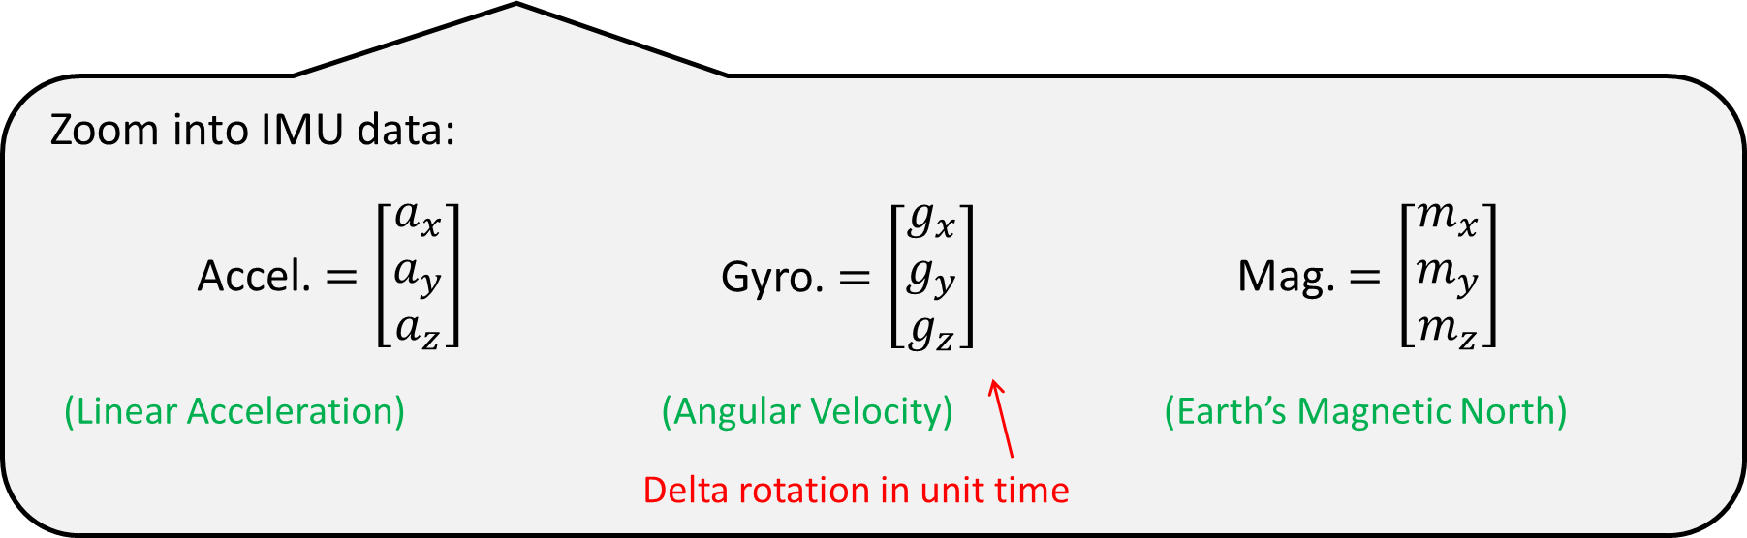
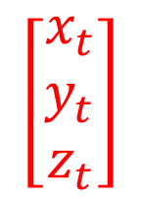
Can we solve localization with these inputs?
$${\left[x_{0}{ y}_{0}{ z}_{0}\right]}^{T}$$
Initial Location
Algorithm
?
$$\left[\begin{matrix}x_{t} \\ y_{t} \\ z_{t}\end{matrix}\right]$$
IMU = Accel + Gyro + Mag

Slide 12

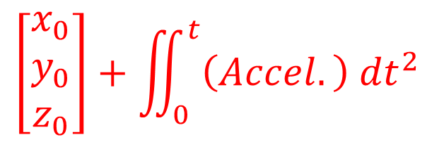
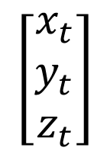
One possibility is:
$${\left[x_{0}{ y}_{0}{ z}_{0}\right]}^{T}$$
Initial Location
$$\left[\begin{matrix}x_{0} \\ y_{0} \\ z_{0}\end{matrix}\right]+\iint_{0}^{t}{\left(Accel.\right) {dt}^{2} }$$
$$\left[\begin{matrix}x_{t} \\ y_{t} \\ z_{t}\end{matrix}\right]$$
Accel., Gyro., Mag.
IMU
Accel. $=\left[\begin{matrix}a_{x} \\ a_{y} \\ a_{z}\end{matrix}\right]$ is in local reference frame
But there is one BIG problem:

Slide 13

Accel. $=\left[\begin{matrix}a_{x} \\ a_{y} \\ a_{z}\end{matrix}\right]$ is in local reference frame
But there is one BIG problem:

Slide 14
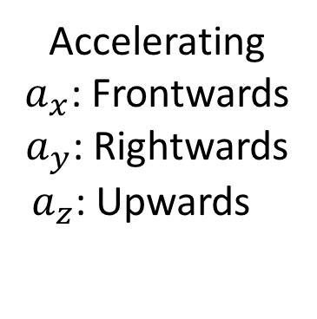
Accel. $=\left[\begin{matrix}a_{x} \\ a_{y} \\ a_{z}\end{matrix}\right]$ is in local reference frame
But there is one BIG problem:
As an analogy
New Delhi Airport
What is
Frontwards
Rightwards
Upwards
w.r.t. the earth?
Map
3D
Trajectory
Accelerating
$a_{x}$: Frontwards
$a_{y}$: Rightwards
${ a}_{z}$: Upwards

Slide 15
This makes orientation necessary

Slide 16
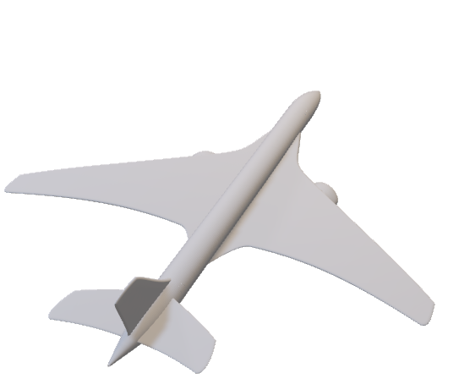

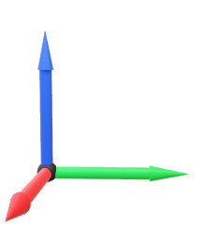

This makes orientation necessary
What is 3D orientation?
Orientation is the 3D rotation needed to make:
Plane’s Own $\left[\begin{matrix}Frontwards \\ Rightwards \\ Upwards\end{matrix}\right]$
$$\left[\begin{matrix}Northwards \\ Eastwards \\ Vertical\end{matrix}\right]$$
Front
Up
Right

Slide 17
This makes orientation necessary
What is 3D orientation?
Orientation is the 3D rotation needed to make:
Plane’s Own $\left[\begin{matrix}Frontwards \\ Rightwards \\ Upwards\end{matrix}\right]$
$$\left[\begin{matrix}Northwards \\ Eastwards \\ Vertical\end{matrix}\right]$$
Up: Vertical
Front: North
Right: East

Slide 18
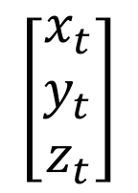

So, how will orientation solve the problem?
What we need to do is:
Initial Location
$$\left[\begin{matrix}x_{t} \\ y_{t} \\ z_{t}\end{matrix}\right]$$
+
Accel.
Accel.
$$\iint_{t}^{ }{ }$$
3D
Orient.
IMU
(Global)
IMU (Local)
Gyro.
Mag.
So 3D orientation is the key.

Slide 19
So how to get 3D orientation?
2 Main Opportunities:
1. Gravity
2. Magnetic North
Both measurable by IMU
Key idea: What rotation is needed such that
      Gravity is exactly in my downward direction
      North is exactly in my frontward direction

Slide 20
So how to get 3D orientation?
Key idea: What rotation is needed such that
      Gravity is exactly in my downward direction
      North is exactly in my frontward direction

Slide 21
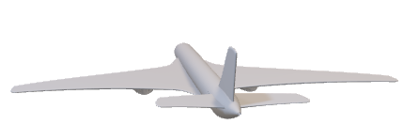
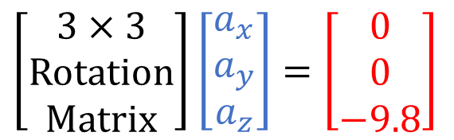
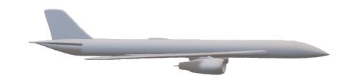
So how to get 3D orientation?
Key idea: What rotation is needed such that
      Gravity is exactly in my downward direction
      North is exactly in my frontward direction
$$\left[\begin{aligned}3×3 \\ Rotation \\ Matrix\end{aligned}\right]\left[\begin{matrix}a_{x} \\ a_{y} \\ a_{z}\end{matrix}\right]=\left[\begin{matrix}0 \\ 0 \\ −9.8\end{matrix}\right]$$
Tilt is determined (2 out of 3 DoFs)
Gravity says a lot about orientation, but not sufficient
Gravity
Downward

Slide 22
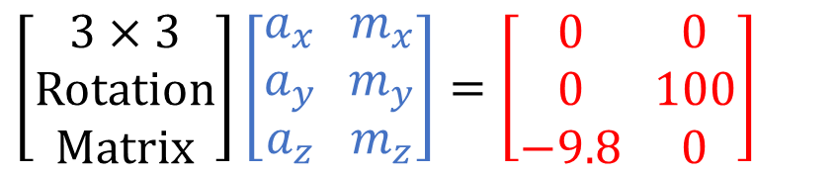
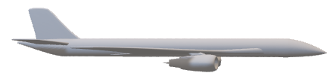
So how to get 3D orientation?
Key idea: What rotation is needed such that
      Gravity is exactly in my downward direction
      North is exactly in my frontward direction
$$\left[\begin{aligned}3×3 \\ Rotation \\ Matrix\end{aligned}\right]\left[\begin{matrix}a_{x} \\ a_{y} \\ a_{z}\end{matrix}\right]=\left[\begin{matrix}0 \\ 0 \\ −9.8\end{matrix}\right]$$
Tilt + Heading is determined (all 3 DoFs)
$$\left[\begin{aligned}3×3 \\ Rotation \\ Matrix\end{aligned}\right]\left[\begin{matrix}a_{x} \\ a_{y} \\ a_{z}\end{matrix} \begin{matrix}m_{x} \\ m_{y} \\ m_{z}\end{matrix}\right]=\left[\begin{matrix}0 \\ 0 \\ −9.8\end{matrix} \begin{matrix}0 \\ 100 \\ 0\end{matrix}\right]$$
My orientation
North
Frontward

Slide 23
So is Gravity + North enough to get 3D Orientation?
Only when object is static … but not otherwise. Why?

Slide 24
So is Gravity + North enough to get 3D Orientation?
Only when object is static … but not otherwise. Why?
Because any motion of the object will reflect
in the accelerometer … thereby
polluting the gravity estimate

Slide 25
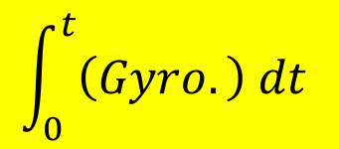
So how to get 3D orientation? (Another idea)
Another Idea for Orientation:
Integrate angular velocity from gyro
Initial
Orientation
+
$$\int_{0}^{t}{\left(Gyro.\right) dt}$$
=
New
Orientation
(at time t)
But gyro drifts, so only useful in short time scales

Slide 26
State of the art today: Sensor Fusion
Static
Moving
Static
Moving
Static
Moving
Time
Rely mostly on
gravity + North
Rely mostly on
gyro integration
……
Always know 3D orientation

Slide 27
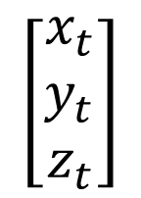

Getting back to our goal
Initial
Location
$$\left[\begin{matrix}x_{t} \\ y_{t} \\ z_{t}\end{matrix}\right]$$
+
Accel.
Location
IMU
(Local)
Y
3D
Orient.
Accel.
Static?
Mag.
$$\iint_{t}^{ }{ }$$
IMU
(Global)
N
Gyro.
3D
Orient.

Slide 28
Getting back to our goal
Initial
Location
$$\left[\begin{matrix}x_{t} \\ y_{t} \\ z_{t}\end{matrix}\right]$$
+
Accel.
Location
IMU
(Local)
Y
3D
Orient.
Accel.
Static?
Mag.
$$\iint_{t}^{ }{ }$$
IMU
(Global)
N
Gyro.
3D
Orient.
Main take away: Gravity is the main anchor for 3D orientation

Slide 29
But what if object is not often static
This paper: MUSE

Slide 30
What does MUSE do?
MUSE = Estimate 3D Orientation even for moving object
Static
Moving
Static
Moving
Time
Use magnetometer as our main anchor
Joint estimation of orientation and location

Slide 31
What does MUSE do?
MUSE = Estimate 3D Orientation even for moving object
Static
Moving
Static
Moving
Time
Use magnetometer as our main anchor
Joint estimation of orientation and location

Slide 32
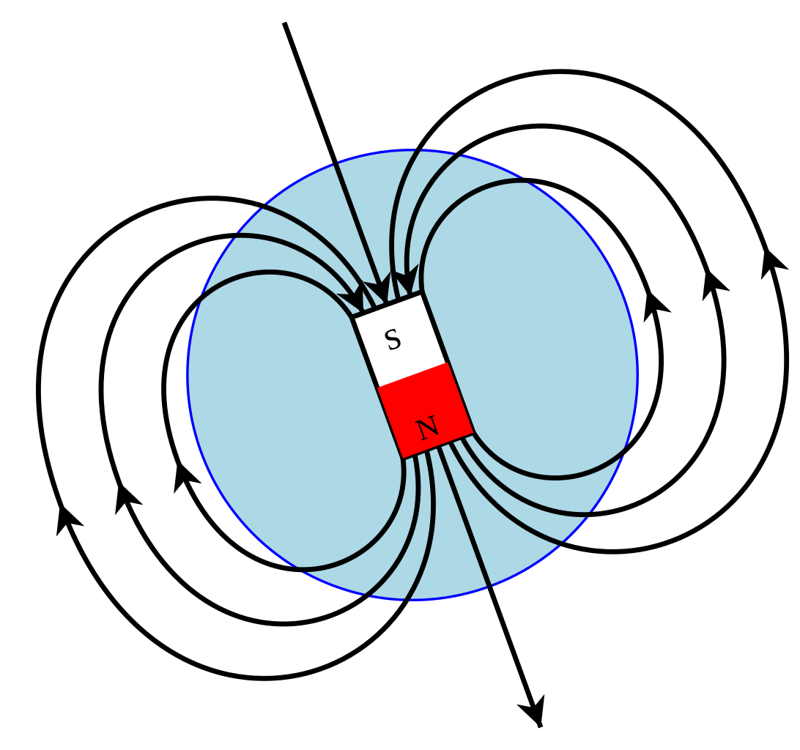
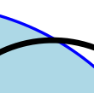
Earth’s North Pole
Earth’s South Pole
From: Wikipedia

Slide 33
Earth’s North Pole
Magnetic Field Direction
on Earth Surface
Earth’s South Pole
From: Wikipedia

Slide 34
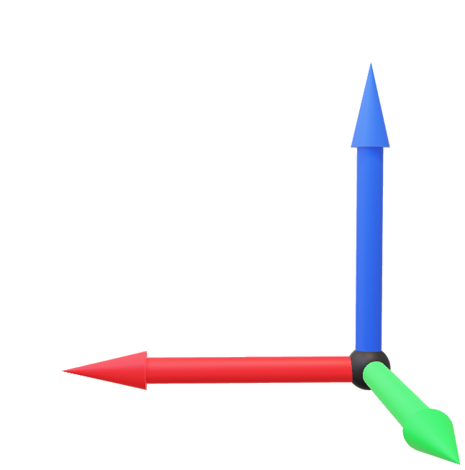
Earth’s Magnetic Field as Main Anchor
Z: Up
Global Reference Frame
Y: North
X: East
Magnetic Field Direction

Slide 35
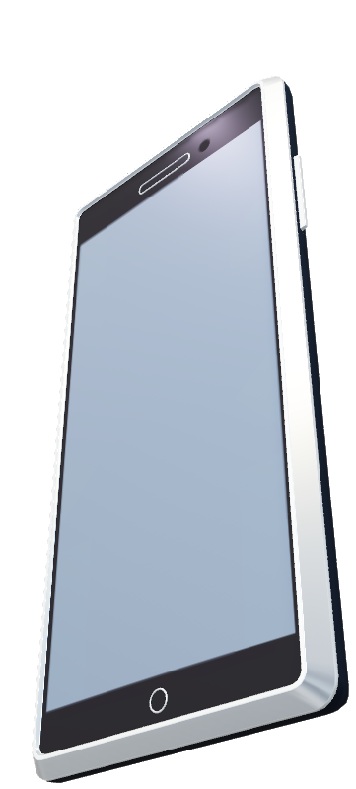
Earth’s Magnetic Field as Main Anchor
This vector is not influenced by motion!
Let’s make it our main anchor
North
Horizontal Plane
Magnetic Field Direction

Slide 36
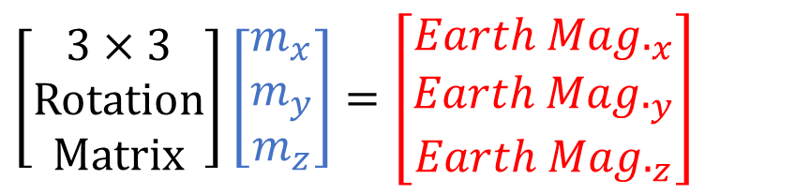
Earth’s Magnetic Field as Main Anchor
$$\left[\begin{aligned}3×3 \\ Rotation \\ Matrix\end{aligned}\right]\left[\begin{matrix}m_{x} \\ m_{y} \\ m_{z}\end{matrix}\right]=\left[\begin{matrix}{Earth Mag.}_{x} \\ {Earth Mag.}_{y} \\ {Earth Mag.}_{z}\end{matrix}\right]$$
Main Anchor
Magnetic Field Direction

Slide 37
Earth’s Magnetic Field as Main Anchor
$$\left[\begin{aligned}3×3 \\ Rotation \\ Matrix\end{aligned}\right]\left[\begin{matrix}m_{x} \\ m_{y} \\ m_{z}\end{matrix}\right]=\left[\begin{matrix}{Earth Mag.}_{x} \\ {Earth Mag.}_{y} \\ {Earth Mag.}_{z}\end{matrix}\right]$$
Three questions:
What does it say about my orientation?
Magnetometer’s resolution is low …
How to know x, y, z of earth magnetic field?

Slide 38
Earth’s Magnetic Field as Main Anchor
$$\left[\begin{aligned}3×3 \\ Rotation \\ Matrix\end{aligned}\right]\left[\begin{matrix}m_{x} \\ m_{y} \\ m_{z}\end{matrix}\right]=\left[\begin{matrix}{Earth Mag.}_{x} \\ {Earth Mag.}_{y} \\ {Earth Mag.}_{z}\end{matrix}\right]$$
Three questions:
What does it say about my orientation?
Magnetometer’s resolution is low …
How to know x, y, z of earth magnetic field?

Slide 39
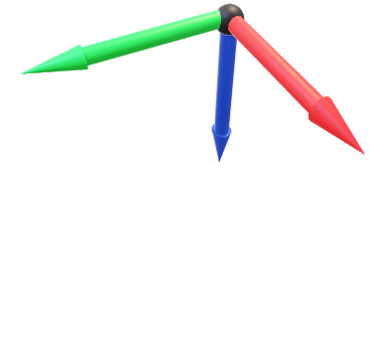


Actual vs. Inferred Measurement
Z: Outward
Y: Front
Z: Outward
Y: Front
[Local]
[Local]
X: Right
X: Right
$$v_{measure}$$
$$v_{infer}$$
Actual Measurement
(from magnetometer)
Inferred Measurement
(inferred from orientation estimation)

Slide 40
Actual vs. Inferred Measurement
Z: Outward
Y: Front
Z: Outward
Y: Front
[Local]
[Local]
X: Right
X: Right
$v_{measure}$ and $v_{infer}$ are equal, if our orientation is estimated perfectly …
$$v_{measure}$$
$$v_{infer}$$
Actual Measurement
(from magnetometer)
Inferred Measurement
(inferred from orientation estimation)

Slide 41


Actual vs. Inferred Measurement
Z: Outward
Y: Front
[Local]
X: Right
$$v_{measure}$$
$$v_{infer}$$
2-DoF Orientation Drift == How off $v_{infer}$ is from $v_{measure}$

Slide 42

Actual vs. Inferred Measurement
Z: Outward
Y: Front
$$∆_{orient}$$
[Local]
X: Right
$$v_{measure}$$
$$v_{infer}$$
2-DoF Orientation Drift == How off $v_{infer}$ is from $v_{measure}$

Slide 43
Actual vs. Inferred Measurement
Z: Outward
Y: Front
$$∆_{orient}$$
[Local]
X: Right
$$v_{measure}$$
$$v_{infer}$$
New Orientation = Old Orientation + $∆_{orient}$

Slide 44
Actual vs. Inferred Measurement
New Orientation = Old Orientation + $∆_{orient}$
Gyroscope:
Orientation(t) = Orientation(t-1) + $\int_{∆t}^{ }{gyro. dt}$
Magnetometer:
Orientation(t) = Orientation(t) + $0.01∗∆_{orient}$

Slide 45
Earth’s Magnetic Field as Main Anchor
$$\left[\begin{aligned}3×3 \\ Rotation \\ Matrix\end{aligned}\right]\left[\begin{matrix}m_{x} \\ m_{y} \\ m_{z}\end{matrix}\right]=\left[\begin{matrix}{Earth Mag.}_{x} \\ {Earth Mag.}_{y} \\ {Earth Mag.}_{z}\end{matrix}\right]$$
Three questions:
What does it say about my orientation?
Magnetometer’s resolution is low …
How to know x, y, z of earth magnetic field?

Slide 46
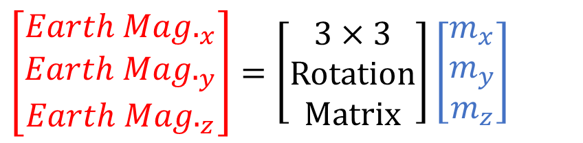
Earth’s Magnetic Field as Main Anchor
How to know x, y, z of earth magnetic field?
Obtain GPS address and check the database is one option …
A easier way is to utilize pause opportunities
$$\left[\begin{matrix}{Earth Mag.}_{x} \\ {Earth Mag.}_{y} \\ {Earth Mag.}_{z}\end{matrix}\right]=\left[\begin{aligned}3×3 \\ Rotation \\ Matrix\end{aligned}\right]\left[\begin{matrix}m_{x} \\ m_{y} \\ m_{z}\end{matrix}\right]$$
Known when object is static

Slide 47
Evaluation

Slide 48
Comparison Baselines
GyroOnly | Only uses gyroscope integration, assuming initial orientation is known
ComplemFilter | (Option 1) Use low-pass filter on acceleration
A3 | (Option 2) Calibrate using “good” opportunities
MUSE | Our algorithm
Ground Truth: Periodically bringing the phone to the same orientation, and excluding those moments from calibration opportunities

Slide 49
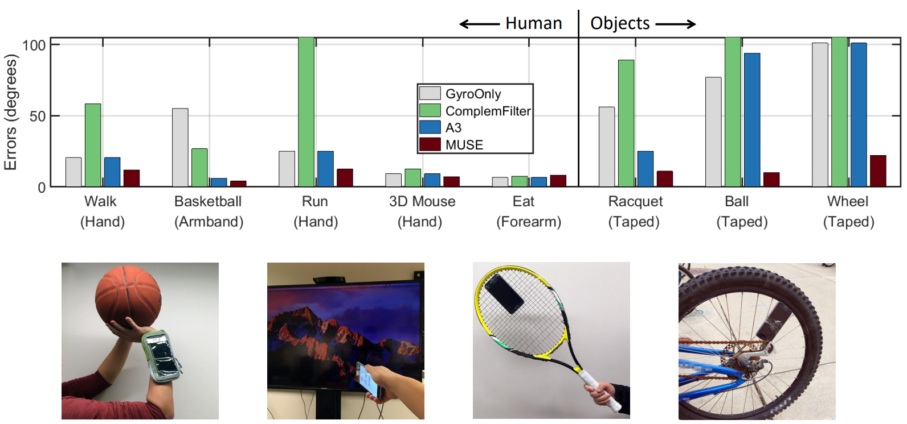
Natural Activities

Slide 50
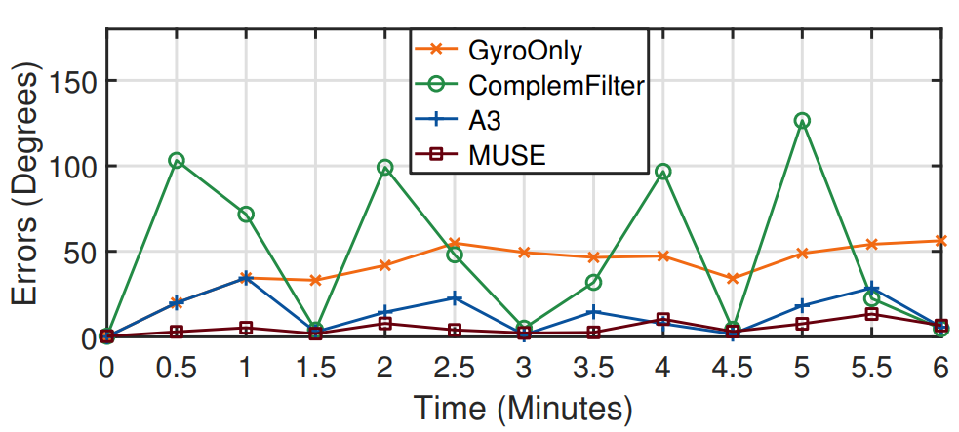
A Sample Trace

Slide 51
OK, we have 3D Orientation now… how to estimate location?

Slide 52

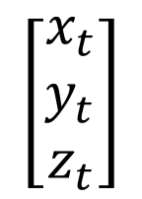
OK, we have 3D Orientation now… how to estimate location?
Initial Location
$$\left[\begin{matrix}x_{t} \\ y_{t} \\ z_{t}\end{matrix}\right]$$
+
Accel.
Accel.
$$\iint_{t}^{ }{ }$$
3D
Orient.
IMU
(Global)
IMU (Local)
Gyro.
Mag.

Slide 53
OK, we have 3D Orientation now… how to estimate location?
Initial Location
$$\left[\begin{matrix}x_{t} \\ y_{t} \\ z_{t}\end{matrix}\right]$$
+
Accel.
Accel.
$$\iint_{t}^{ }{ }$$
3D
Orient.
IMU
(Global)
IMU (Local)
Gyro.
Mag.
Localization impossible if
accelerometer has any noise … why?

Slide 54
Motion models can bound location error
Initial Location
$$\left[\begin{matrix}x_{t} \\ y_{t} \\ z_{t}\end{matrix}\right]$$
+
Accel.
Accel.
$$\iint_{t}^{ }{ }$$
3D
Orient.
IMU
(Global)
IMU (Local)
Gyro.
Mag.

Slide 55
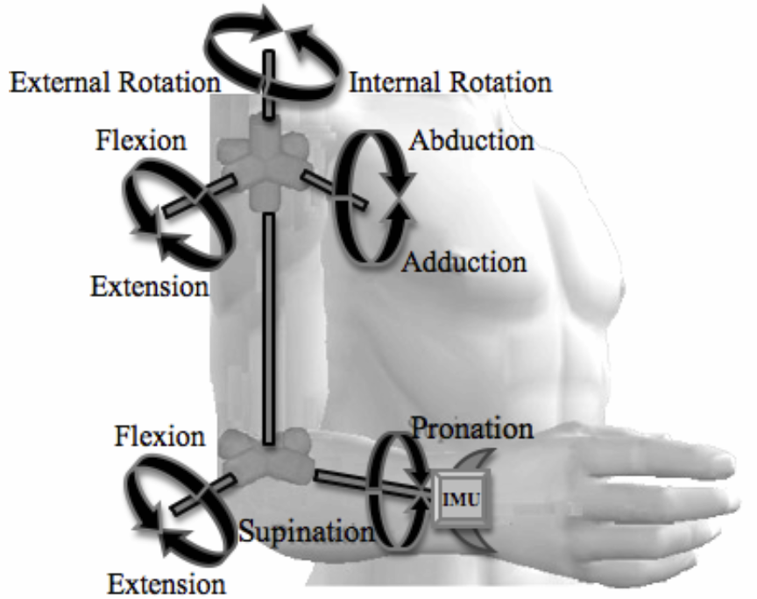
Motion models can bound location error
Initial Location
$$\left[\begin{matrix}x_{t} \\ y_{t} \\ z_{t}\end{matrix}\right]$$
+
Accel.
Accel.
$$\iint_{t}^{ }{ }$$
3D
Orient.
IMU
(Global)
IMU (Local)
Gyro.
Mag.
Motion model as priors

Slide 56
MUSE uses this motion model to
jointly estimate both { orientation + location }
Initial Location
$$\left[\begin{matrix}x_{t} \\ y_{t} \\ z_{t}\end{matrix}\right]$$
+
Accel.
Accel.
$$\iint_{t}^{ }{ }$$
3D
Orient.
IMU
(Global)
IMU (Local)
Gyro.
Mag.
Motion model as priors

Slide 57
MUSE uses this motion model (in a particle filter) to
jointly estimate both { orientation + location }
Initial Location
$$\left[\begin{matrix}x_{t} \\ y_{t} \\ z_{t}\end{matrix}\right]$$
+
Accel.
Accel.
$$\iint_{t}^{ }{ }$$
3D
Orient.
IMU
(Global)
IMU (Local)
Gyro.
Mag.
Motion model as priors

Slide 58
OK, we have 3D Orientation now… how to estimate location?
Initial Location
$$\left[\begin{matrix}x_{t} \\ y_{t} \\ z_{t}\end{matrix}\right]$$
+
Accel.
Accel.
$$\iint_{t}^{ }{ }$$
3D
Orient.
IMU
(Global)
IMU (Local)
Gyro.
Mag.
Motion model as priors

Slide 59
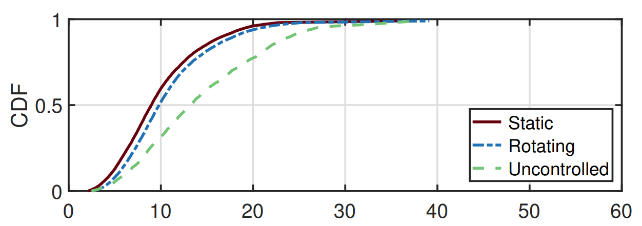
MUSE Localization Error
Fits motion model the best
(cm)
Motion model breaks

Slide 60
Conclusion
Conventional Systems
This paper
Use magnetometer as
a new “gravity” sensor
Orientation
Joint estimation of orientation and location
Location

