Slide 1
Cooperative Packet Recovery in Enterprise Wireless - LANs
Mahanth Gowda
Souvik Sen
Duke University
mahanth.gowda@duke.edu
HP Labs
souvik.sen@hp.com
Romit Roy Choudhury
Sung-Ju Lee
Duke University
romit.rc@duke.edu
Narus
sjlee@narus.com

Slide 2
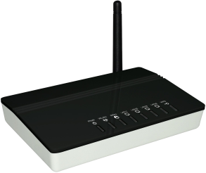
Wireless LAN & EWLAN
Internet
Internet
Internet
Controller
AP
AP
AP
Internet
Internet
Internet
Internet
AP
AP
AP

Slide 3
Packet Combining
Controller
AP
AP
AP
AP
AP
AP

Slide 4
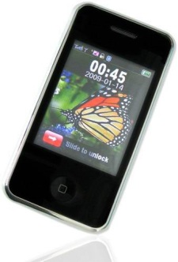
Application Scenario
Upload traffic
Usually multiple Access Points (APs) overhear client’s data
Increase bit rate, induce errors, recover via combining
Controller

Slide 5
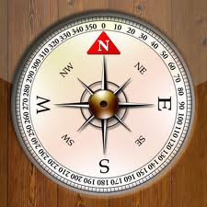
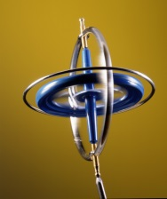
Do we Care for Upload Traffic ?
Upload traffic is increasing at a rapid pace because:
Cloud Computing
P2P File Access
Code Offloading
Controller
Sensor Data Upload
VoIP,
Video Chat

Slide 6
Packet combining is an old idea …
Several creative works done in the past
MRD (Mobicom 2005)
Soft (Mobicom 2007)

Slide 7
MAC Layer combining - MRD
Corrected Packet
Low Bandwidth overhead,
Less Gain
Bit Combining
Bits
Bits
Decoding
Decoding
Demodulation
Demodulation
Signals
Signals

Slide 8
MAC Layer combining - SOFT
Corrected Packet
Low Bandwidth overhead,
Less Gain
Soft Combining
Soft Bits
Soft Bits
Soft Decoding
Soft Decoding
Soft Demodulation
Soft Demodulation
Signals
Signals
Bits: 1 0 1 0
Soft Values: 0.6 -0.3 0.2 -0.7

Slide 9
PHY Layer combining - MRC
Symbol Combining
Signals
Signals
Signals
Signals

Slide 10

MRC (Maximal Ratio Combining)
Weighted centroid of erroneously received symbols
Weights based on channel quality
P₁
P₂
P₃
P₄
$$S = \frac{\sum{h_{i}∗R_{i}}}{\sum{h_{i}}}$$
P₅
P₆
P₇
P₈
Received Symbol at ${AP}_{i}$
P₉
P₁₀
P₁₁
P₁₁
Jointly decode possibly corrupt symbols to infer the correct symbol
P₁₃
P₁₄
P₁₅
P₁₆

Slide 11
PHY Layer combining (MRC)
High gain, Prohibitive Bandwidth
Symbol Combining
Demodulation
Signals
Signals
Decoding
Corrected Packet
Signals
Signals

Slide 12
Epicenter
Practical Symbol Level Packet Combiner

Slide 13
Is there a sweet spot?
Symbols
Coarser Symbols?
Gain
10101
Bits
Bandwidth Overhead

Slide 14
Contributions
Finding a sweet spot in the overhead-combining tradeoff
Aggressive rate estimation algorithm to leverage combining
Symbol Combining
Epicenter AP
Rate Estimation
Epicenter Client

Slide 15
Coarser Symbols
I
Q
Symbols
I
Gain
Q
MRC Bits
10101
Bits
x
1.6x
9x
Bandwidth Overhead

Slide 16
Coarser Symbols
I
Q
Symbols
I
Q
I
Epi 1x
Gain
Q
MRC Bits
10101
Bits
x
1.6x
2x
9x
Bandwidth Overhead

Slide 17
Coarser Symbols
I
Q
I
Symbols
Q
Epi 2x
I
Q
I
Epi 1x
Gain
Q
MRC Bits
10101
Bits
Overhead of Soft = 3x
x
1.6x
2x
2.5x
9x
Bandwidth Overhead

Slide 18
Epicenter System Architecture
High Gain,
Low Bandwidth
Coarse Symbol
Combining
Demodulation
Low Fidelity
Signals
Low Fidelity
Signals
Decoding
Low Fidelity Transformer
Low Fidelity Transformer
Corrected Packet
Signals
Signals

Slide 19
Rate Adaptation
Rate is a function of modulation and coding scheme
Higher modulations support higher rates, but tolerate few errors
Wrong Demodulation with 16QAM
Correct Demodulation with QPSK
Error Vector = Received Symbol – Transmitted Symbol
1101
1001
0001
0101
P₁
P₂
P₃
P₄
10
1000
0000
0100
1100
00
P₅
P₆
P₇
P₈
P₁
P₂
v
1110
1010
0010
0110
P₉
P₁₀
P₁₁
P₁₂
1111
0011
0111
11
1011
01
P₁₃
P₁₄
P₁₅
P₁₆
P₃
P₄

Slide 20
‘Look up’ based Rate Estimation
Bit errors depend upon the distribution of error vectors
The Expected Bit error rate
in the fig is
F1*0 +
(F2)*1.5 +
(F3)*3
Bit error rate helps in bit
rate estimation
Empirical table of rates, fractions, delivery ratio (DR)
<Rate, F1, F2, F3, DR>
P₁
P₂
P₃
P₄
F2
F3
P₅
P₆
P₇
P₈
F1
P₉
P₁₀
P₁₁
P₁₁
P₁₃
P₁₄
P₁₅
P₁₆
Key
Value

Slide 21
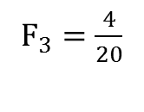
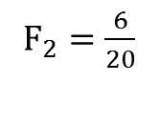
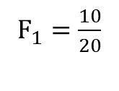
Table Look up Example
Key
<24, 10/20, 6/20, 4/20>
$F_{3}=\frac{4}{20}$
F₃
P₁
P₂
P₃
P₄
$F_{1}=\frac{10}{20}$
P₅
P₆
P₇
P₆
P₈
F₁
F₂
$F_{2}=\frac{6}{20}$
P₉
P₁₀
P₁₁
P₁₂
P₁₃
P₁₄
P₁₅
P₁₆
Testing 24 Mbps, 16 QAM

Slide 22
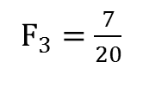
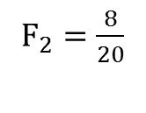
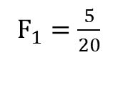
Table Look up Example
Key
<54, 5/20, 8/20, 7/20>
$F_{3}=\frac{7}{20}$
F₃
P₁
P₂
P₃
P₄
P₅
P₆
P₇
P₈
P₈
P₉
P₁₀
P₁₁
P₁₂
F₁
$F_{1}=\frac{5}{20}$
F₂
P₁₃
P₁₄
P₁₅
P₁₆
P₁₇
P₁₈
P₁₉
P₂₀
P₂₁
P₂₂
P₂₃
P₂₄
$F_{2}=\frac{8}{20}$
P₂₅
P₂₆
P₂₇
P₂₈
P₂₉
P₃₀
P₃₁
P₃₂
P₃₃
P₃₄
P₃₅
P₃₆
Testing 54 Mbps, 64 QAM (Partial constellation shown)

Slide 23
Rate Prediction Algorithm
Estimate the distribution of Error Vectors using client → AP channels (details in paper)
Estimate Delivery Ratio for all 802.11 Data-rates/AP-combination via look-up table
Prescribe the Data-rate/AP- combination that maximizes throughput
Key | Value
6,0.8,0.1,0.1 | 0.90
.. | ..
Rate, ${{F_{1,}F}_{2,}F}_{3}$
Delivery Ratio
Table Look-up (Details in paper)

Slide 24
Evaluation
Epicenter

Slide 25
Methodology
Software Defined Radios – USRP + GnuRadio
6 USRP-APs were co-located with real APs in our building
A client-USRP was mounted on a wheel chair
Client communicates with closest AP, others overhear
Comparison of Following Schemes
Soft
Epi – {1x, 2x}
MRC – {Bits, Symbol}
Accuracy of Rate Prediction

Slide 26
Symbol Level – Reduced Errors

Slide 27
Throughput Gain
~ 47% gain

Slide 28
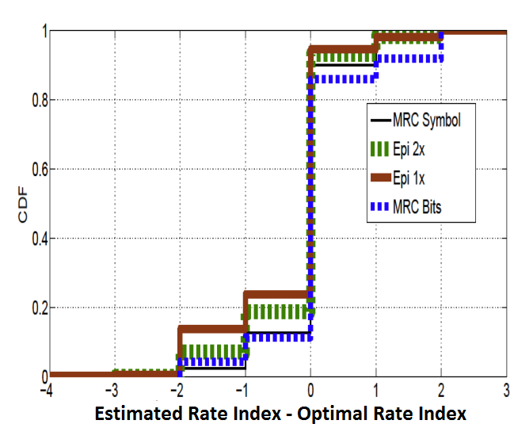
Rate Prediction
70-80% accurate

Slide 29
More results in paper
Bit Error Rates (Comparison with Soft)
Performance of AP selection
Downlink Throughput gain – Range amplifier

Slide 30
Conclusion
Epicenter, Best of Both
Symbols
Coarser Symbols
Gain
10101
Bits
Bandwidth Overhead

Slide 31
Conclusion
Epicenter uses coarser representation of symbols for combining
Preserves diversity among symbols necessary for combining
Enormously decreases bandwidth requirements
Look up based rate prediction achieves 70-80% accuracy
Epicenter achieves 25-90% throughput gain over 802.11 and 40% over Soft

Slide 32
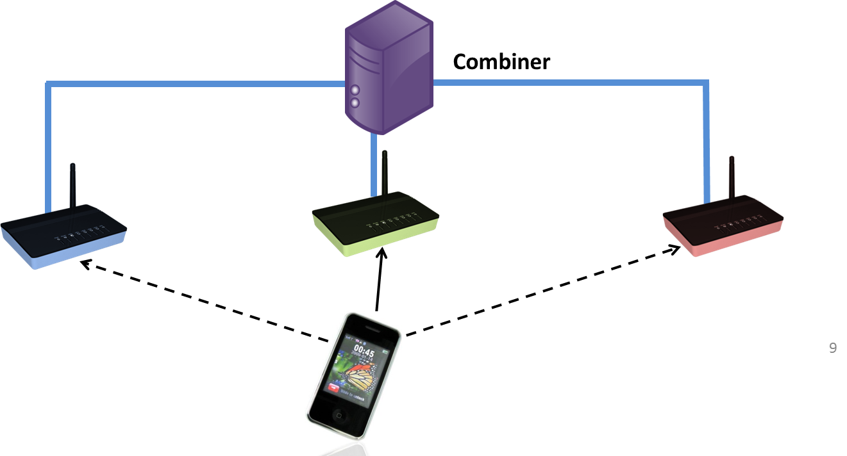
Thank You
DUKE SyNRG Research Group
www.synrg.ee.duke.edu

