Slide 1
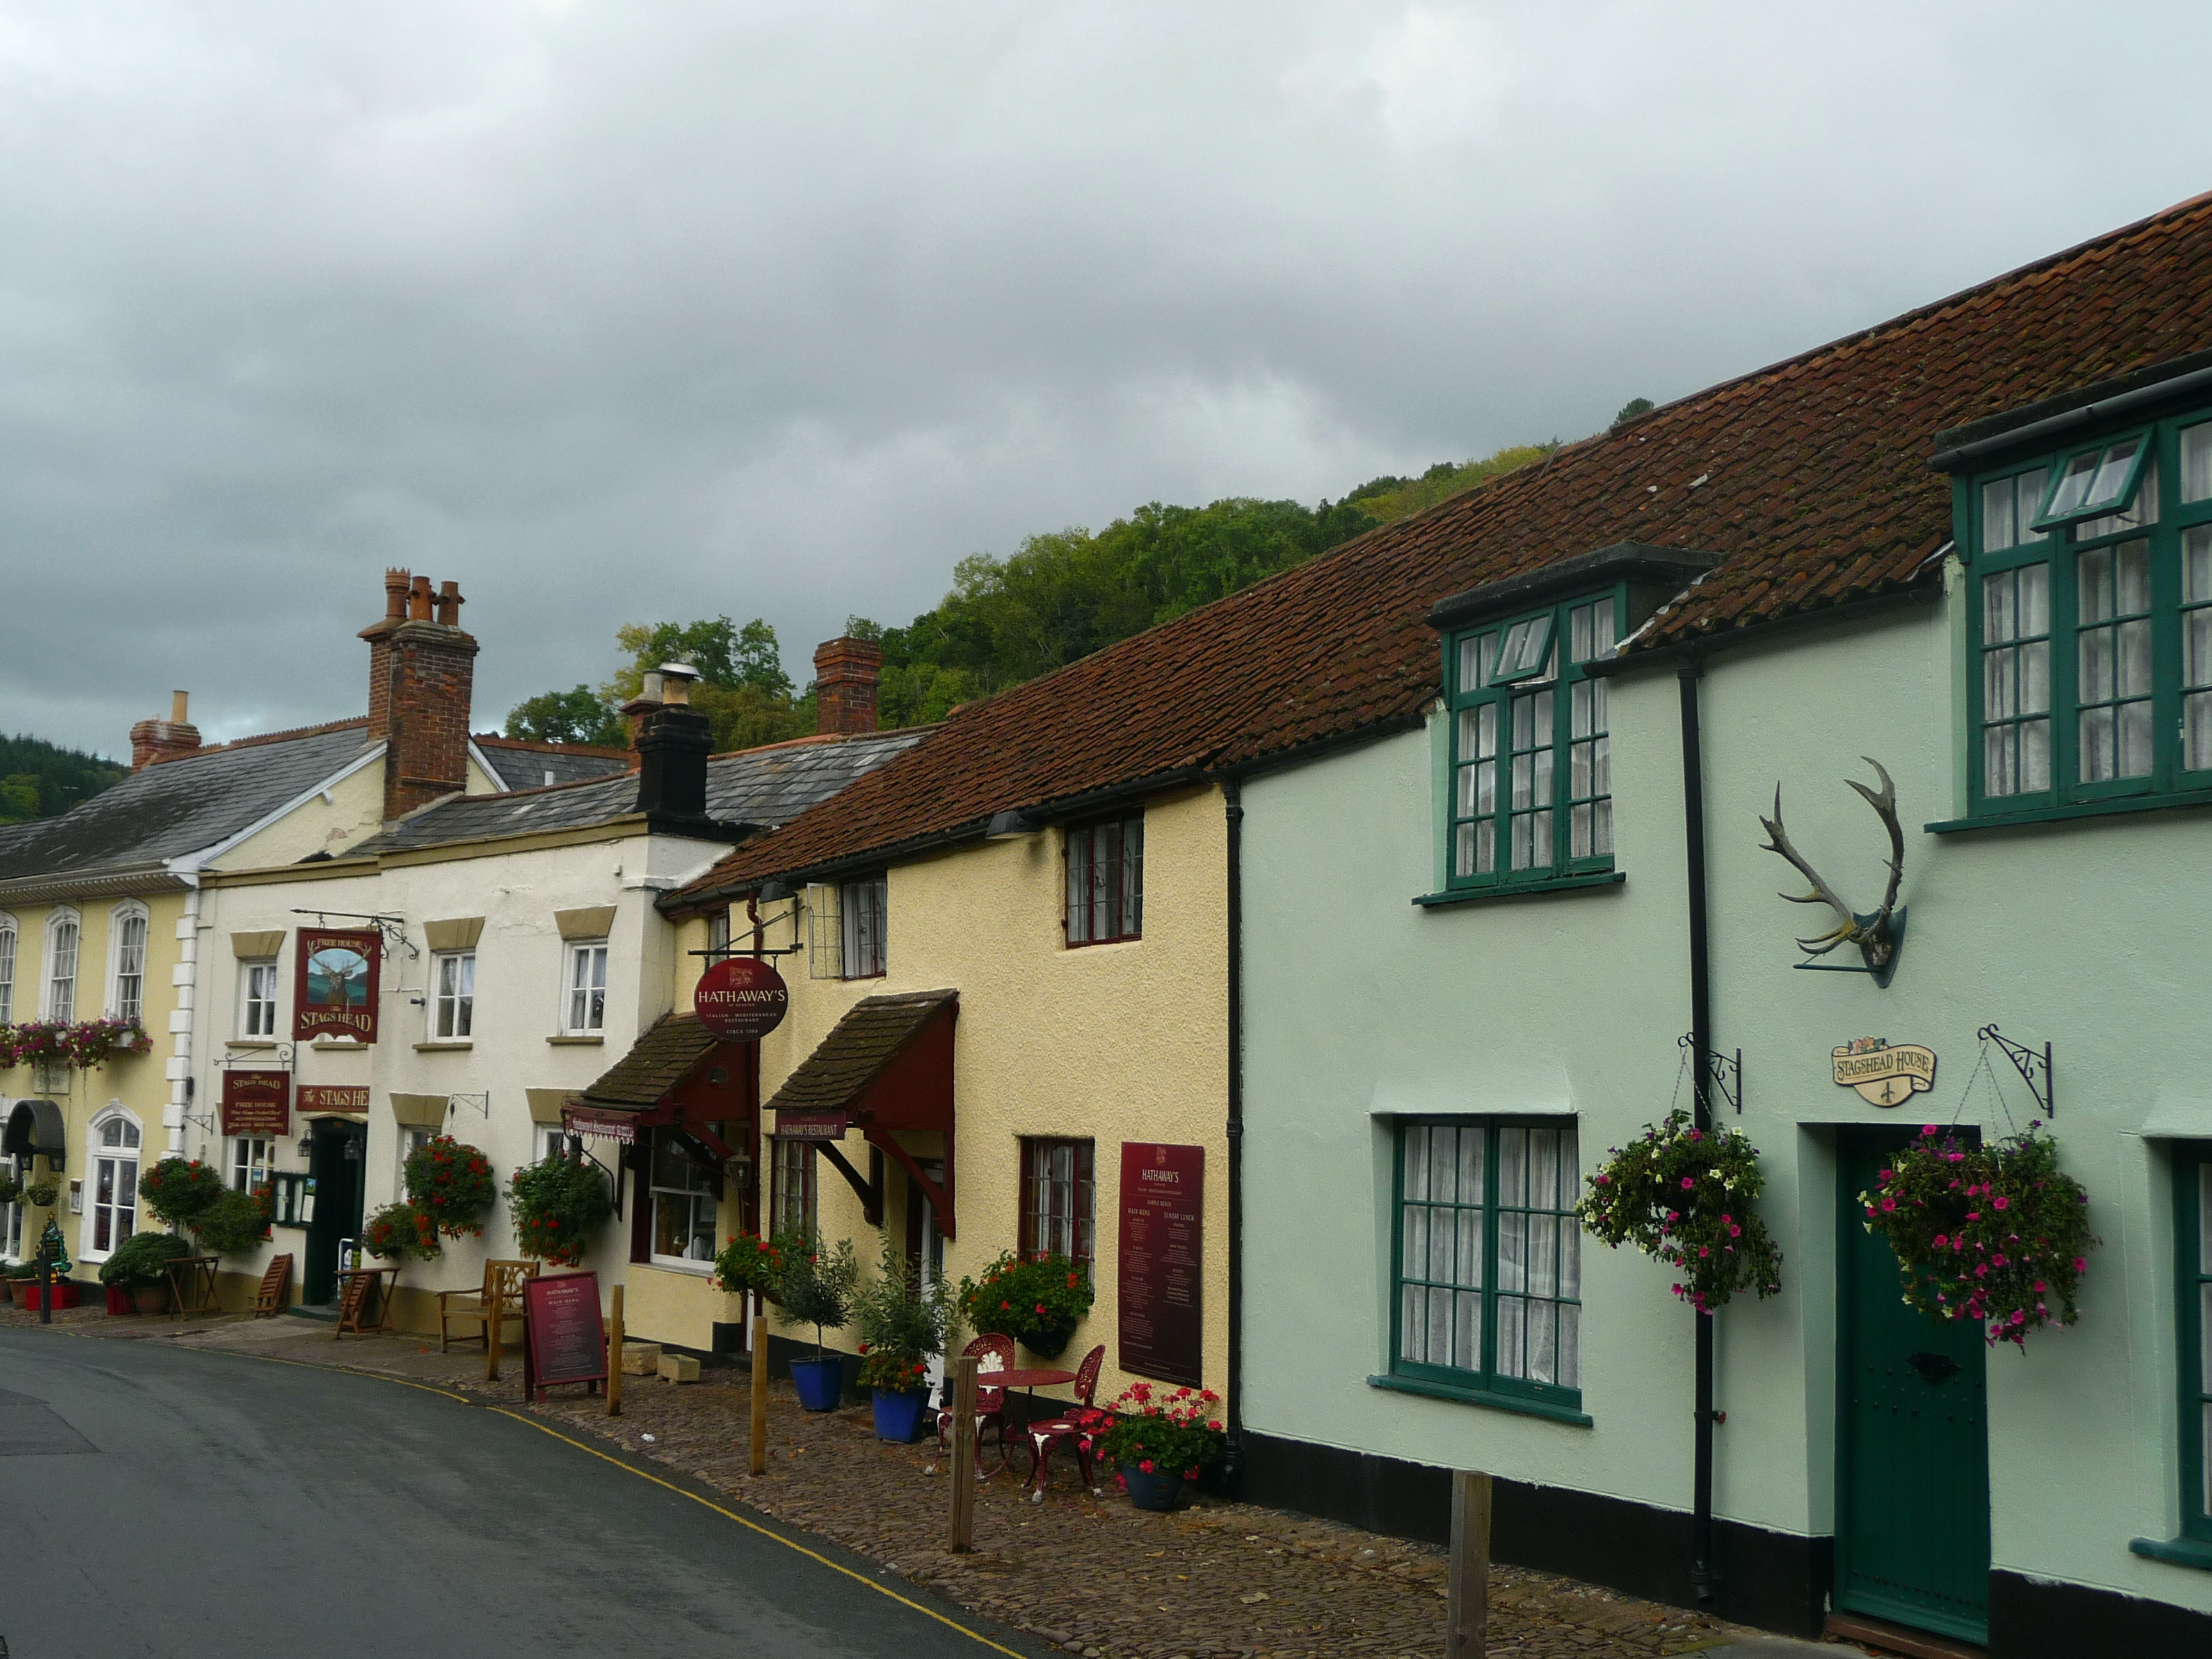
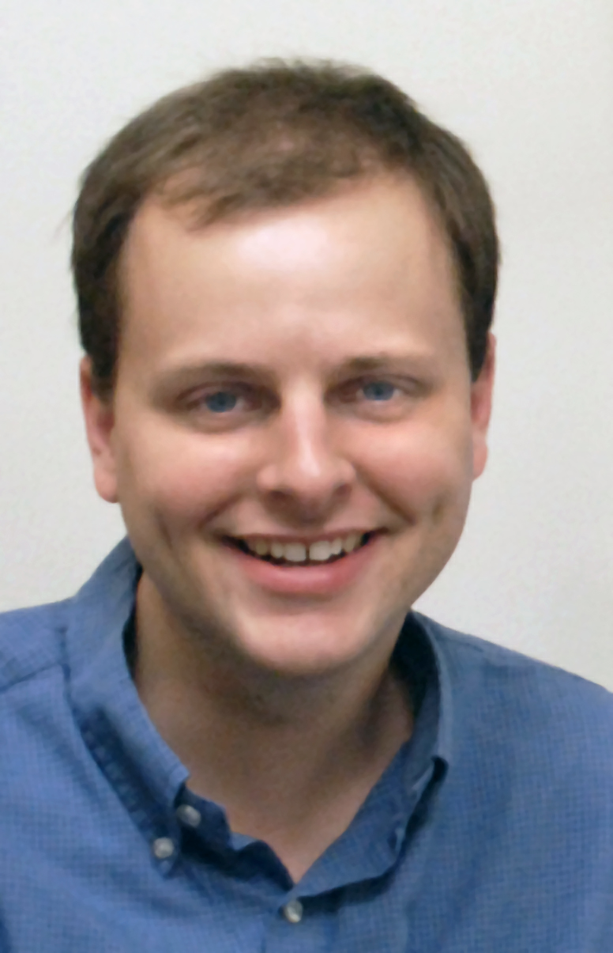
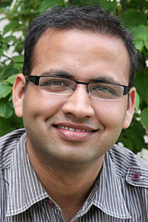

Satellites in Our Pockets …
An Object Positioning System Using Smartphones
IBM T. J. Watson Research
Duke University
(formerly at Duke University)

Slide 2

Augmented Reality
Localization for WHAT WE CAN SEE
Roof
leaks
from
here
Creaky
Window
Good food,
Open late

Slide 3
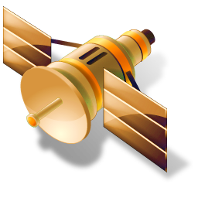
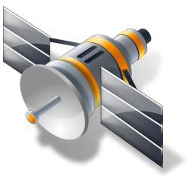




y
z
x

Slide 4

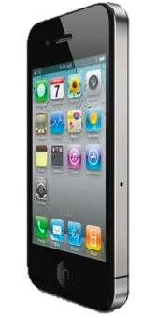

Why not just triangulate?
North
Need visual information
to correct for noise in GPS / compass
East

Slide 5
Challenges and Disclaimers
GPS / compass / gyroscope sensing is noisy
  Complex error sources, hard to reason about accuracy
Small errors can be magnified
  Attempting to project far into the distance
Need to capture user intent
  What, exactly, is the user trying to tag?
Combining multiple information sources
  Very little data to connect independent sensor readings
Not attempting to push state-of-the-art in vision,
Nonobvious to leverage, integrate with sensing

Slide 6
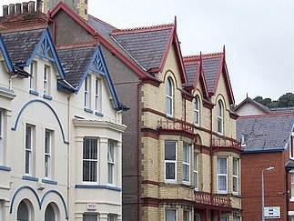
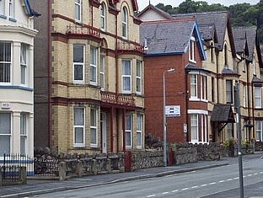
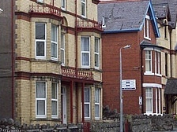

System Overview
y
z
x
y
z
x
(noisy)
(fixed)
y
z
x
(fixed)
(object)

Slide 7
Hints from Vision
y
z
x

Slide 8
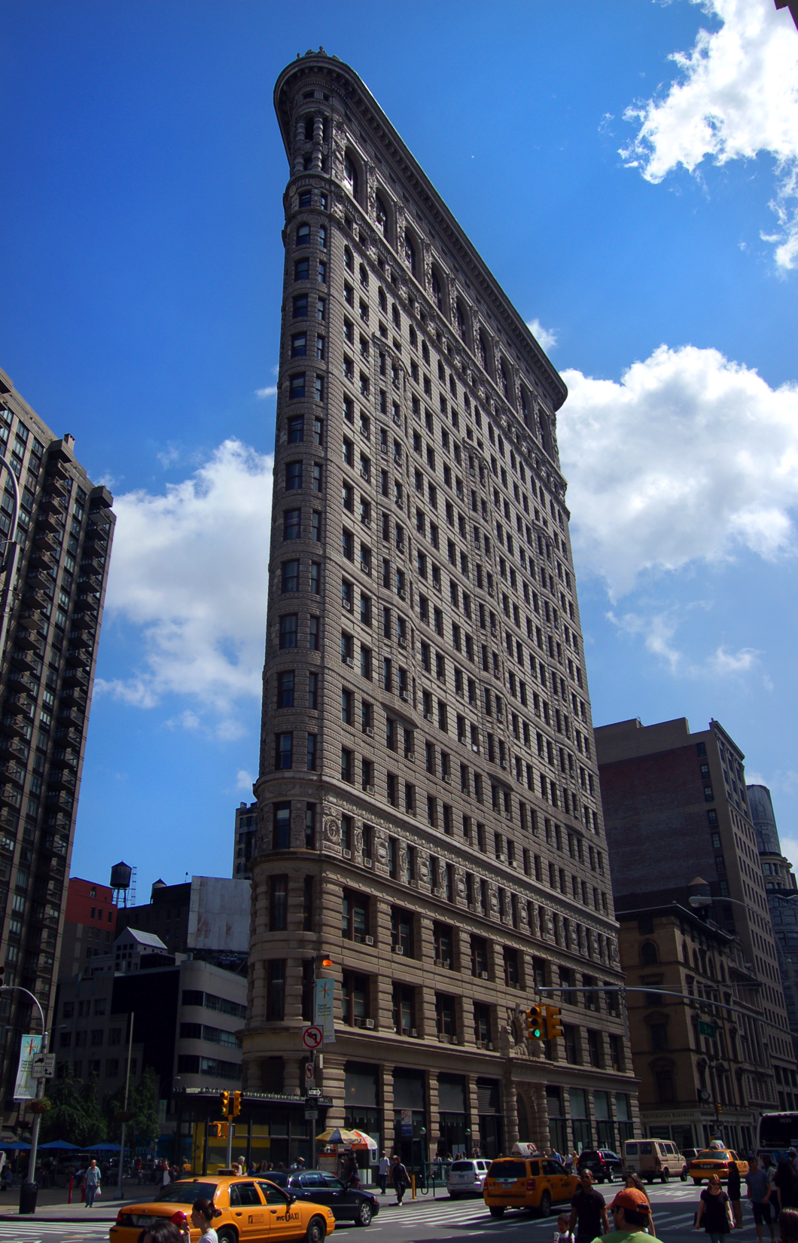
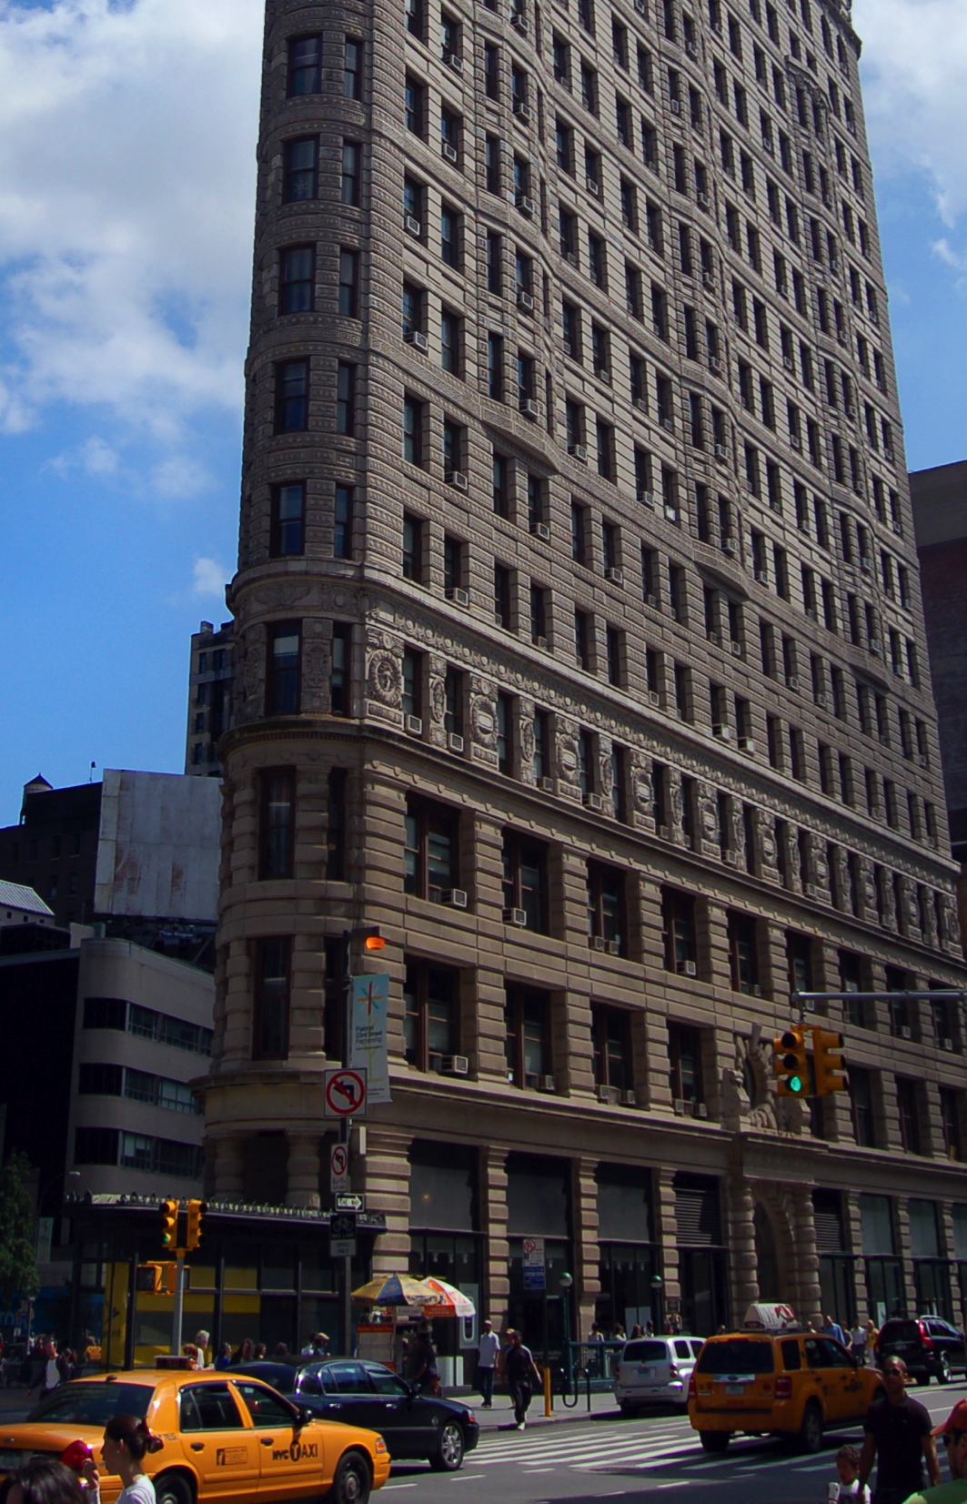
Keypoint Detection
50%
Closer
Descriptor Extraction
Matching
Spatial
Reasoning

Slide 9
Structure from Motion (SfM)
Extracting 3D geometry
  Like 3D from stereo vision, but less constrained
  Recover 3D coordinates of object keypoints, cameras
Bundler: open-source SfM library
  Backbone of Microsoft “Photosynth” project
  Thesis of Noah Snavely (UWash PhD, now at Cornell)
Bundler
y
z
x

Slide 10
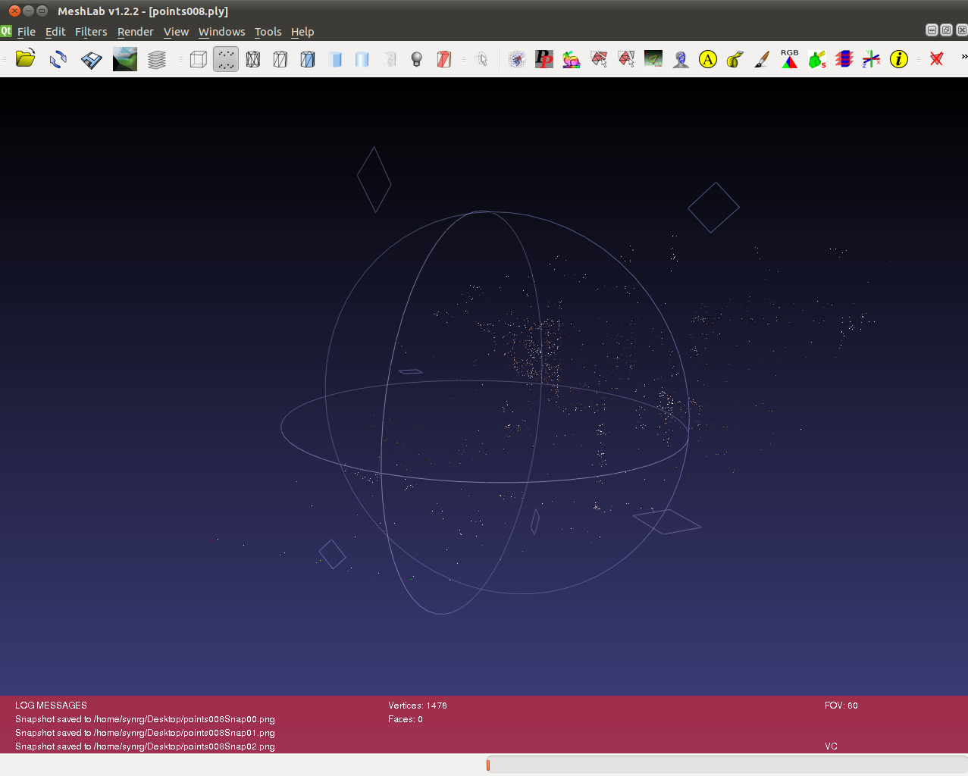
Point cloud
Leverage
Structure
Captures sparse object structure
Captures camera locations
Leverage
Angles
Leverage
Distances

Slide 11
Correcting GPS with Vision
y
z
x
(noisy)
(fixed)

Slide 12
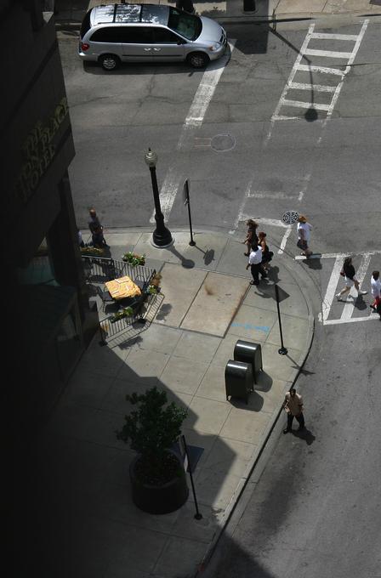
Scaling Factor
2D Planar Rotation
Move GPS points as little as possible,
Constrained as a scaling + rotation of vision
GPS
Vision

Slide 13
Enhanced Triangulation
y
z
x
(fixed)
(object)

Slide 14
Triangulating from >2 Points
North
Minimize Total Angular Error
(a, b)
East

Slide 15
Leveraging Estimated Distance
North
Distance, Scaling from Vision, GPS
Distance constrained:
Median[Vision × GPS Scaling Factor]
East

Slide 16
Leveraging Angular Structure
North
Interior Angles Known from Vision
East

Slide 17
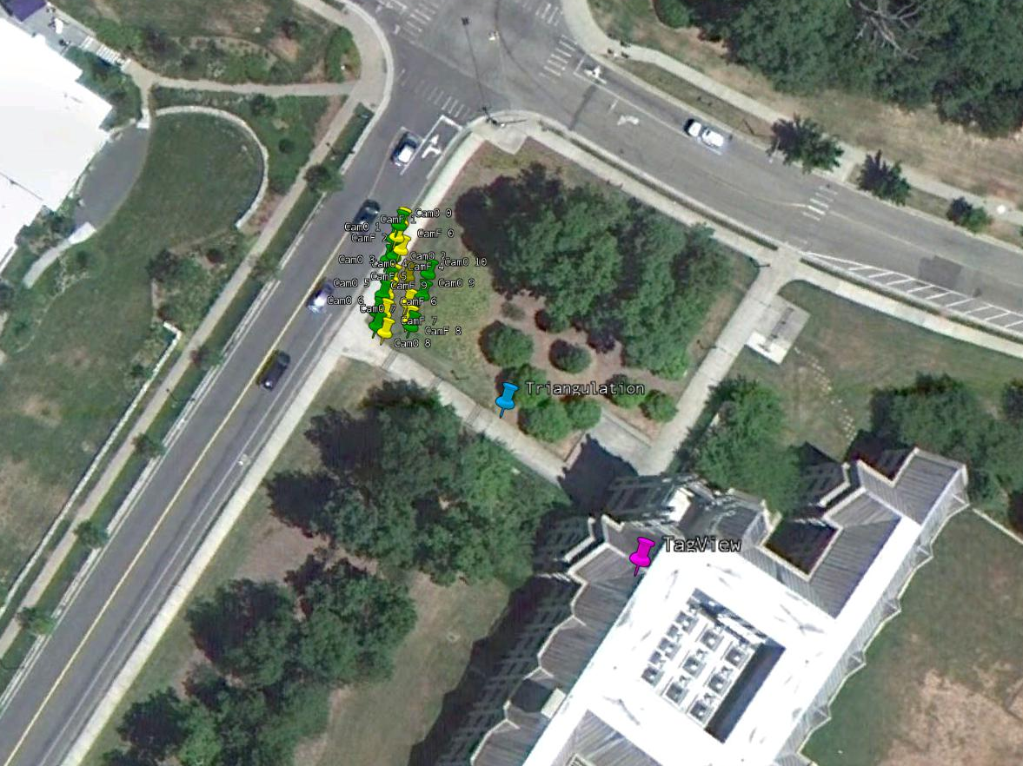
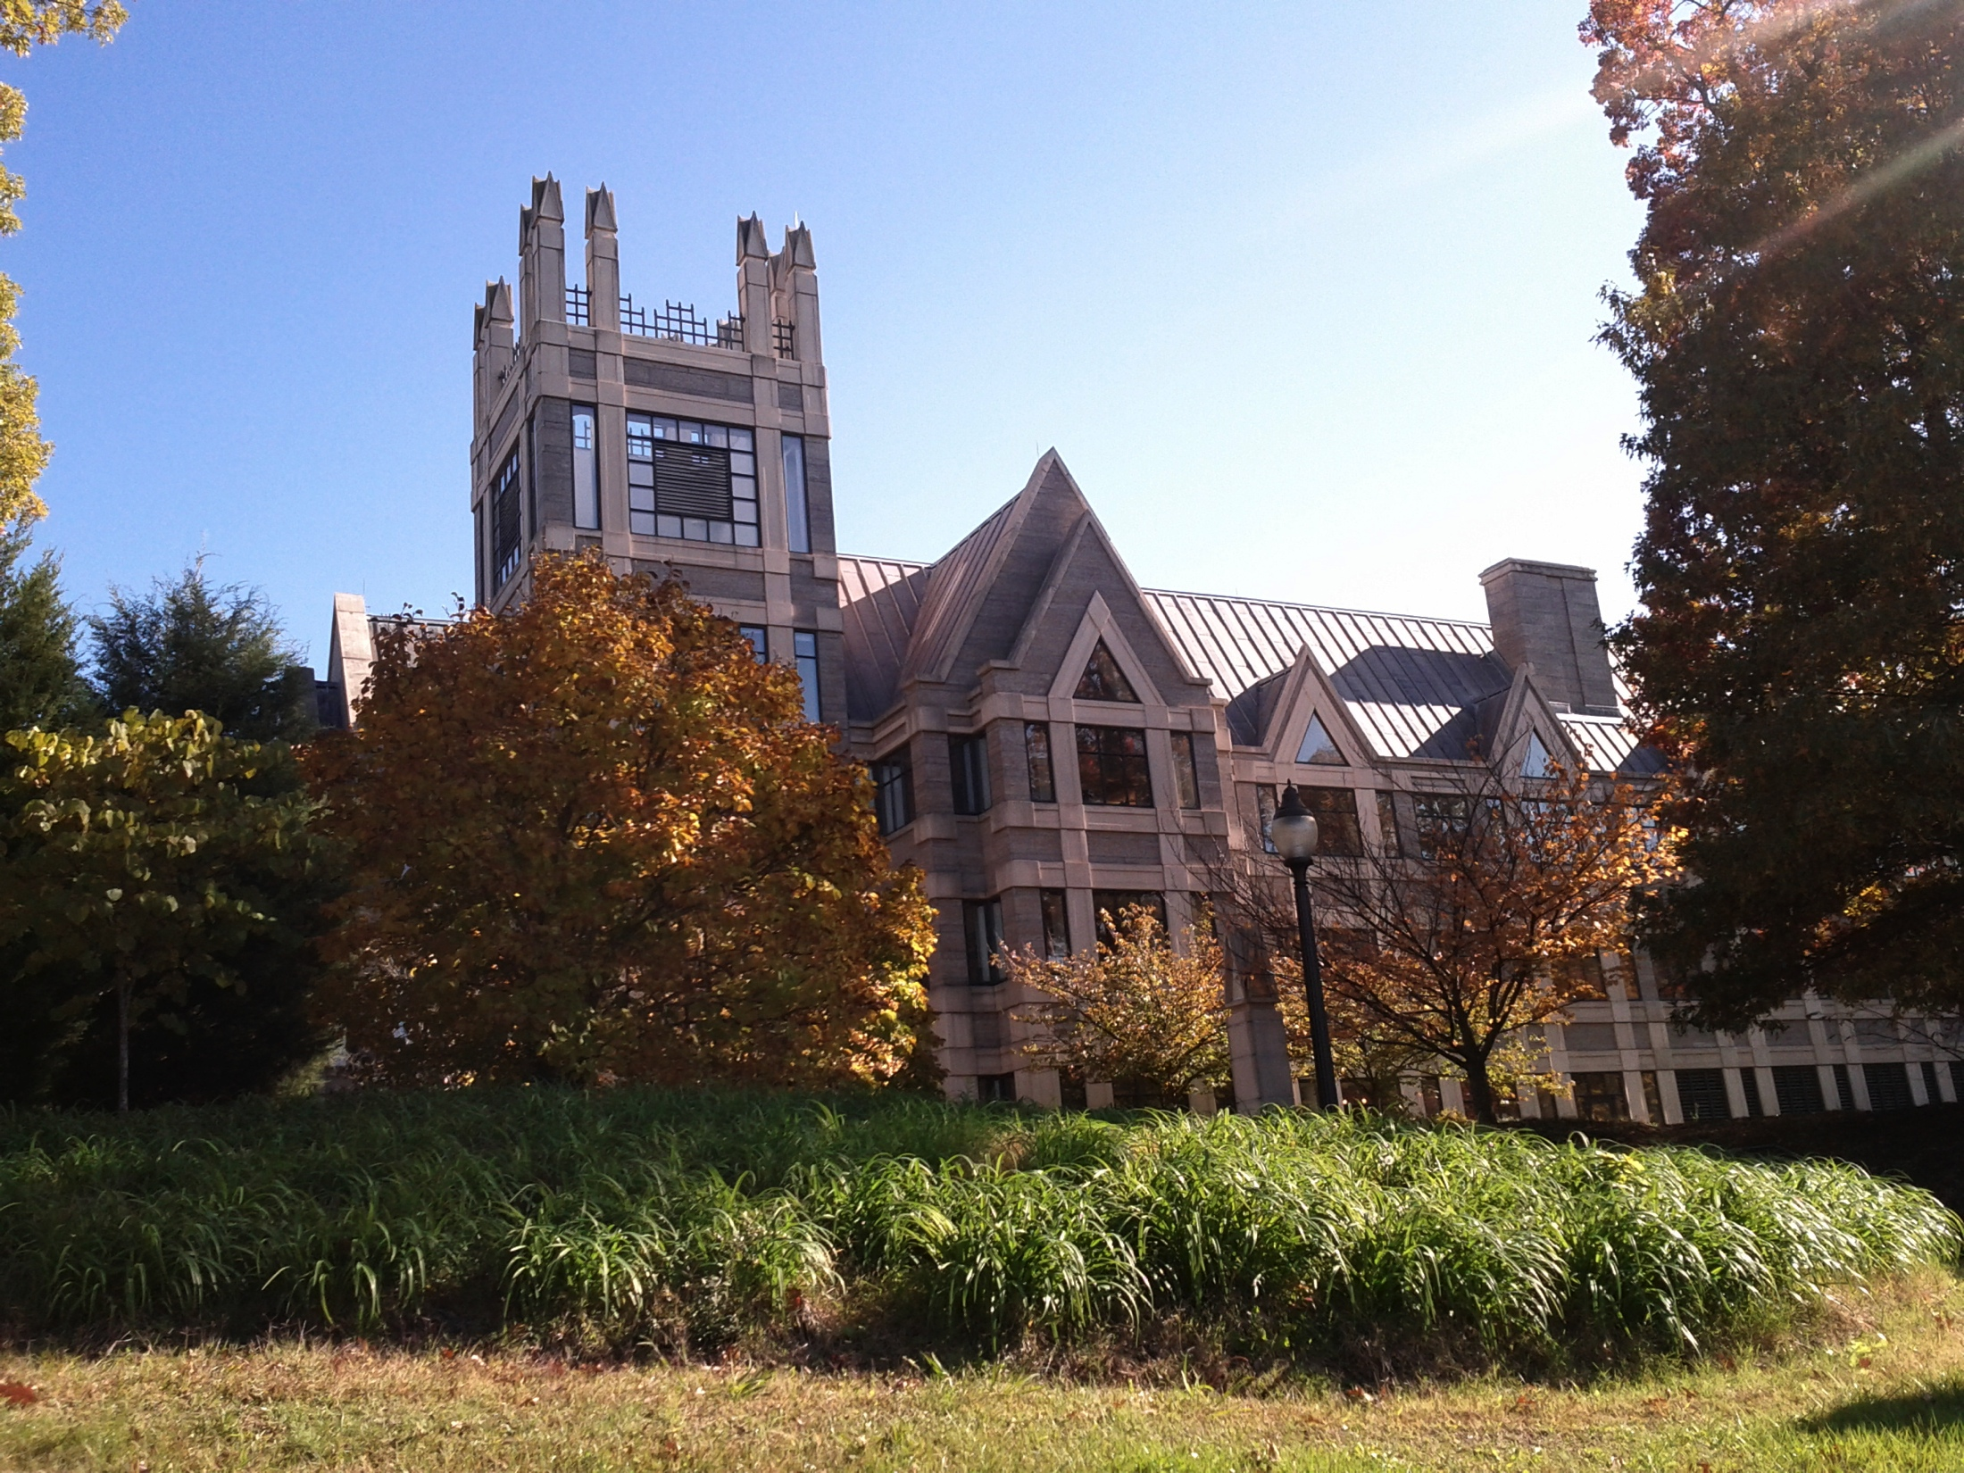

One Real-World Example…
Ongoing Work in Addressing Failure Cases
Vision: e.g., Sun-in-eyes breaks SfM
Sensing: e.g., when GPS errors are too large
User
Public
Policy
101
GPS + Compass
OPS
Public
Policy
101

Slide 18
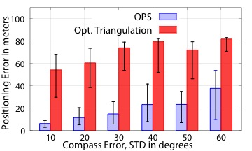
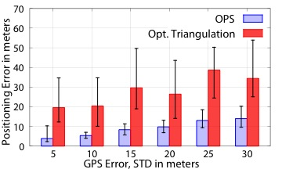
Results Show Promise
Reduced Sensitivity to Compass Error
Reduced Sensitivity to GPS Error

Slide 19
Conclusion
“Localization” has traditionally
been viewed as
self-localization
OPS extends this understanding, localizing distant
objects-in-sight
Future research can provide “localization” as a generic service for context awareness

Slide 20
Thank you
Questions?
IBM T. J. Watson Research
Duke University
(formerly at Duke University)

Slide 21
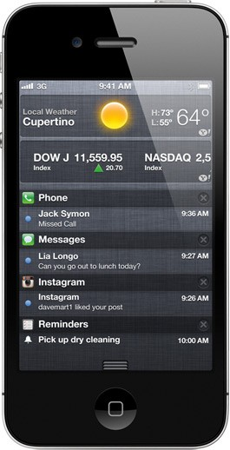
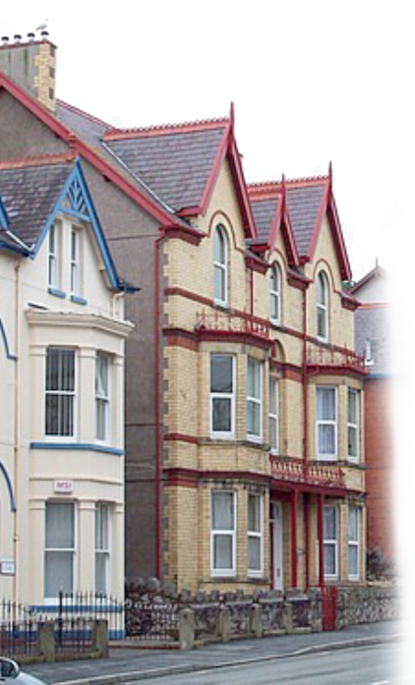

Estimating Height (3D)
Center Line
2592
pixels
-250 pixels
adjustment = -250 / 2592 × 54°
= -5.2°
pitch = 20°

