Slide 1
RxIP: Monitoring the Health of Home Wireless Networks
Justin Manweiler
Peter Franklin
Romit Roy Choudhury
Duke University
IBM T. J. Watson Research
jmanweiler@us.ibm.com
Duke University
Zynga
peter.franklin@gmail.com
Duke University
romit.rc@duke.edu
INFCOM 2012, TS08 Wireless Networks III
March 28, 2012

Slide 2
In the enterprise
Wi-Fi only begins with the 802.11 spec

Slide 3

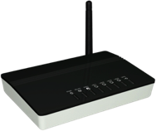

















Slide 4
Dedicated “controllers” add value…

Slide 5
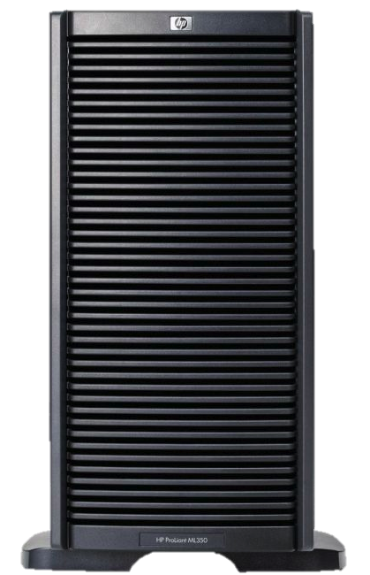




Slide 6
… in the literature …
Jigsaw
SIGCOMM 06
DenseAP
NSDI 08
Shuffle
MobiCom 09
Centaur
MobiCom 09
FLUID
MobiCom 2011
PIE
NSDI 2011

Slide 7






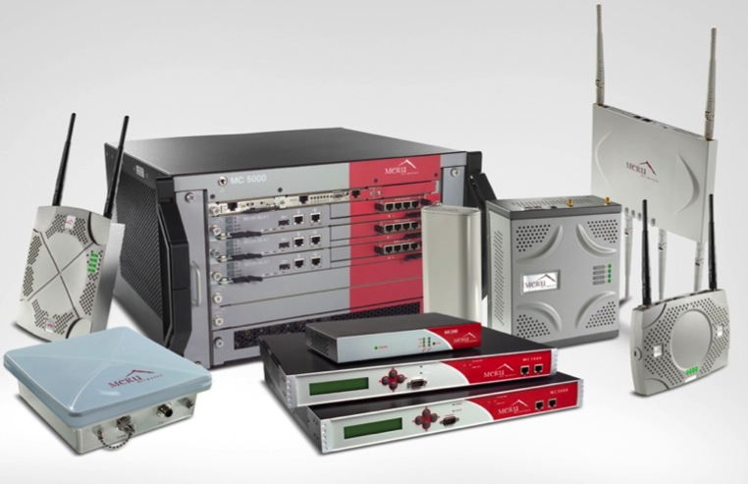
… and in practice

Slide 8
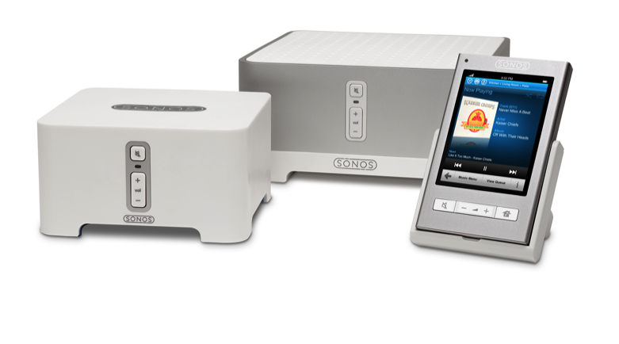
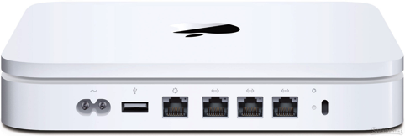



What about home networks?
Do controllers still make sense?

Slide 9
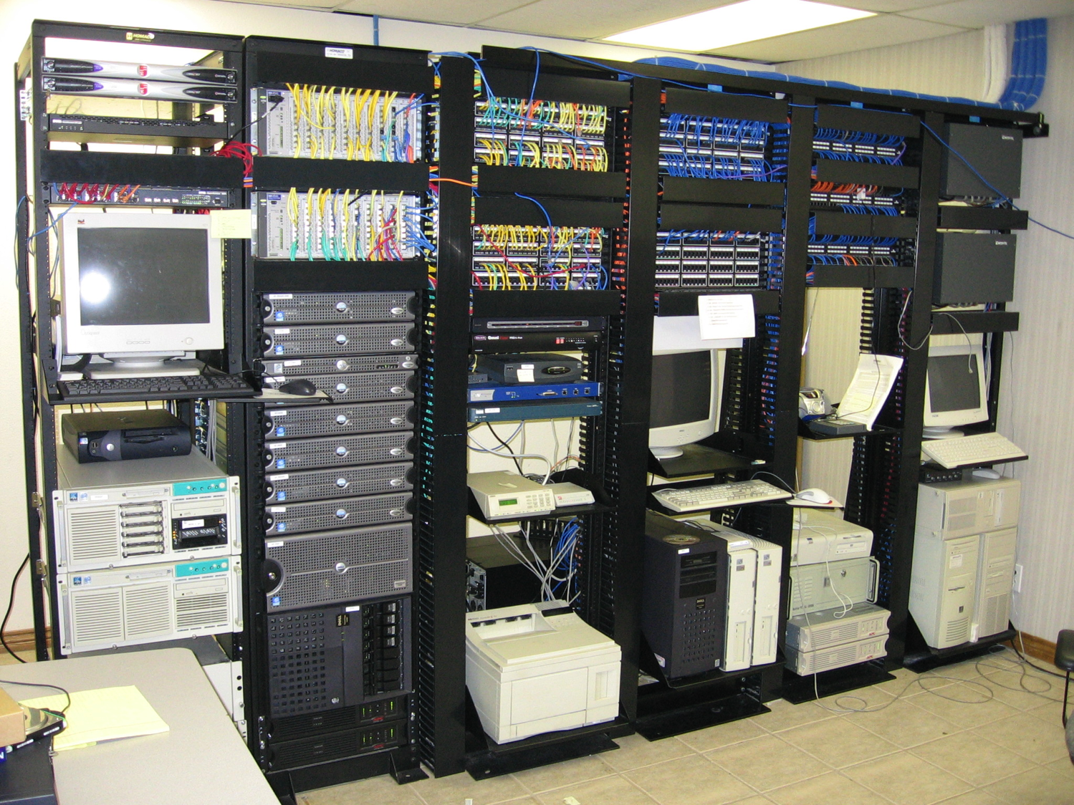
My home doesn’t look much like this…
Nontechnical users / No IT staff
Limited Net Infrastructure
Thoughtless Deployments

Slide 10




With thoughtless deployments: classic hidden terminals return

Slide 11

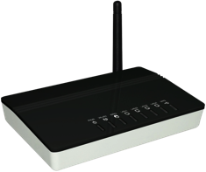

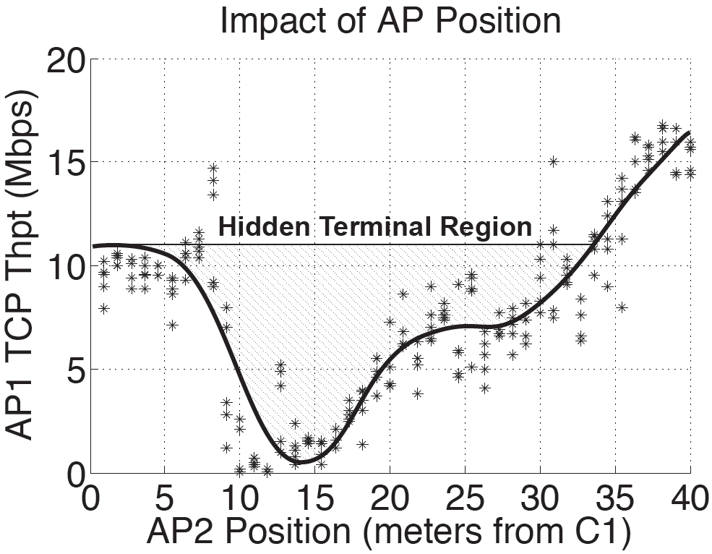
AP Placement Matters:
Bad choice? Persistent Impacts.

Slide 12
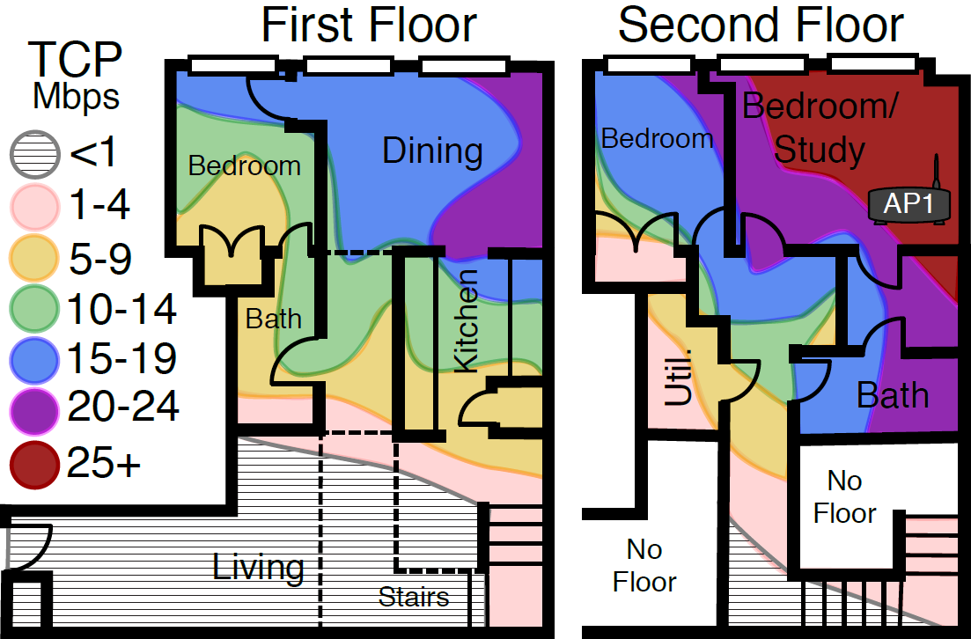

Functional network
+ hidden terminal
unusable

Slide 13
RxIP
Prescription: Internet Protocol

Slide 14



Slide 15
4 Steps to Recovery
1) Bootstrap: Establishing Internet Coordination
2) Detection: Verifying Hidden Terminals as the Cause
3) Fault Assessment: Identifying Hidden Terminal APs
4) Recovery: Isolating Traffic from Hidden Terminals

Slide 16
1) Bootstrap Phase
APs broadcast wired IP coordination address/port
  Embedded in 802.11 beacons
  Intermediate nodes forward extra hop (via wired)
  2-hop coordination w/ microsecond-accuracy time sync
IP Address
Time Sync
@ μsec accuracy
IP Address
Time Sync
IP Address
Time Sync

Slide 17


2) Detection
APs detect the presence of a hidden terminal
  High loss rates when link SNR (quality) is good
  Link asymmetry – divergent upload/download behavior
?
?

Slide 18
3) Fault Assessment
APs cooperate to isolate hidden terminals
  APs maintain detailed records of packet transmissions
  Pairs of APs attempt to correlate concurrency with loss
  Fast O(1) record / lookup through Bloom Filters
APs poll suspected hidden terminals
  Yes/No Questions … Did you transmit at time X?
  Per-peer saturating counter
Hidden Terminal
Threshold

Slide 19

4) Recovery
APs cooperate to isolate hidden terminal traffic
  Hybridized CSMA/TDMA schedule
  Completely managed by APs, clients unaware
Channel access “semaphore” between APs
  APs mutually agree to never transmit concurrently
  Initiate a pairwise token exchange to schedule timeslots
My turn…
My turn…

Slide 20

Synchronized Token Passing
Pass all tokens to transmit
My turn…
My turn…
My turn…
My turn…
My turn…

Slide 21
RxIP CSMA/TDMA Properties
No deadlock in arbitrary graphs
  Guaranteed by partnership establishment protocol
No unnecessary silencing
  AP is only silenced if its hidden terminal is transmitting
Proven optimal in bipartite graphs
  Likely scenario in sparse hidden terminal graphs
What happens if tokens lost/delayed?
  Tokens preschedule channel access time
  Active failure detection/recovery prevents disruptions

Slide 22
Evaluation Results

Slide 23
Methodology
Testbed implementation
  Click Modular Router + MadWIFI Atheros 802.11 Driver
  12 laptops serving as APs and clients
  Throughput testing using Iperf
Detection/recovery in varied scenarios
Microbenchmarks
  Confirm robustness to Internet latency
  Validate precision of time synchronization
Extreme HT conditions
  Reflects ability to cope with adverse network conditions

Slide 24
RxIP Ensures Stability:
Less Sensitive to AP Placement

Slide 25
RxIP Ensures Stability:
Less Sensitive to Mobility

Slide 26
2 AP / 2 Client – TCP Throughput

Slide 27
2 AP / 2 Client – TCP Fairness

Slide 28
Conclusion
RxIP APs can Mitigate Hidden Terminal Effects
  (1) Detect the presence of a hidden terminal
  (2) Isolate the cause to particular nearby AP
  (3) Interference-aware hybrid TDMA/CSA scheduling
Peer-to-peer Negotiation of the Wireless Channel
  Bring traditionally-centralized enterprise techniques home
Room for Exploration
  Many successful enterprise WLAN designs
  Research opportunities in porting to RxIP platform

Slide 29
Thank you
jmanweiler@us.ibm.com
SyNRG Research Group
synrg.ee.duke.edu

Slide 30
Prescheduled Channel Access

Slide 31
Hidden Terminal “Interactive Proof”
4 cases for probe response, alter sat. counter
  Failure, peer concurrent → large increase
  Success, peer concurrent → large decrease
  Failure, peer not transmitting → small decrease
  Success, peer not transmitting → small decrease
Prevents
Cheating

Slide 32
UDP 6 AP Extreme Hidden Terminals

Slide 33
Under a Hidden Terminal:
Mobility Complications

